Slide 1
2013 Acts
Relating to Municipal
Government
July 24, 2013

Slide 2
2013 Acts
Effective date of Acts without emergency clause or stated effective date --- August 16, 2013

Slide 3
2013 Acts
Act 88 – amends law concerning persons required to file a statement of financial interest. Adds a member of an A & P commission and a member of a research park authority board.

Slide 4
2013 Acts
Act 91 – to clarify the use of insurance premium taxes. Adds insurance for buildings and utility costs to the list of uses of Act 833 funds.

Slide 5
2013 Acts
Act 217 – amends Local Government Joint Investment Trust Act. Allows local governments to become parties to an already created trust by action taken by the depository board rather than the governing body.

Slide 6
2013 Acts
Act 288 – to restrict the amount of credited service earned by a local elected public official to one for one unless additional contributions are provided. Requires a 2.5% employee and employer contribution to get 2 for 1 credit. (1-1-14)

Slide 7
2013 Acts
Act 312 – to amend Arkansas law concerning the use of public funds to support or oppose ballot measures. It is unlawful for a public servant or a governmental body to expend or permit the expenditure of public funds to support or oppose a ballot measure.

Slide 8
2013 Acts
Act 318 – to allow school districts that have been consolidated to sell, preserve, lease, or donate real property that is no longer utilized by the school districts. May donate real property to a city or county for limited purposes.

Slide 9
2013 Acts
Act 405 – to amend the law concerning certain county and municipal public finance matters. Deletes the requirement for security for investment of public funds; defines the form of deposits that require security; and

Slide 10
2013 Acts
Act 405 (Continued)
Requires officials to enter into supplemental agreements with banks that are required to perfect security of public deposits not fully insured directly by the U.S.

Slide 11
2013 Acts
Act 458 – to authorize investment of public funds in additional investments insured by FDIC. Removes the restriction that the investment of public funds through an AR bank into one or more banks located within the U.S. be only CDs. Now law says deposit. (3-21-13)

Slide 12
2013 Acts
Act 523 – concerning the salary of a municipal official whose professional license or registration is suspended.

Slide 13
2013 Acts
Act 572 – concerning salaries for county and municipal employees. Allows salaries paid to any employee to exceed the maximum annual salary as authorized by the governing body as follows:

Slide 14
2013 Acts
Act 572 (Continued)
Overtime payments as authorized by law;
Payment of a lump sum to a terminating employee;
Payment of overlapping pay periods at the end of a fiscal year;

Slide 15
2013 Acts
Act 572 (Continued)
Payment for the biweekly 27 pay periods; and
Payments for incentive, certificate, holiday, or working out of classification.

Slide 16
2013 Acts
Act 712 – to permit cities with an advertising and promotion tax to share the cost of an audit; and to require that certain records be provided to a joint auditor.

Slide 17
2013 Acts
Act 726 – to amend the law concerning municipal police chiefs. Law now allows police officers of any size municipality to charge the same fees allowed to the county sheriff under ACA 21-6-307.

Slide 18
2013 Acts
Act 753 – concerning planning for an absentee mayor in all municipalities.

Slide 19
2013 Acts
Act 927 – to make appropriation for state turn back to municipalities.
Section 13 special language:
Cities receiving total highway revenues & severance turn back of $2 million or more have a new reporting requirement.

Slide 20
2013 Acts
Act 1020 – to assist not-for-profit organizations; and to allow not-for-profit organizations to purchase surplus public commodities.

Slide 21
Ethics, Unauthorized Disbursements, and Unaccounted for Funds

Slide 22
Year | Ethics | Unauthorized Disbursements | Unaccounted for Funds | Total
2012 | $ 145,196 | $ 352,695 | $ 11,342 | $ 509,233
2011 | 124,872 | 323,868 | 4,230 | 452,970
2010 | 210,774 | 551,351 | 91,267 | 853,392
2009 | 255,887 | 700,802 | 48,364 | 1,005,053
2008 | 368,530 | 476,536 | 45,899 | 890,965
2007 | 221,854 | 502,499 | 79,310 | 803,663

Slide 23
City of Parkin
Agreed-Upon Procedures Report
December 31, 2010
and
Additional Procedures for the Period
January 1, 2009 through October 19, 2011

Slide 24
Misappropriation of Court Funds
January 1, 2009 ~ October 19, 2011
$43,019 Not Deposited

Slide 25
How Was This Discovered?
Routine audit procedures
Cash/Check composition per deposit slips did not agree with receipts
Past experience with auditee
Cash count on 10-19-11 short $110

Slide 26
What Did We Do?
Interviewed Court Clerk
  Admitted to taking $50 of the cash shortage
  Indicated not receipting payments made by check of approximately $7,000
Obtained bank microfilm
Compared checks deposited to those receipted

Slide 27
What Did We Find?
Check for cash substitution scheme
Approximately 100 checks not receipted but deposited in place of cash payments receipted

Slide 28
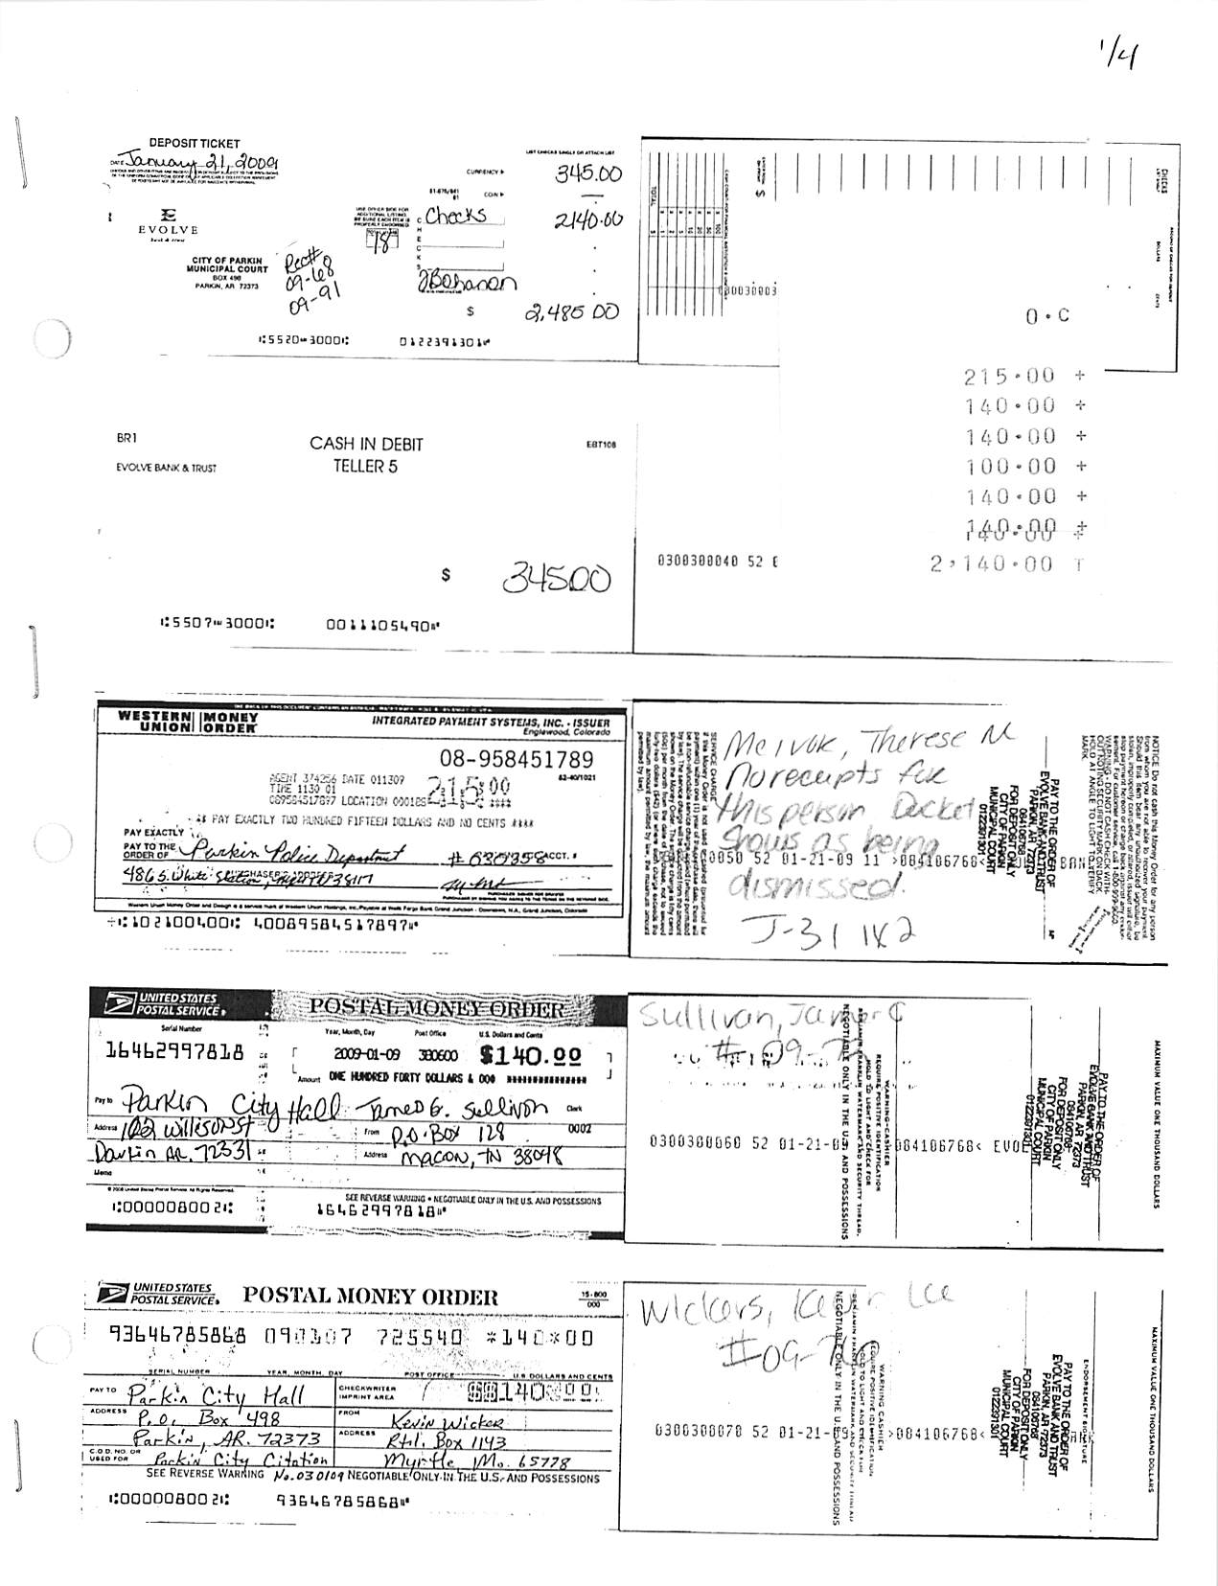
Example of Money Order Deposited Not Receipted

Slide 29
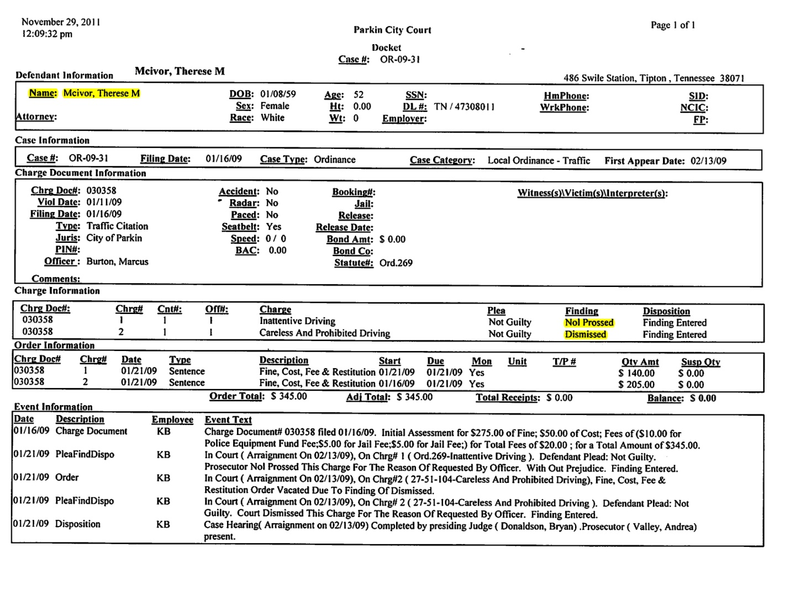
What Did We Find?
Altered Court Docket

Slide 30
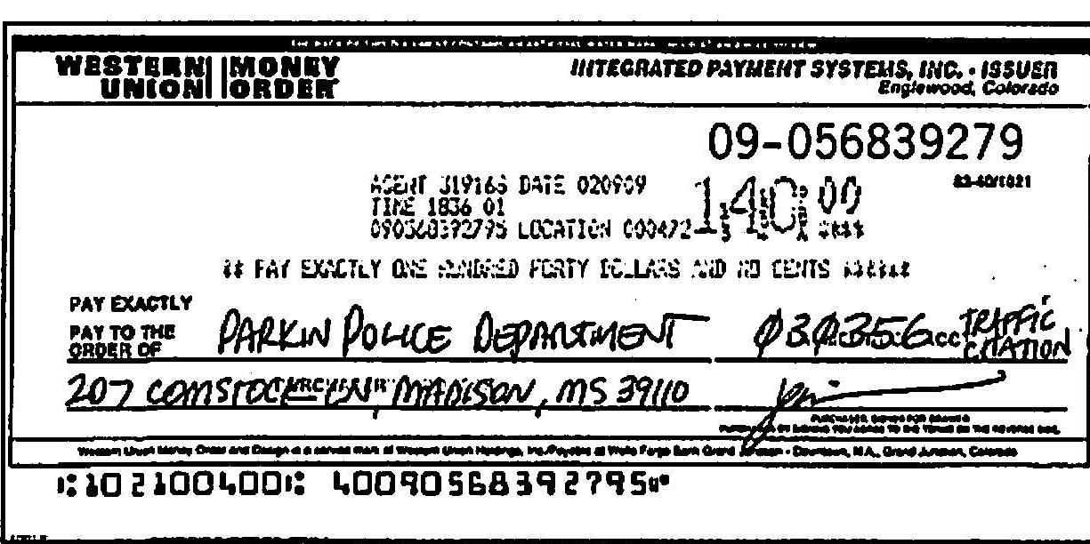
Example of Money Order Deposited Not Receipted

Slide 31
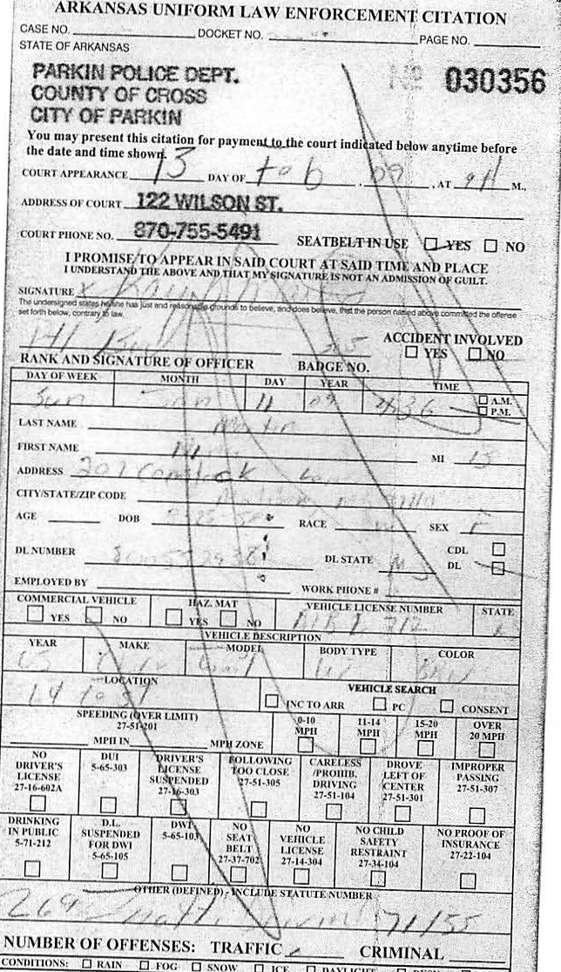
What Did We Find?
Altered Ticket
Ticket # 030356 Marked Void
Note Crease Indicating Ticket Copy was Mailed with Payment

Slide 32
Status
Bohanon admitted to taking > $30,000
Bohanon terminated 10-19-11
Bohanon arrested and charged with theft of property, a Class B felony
Trial date 7-8-13

Slide 33
City of Forrest City – 2010
The City paid unused sick leave in excess of the maximum carryover to nonuniformed employees in conflict with the City’s personnel manual, which indicates sick leave will be paid upon retirement.

Slide 34
City of Forrest City – 2010
Included in these payments, the Mayor and Clerk/Treasurer received $2,252 and $1,783, respectively, and other City employees received $34,235. (Total of $38,270)

Slide 35
City of West Memphis – 2011
The City paid $3,141 for country club dues for the Director of Economic Development in apparent conflict with Ark. Const. art. 12, sec 5, as interpreted in Op. Att’y Gen. nos. 93-416 and 94-021 which both indicate this type of expenditure does not meet the “public purpose doctrine.”

Slide 36
City of Crawfordsville – 2011
Fire Department Secretary opened and maintained a bank account outside of City Treasurer’s control. Undocumented payments to vendors and cash withdrawals totaled $8,490.

Slide 37
Town of Weldon – 2012 Pop. 75
R/T misappropriated funds totaling $47,893.
Unauthorized checks to herself $7,700;
Cashed town franchise tax checks $14,489; and
Cashed town checks issued to other funds $25,704

Slide 38
Arkansas County
Financial Audit Report
For the Year Ended
December 31, 2010

Slide 39
Internal Control
Over Financial Reporting
Improper transactions in County Clerk’s Office
Federal and state payroll tax withholdings overstated by $13,364 for County Clerk and spouse who is a County employee

Slide 40
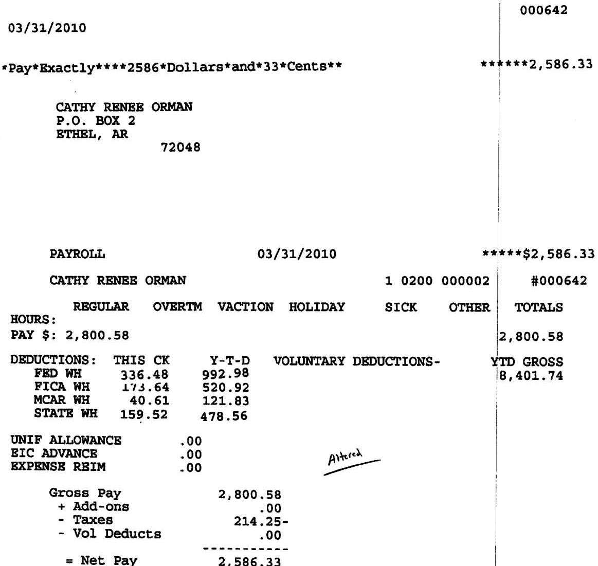
What Tipped Us Off
Payroll Test-Altered Paycheck Stub

Slide 41
County Clerk’s
Altered Paycheck Stub
Totals 710.25

Slide 42
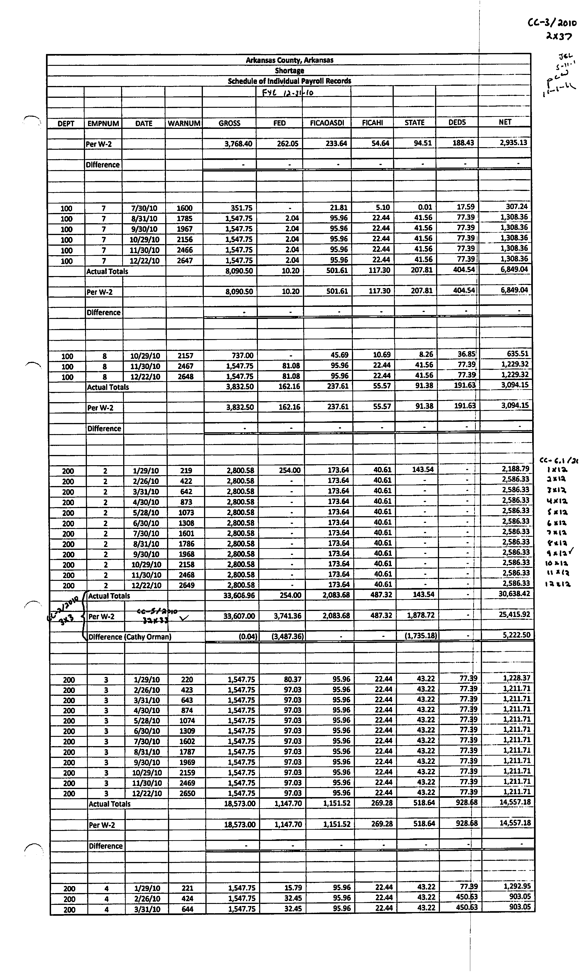
What We Did
Compared Payroll Journal to W-2s

Slide 43
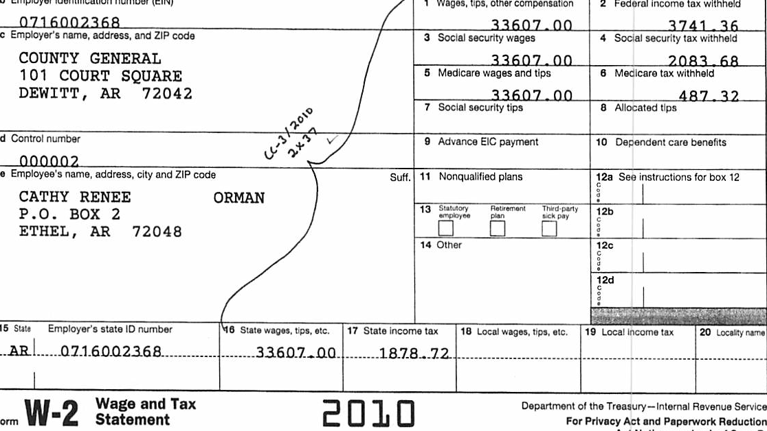
What We Found
Incorrect Form W-2s
$254.00
$143.54

Slide 44
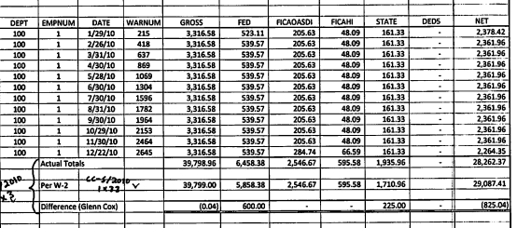
What We Did
Compared Payroll Journal to W-2s
For All Employees

Slide 45
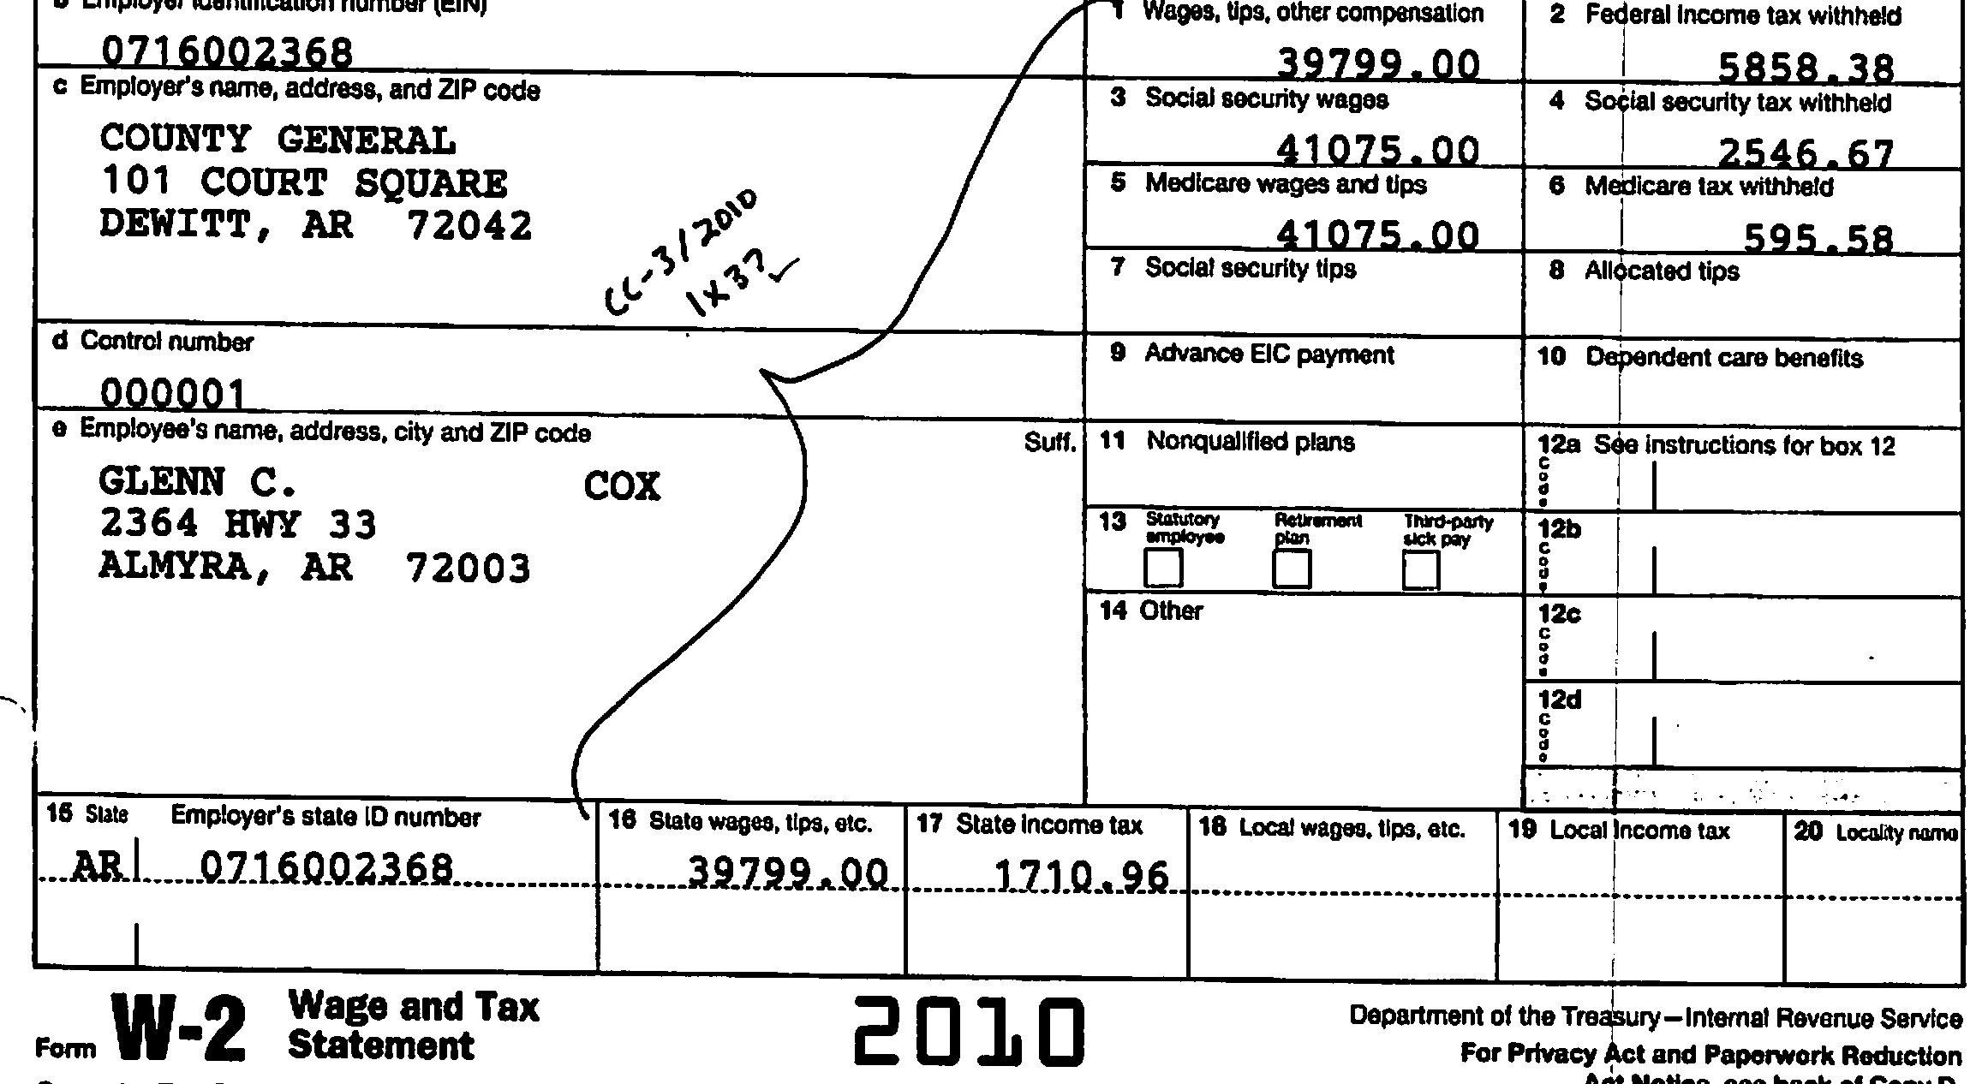
What We Found
Incorrect Form W-2s
$6,458.38
$1,935.96

Slide 46
Summary
Federal and State
Payroll Tax Withholdings
Overstated for County Clerk and spouse
Understated for 43 employees
$13,364

Slide 47
Internal Control
Over Financial Reporting
Improper transactions in County Clerk’s Office
Federal and state payroll tax withholdings overstated by $13,364
Unauthorized disbursements totaling $18,283

Slide 48
Improper Disbursements
$2,948

Slide 49
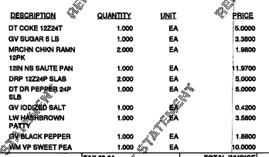
Wal-Mart Invoice Paid by County

Slide 50
Kroger Invoice Paid by County

Slide 51
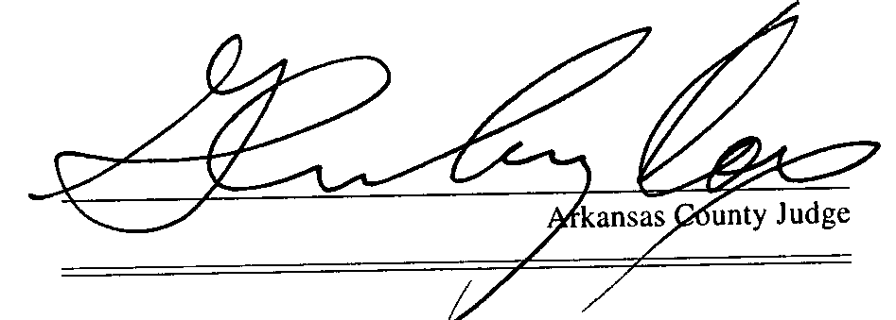

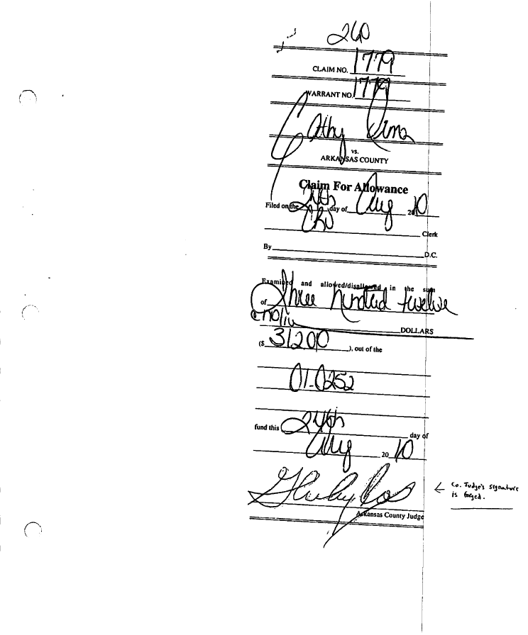
Claim Approval by County Judge
Yes
No

Slide 52
Status
Cathy Orman, County Clerk, resigned 6-30-2011
On February 22, 2012, Orman pled guilty to theft of property and forgery in the second degree.
Sentenced to 180 months probation, 200 hours community service, and pay $21,615 in fines and costs and audit expenses in monthly installments of $310 beginning March 23, 2012.
Full restitution was paid prior to plea.

Slide 53
Clay County
Corning Branch Library
Financial Audit Report
December 31, 2009

Slide 54
Unauthorized Disbursements
January 1, 2008 ~ December 31, 2010
Corning Branch Library Director
  Unauthorized disbursements $47,160
  Used 4 types of unauthorized disbursement schemes

Slide 55
Improper Transactions
  Savings account withdrawals $ 2,106
  Cash withheld from deposits 29,599
2008 $ 500
  2009 5,204
  2010 23,895

Slide 56
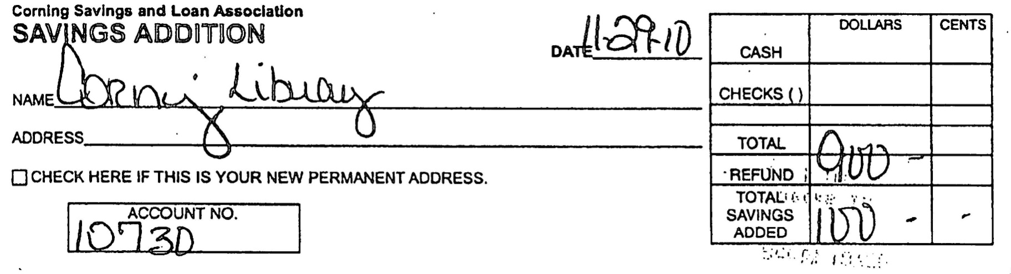
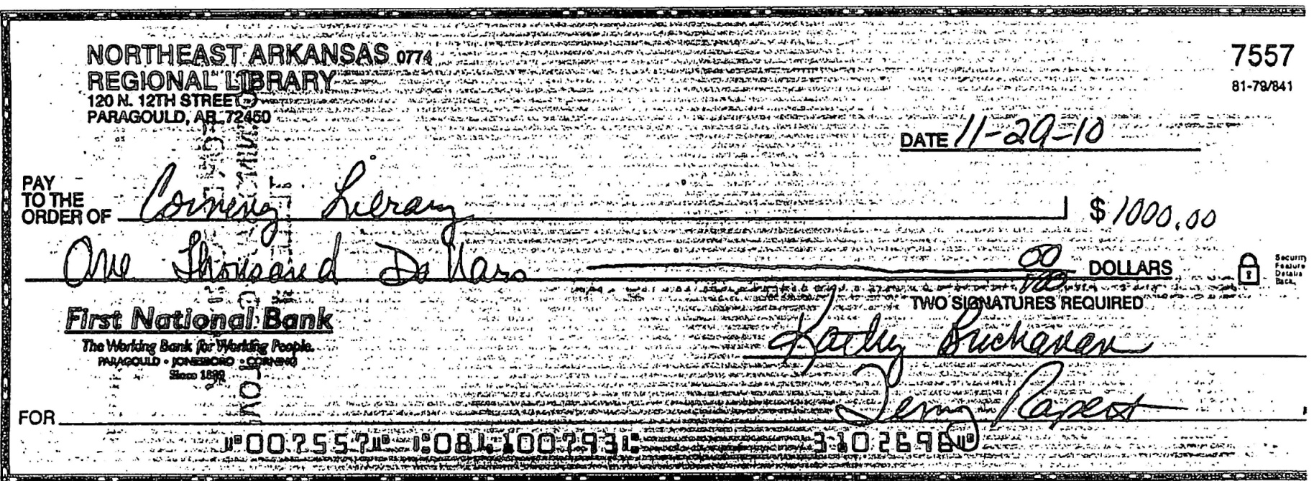
Bank Deposit

Slide 57
Improper Transactions
Issued checks to sister = $13,221
    2008 $ 360
    2009 5,364
    2010 7,497

Slide 58
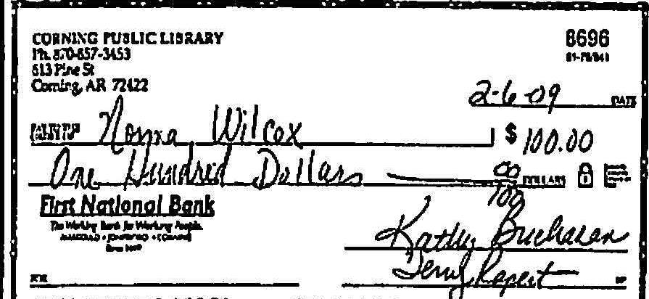
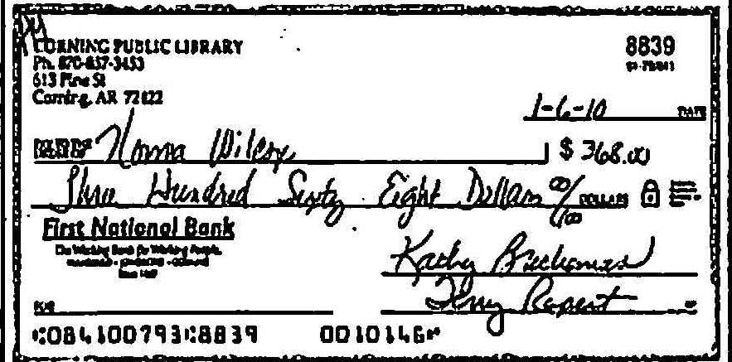
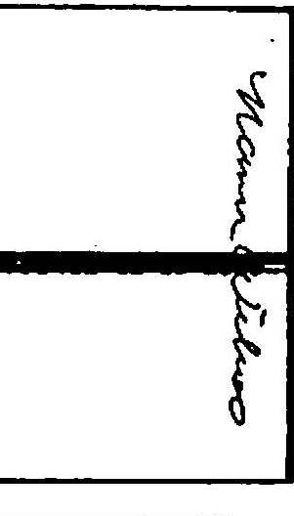
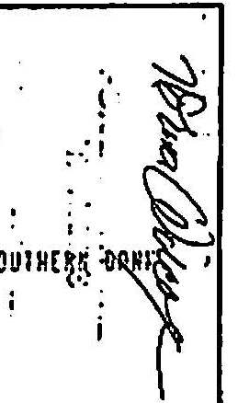
Endorsements
Legitimate
Forged

Slide 59
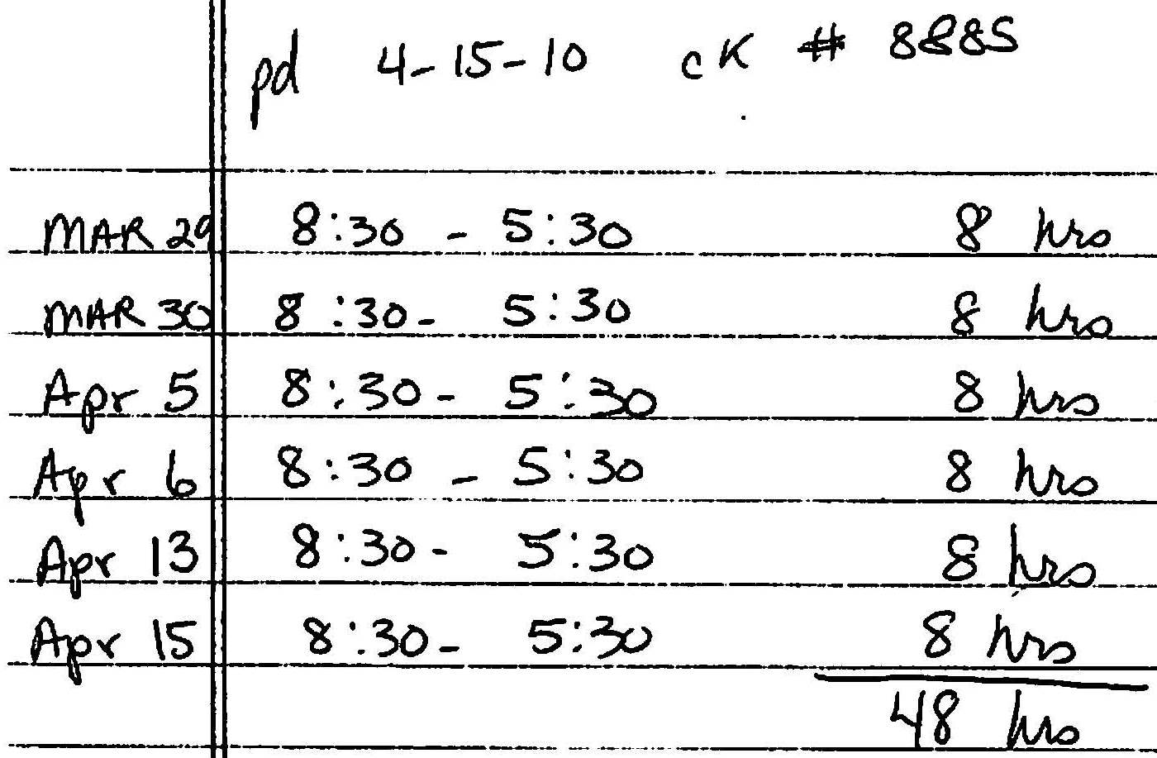
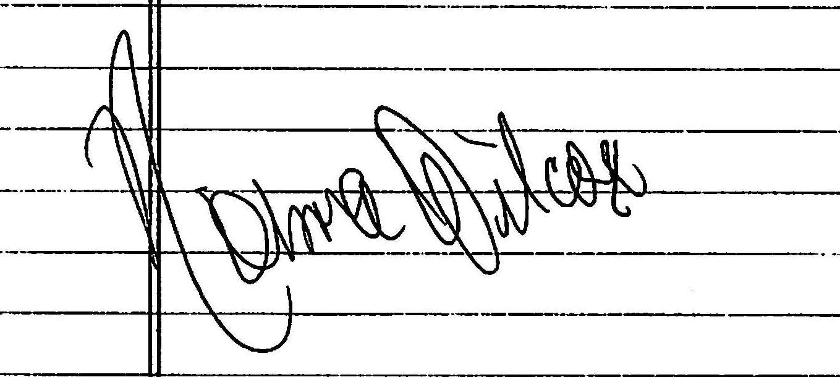
Documentation for Check

Slide 60
Fictitious Reimbursements
    Mileage Reimbursements = $2,234
        2009 $1,148
        2010 1,086

Slide 61
Improper Transactions
Savings account withdrawals $ 2,106
Cash withheld from deposits 29,599
Checks issued to sister 13,221
Fictitious reimbursements 2,234
Total Improper Transactions = $47,160

Slide 62
Status
Buchanan’s employment terminated 1/11/11
Charged with felony theft of property 1/14/11
Pled guilty 8/16/11
Sentenced to 30 days in county jail and 84 months probation
Court-ordered restitution - $51,640

Slide 63
Lafayette County
Financial Audit Report
For the Year Ended
December 31, 2011

Slide 64
Internal Control
Over Financial Reporting
Unaccounted for Funds in the
Treasurer/Collector’s Office
$162,275 not deposited in Collector’s bank accounts (1/1/11 through 9/20/12)

Slide 65
What We Found:
Cash Shortages
For 2011
Current tax account: $24,380
Delinquent tax account: $68,011
As of 9/20/12
Current tax account: $13,584
Delinquent tax account: $56,300
Total cash shortages: $162,275

Slide 66
What We Found:
Checks Substituted for Cash
Bank Deposits (1/1/12 through 9/20/12)
$65,370 in tax payments for utility companies not receipted in current account
Checks substituted for cash and deposited in delinquent tax account to cover missing cash
Deposit slips altered to remove cash

Slide 67
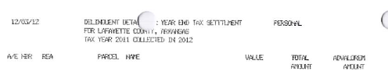
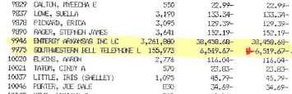
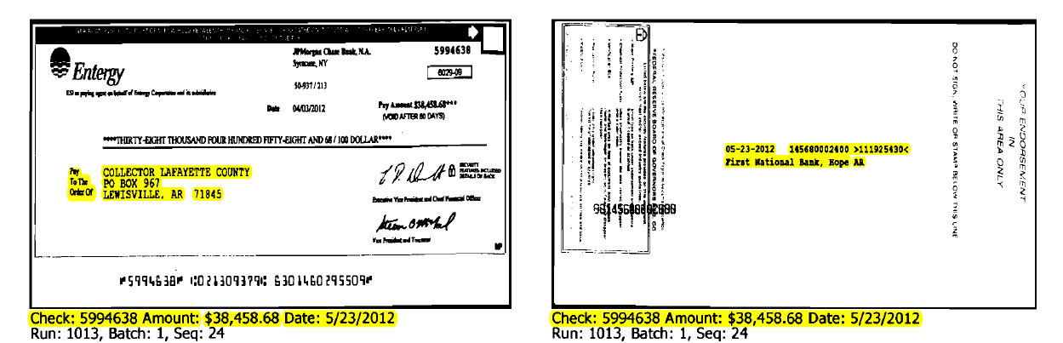
What We Found: Delinquent Tax List

Slide 68
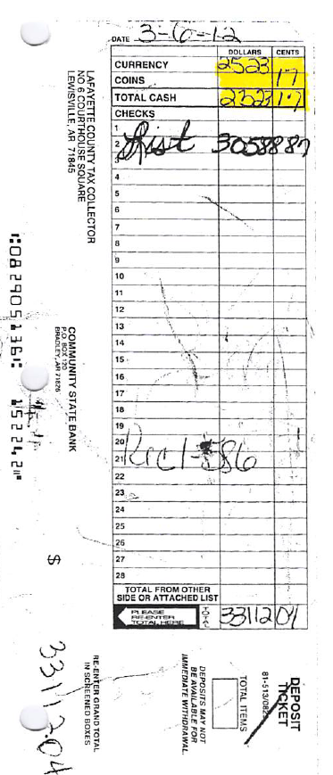
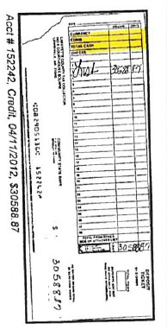
What We Found: Altered Deposit Slips
Original
Cash
Bank Image
Checks
Cash Removed
Checks
Total
Total Altered

Slide 69
Why the Shortage Was Not Detected
Treasurer/Collector was one individual
Delinquent tax settlements to taxing units were made using other funds in the Treasurer’s control

Slide 70
Summary:
Treasurer/Collector
Substituted checks for cash
Deposited checks in delinquent account to hide that cash was not deposited
Altered deposits and deposit slips to remove cash
Did not receipt tax payments for utility companies in current account
Removed utility companies from delinquent tax list before publication

Slide 71
Internal Control
Over Financial Reporting
Unaccounted for Funds in the Treasurer/Tax Collector’s Office
$162,275 not deposited in Tax Collector’s bank accounts (1/1/11 through 9/20/12)
Unaccounted for Funds in the Sheriff’s Office
$905 not deposited in Sheriff’s Office accounts (1/1/11 through 7/3/12)

Slide 72
Unauthorized Disbursements
$255 improperly disbursed to elected officials and a vendor (1/1/11 through 7/3/12)
$135 to Assessor for nonbusiness travel expenses
$54 to Sheriff for fabricated invoice
$66 in nonbusiness travel expenses and meal charges exceeding maximum to Treasurer/Collector

Slide 73
Other Travel Issues
Sheriff’s Office Bookkeeper reimbursed for fuel purchases instead of mileage
Employee reimbursed $124 for multiple trips to the bank in the same day
Travel expenses submitted without business purpose documentation attached

Slide 74
Other Improper Disbursements
$1,902 paid to businesses and individuals without adequate documentation
$5,234 paid by Sheriff’s Office for personnel clothing not included on employees’ IRS Form W-2
Treasurer/Collector involved in purchasing process for Sheriff’s Office
$562 in overpayments to vendors

Slide 75
Status
Referred to PA - 8th South JD
  Recused
Special Appointed Prosecutor – PA 13th JD
  Referred to FBI

Slide 76


Questions

