Slide 1
The GFOA’s new program for
Small Governments that prepare
Modified Cash Basis
Financial Reports
Krisztina Dommer
Senior Manager, GFOA
Chicago, Illinois
www.gfoa.org/conformance
Notes:
The GFOA is pleased to announce a new award program called the Certificate of Conformance Program for Small Government Financial Reports. This new program was established to assist small governments that, for practical considerations, do not report using generally accepted accounting principles. Small government annual financial reports prepared on the modified cash basis of accounting is the focus of the new program. GFOA Executive Director/CEO Jeffrey L. Esser said, “The Certificate of Conformance Program will help governments improve the quality of financial reports by creating nationally recognized guidelines. Participants will benefit from the increased training and professionalism that go hand in hand with producing high quality financial reports.”
For more information on the program, please visit www.gfoa.org/conformance.

Slide 2

Overview

Slide 3
Background and Environment

Slide 4
GASB Research
2008 Research Report by the Government Accounting Standards Board (GASB)
  In summary, thousands upon thousands of small governments use a basis of accounting other than GAAP in their audited and published annual financial reports.
Notes:
98% of all state and local revenue from the 90,000 units of state and local governments is accounted for by the largest 30,000 units
33% of those 30,000 governments do not follow GAAP
No estimate for the other 58,305 smaller governments, but likely a large number prepare their annual financial reports using a financial reporting framework other than GAAP (special purpose framework).

Slide 5
GAAP: Why not?
GAAP is comprehensive, informative, and results in easily understandable and comparable financial statements.
  So, why would a government choose to use a different basis of accounting other than generally accepted accounting principles?
Notes:
GAAP is the platinum or diamond standard, if you will. However, it is just not realistic for everyone to achieve. Smaller governments have particular trouble implementing GAAP. The goal is to move toward using GAAP if you are not currently in a position to use it for financial reporting.

Slide 6
GAAP: Why not? cont.
Perceived complexity
Certificate of Conformance Program encourages a presentation closer to GAAP but on a less complex basis of accounting (i.e., modified cash basis).
Notes:
Small governments may view GAAP as too complicated for their neck of the woods.
Cash basis perceived as easier to understand and use by small entities and the users of their financial data.
Cash basis reporting may be required by regulatory agencies
Cash basis information understood to be more closely tied to budget and management decisions

Slide 7
GAAP: Why not? cont.
Cost of “once a year” financial report preparation
  Smaller/less qualified accounting staff
  Complexity of GAAP requirements
The Certificate of Conformance Program’s additional requirements are simple and easy to implement with guidelines provided in a preparer checklist and the availability of a sample Small Government Annual Financial Report (SGAFR).
Notes:
Smaller or less qualified accounting staff :Independence standards require documentation of Skills, Knowledge, and Experience (SKE) of staff by the independent auditor
Complexity regarding recognition, measurement and disclosure requirements: Often requires small governments to obtain assistance converting their current financial records to GAAP, which can be costly.

Slide 8
GAAP: Why not? cont.
Timely financial reporting
The Certificate of Conformance Program encourages timeliness of reporting with deadlines that will normally fall six months after the fiscal year end of the government. In the first year of the award program, allowances will be made for more time.
Notes:
Timeliness
Year-end closing and financial statement preparation
No need to “true up” or convert the financial statements to GAAP
Timely audit

Slide 9
Cash (modified cash basis) limitations
A different measure of financial position.
  Full cost of services not presented.
  Not all assets and liabilities are reported.
May not satisfy certain users.
  Rating agencies, creditors, investors, taxpayers, and officials .
Financial decisions can be problematic.
  Determination of cost of services, rate-setting, and balancing the budget.
Financial position and results of operations can be more easily manipulated.
Notes:
More easily manipulated: If there are no developed standards for other basis of accounting beyond GAAP, then it would be easier to change reporting rules for whatever suits you!

Slide 10
When can the cash (modified cash basis) be appropriate?
GAAP financial reporting is not contractually or legally required.
Internal and external users understand the cash (modified cash) presentation and its limitations but still find it relevant for their needs.

Slide 11
When can the cash (modified cash basis) be appropriate? cont.
Entity does not have the skills, knowledge, or experience (SKE) to prepare GAAP financial statements.
It is cost-effective.
The entity is required or permitted by law or regulation to prepare financial statements using a special purpose framework for financial reporting.

Slide 12
Current standards and guidance
Authoritative and Non-authoritative Resources for Cash Basis Financial Statements

Slide 13
Cash (modified cash) basis standards and guidance
No real authoritative standards in U.S. for cash or modified cash basis “accounting principles.”
Some limited authoritative AICPA audit standards related to cash or modified cash basis statements – specifically AU-C Section 800 – Special Purpose Frameworks.
Non-authoritative guidance is available in the form of the AICPA Practice Aid – Applying OCBOA in State and Local Government Financial Statements (www.cpa2biz.com, product code APAOCBO12P).
Notes:
Practice guide authored by Mike Crawford, an auditor from Oklahoma City, OK. Mike has seen hundreds of clients implement an other comprehensive basis of accounting in their financial reports during his career. The practice aid is non-authoritative guidance available to help those who are not reporting using GAAP. The Certificate of Conformance guidelines are based on this AICPA work and goes beyond it as well.

Slide 14
Special purpose frameworks
Financial reporting frameworks other than GAAP are identified in AICPA AU-Section 800 as one of the following bases:
  Cash basis
  Tax basis
  Regulatory basis
  Other basis
  Contractual basis
Commonly referred to as Other Comprehensive Bases of Accounting (OCBOA)

Slide 15
Special purpose frameworks defined
Cash basis
  A basis of accounting that the entity uses to record cash receipts and disbursements and modifications of the cash basis having substantial support
Tax basis
  A basis of accounting that the entity uses to file its tax return for the period covered by the financial statements
Regulatory basis
  A basis of accounting the entity uses to comply with the requirements or financial reporting provisions of a regulatory agency to whose jurisdiction the entity is subject
Contractual basis
  A basis of accounting that the entity uses to comply with an agreement between the entity and one or more third parties other than the auditor
Other basis
  A basis of accounting that uses a definite set of logical, reasonable criteria that is applied to all material items appearing in the financial statements
Notes:
As we will discuss shortly, the Certificate of Conformance Program guidelines focus on using a modified cash basis. We will define and clarify what that means very soon!

Slide 16
GFOA Certificate of Conformance Program
New Professional Recognition Program for Small Government Annual Financial Reports

Slide 17
What is the Certificate of Conformance Program?
Professional recognition program designed to help small governments that, for practical considerations, do not prepare financial statements in conformity with generally accepted accounting principles (GAAP) improve the quality of their annual financial reports.
Notes:
Everyone wants to buy the diamonds, so GAAP remains the end-goal here, but we still want everyone to strive to achieve the best at the level they are at!

Slide 18
Program objectives
Uniform guidelines
Quality and consistency
Stairway to GAAP
Ownership and pride
Notes:
1. Provide a uniform set of nationally recognized guidelines for governments electing to report on a basis of accounting other than GAAP
2. Improve the quality and consistency of small government annual financial reports across the country, to enhance comparability
3. Provide a stepping stone to GAAP financial reporting for those governments interested in moving in that direction
4. Encourage small governments to take ownership and pride in their own financial reports. Small governments make the US go round! You shouldn’t be ignored! All efforts that are undertaken to enhance financial reporting, accountability, and transparency in the government arena should be applauded and celebrated. It is the hope of the program that we will set the stage for that. The outcome of good financial reporting is better fiscal management, so financial reporting should not be viewed as a “once a year” nag, but an effort necessary to manage governments of all sizes!

Slide 19
How can the program help?
Improve the quality and consistency of small government annual financial reports by:
  Providing guidelines to help standardize the format and content of annual financial reports prepared on a modified cash basis,
  Encouraging governments to follow those guidelines by offering public recognition to those that successfully do so, and
  Assisting governments to implement the guidelines by providing technical materials and training.

Slide 20
How does it differ from the Certificate of Achievement Program?
The Certificate of Conformance Program
  Encourages compliance with the basic norms of sound financial reporting in situations where GAAP financial reporting is not practical.
The Certificate of Achievement Program
  Recognizes outstanding achievement in financial reporting, which presupposes financial reporting in conformity with GAAP.
    For some governments, participation in the Certificate of Conformance Program may be a first step toward GAAP financial reporting and participation in the Certificate of Achievement Program.
Notes:
A stairway to GAAP, if at all possible.

Slide 21
Which governments can participate?
Any type of government
Primary government revenues ≤ $25 million either for:
  Current year, or
  Average of the five most recent years
Where GAAP financial report is
  Not required and
  Not prepared at any time in the most recent five years

Slide 22
SGAFR vs. CAFR
Program report referred to as a small government annual financial report (SGAFR) rather than a comprehensive annual financial report (CAFR).
  Includes both an introductory section and a financial section.
  Not required to include a statistical section.
    Five-year trend tables are prescribed to provide similar information.

Slide 23
Submissions and judging
Accepting applications for the fiscal year that ended June 30, 2012, and after.
  June 30, 2012, report submissions should be received by no later than May 31, 2013.
  The normal deadline will be six months following the fiscal year end of the government submitting a report.
    Allowances will be made during the first year of the award program giving submitters an additional five months.
  A complete list of deadlines can be found on the GFOA’s web page for the program.
Reports to be judged by combination of
  Volunteer reviewers
  GFOA professional staff

Slide 24
Checklists and sample SGAFR
Available on GFOA website (www.gfoa.org/conformance)
  Checklists
    General purpose local governments
    School districts
    Stand-alone business-type activities
  Sample Small Government Annual Financial Report
    Example of an award-winning report for preparers to model.

Slide 25
Investment
Basic fee structure
Nonmembers that submit for the first time receive a GFOA membership that allows them to submit at the member rate.
Total Revenues | GFOA Member Fee | Nonmember Fee
Under $1 million | $290 | $580
$1-10 million | $370 | $740
Over $10 million | $435 | $870
Notes:
Membership will grant you access to a discounted rate on all GFOA publications and training as well as a subscription to out newsletter, the GAAFR update (which will keep you updated on GAAP), and the Government Finance Review magazine. It also grants you access to the staff of the Technical Services Center, who can help you with any accounting or financial reporting question you can throw at them! Finally, you get to submit your initial submission at the member rate without paying any membership dues in your first year. It’s a great deal if you want to get involved with GFOA!

Slide 26
Advantages
Grade assigned to each section of the report.
Specific comments and suggestions for improvement.
  Access to GFOA professional staff for guidance
If the report meets the program’s criteria,
  Plaque and press release,
  A complete list of all award-winning reports maintained on the GFOA’s website, and for
  First-time winners of the award, an announcement in the GFOA Newsletter.
Results within six months of receiving a submission, which provides adequate time to implement comments and suggestions.

Slide 27
Application of the modified cash basis of accounting
What is modified cash and how do we apply it?

Slide 28
Reporting options
Plain vanilla cash basis
  Limited to the reporting of cash and cash equivalents and changes therein.
Modified cash basis
  Modifications to cash receipt and disbursement transactions or events only.
  Modifications should have substantial support in GAAP or other accounting literature and be logical.
    Such as recording interfund receivables and payables resulting from cash transactions or events.

Slide 29
Modifications to the cash basis
Modifications that result in cash inflows and outflows providing a future benefit or obligation being spread out over multiple accounting periods.
  Reporting an interfund cash advance to be repaid in future periods as an asset by the lending fund (a future cash benefit) and a liability by the receiving fund (a future cash obligation).
NOT recording certain elements on a cash basis and other elements on a full GAAP basis.
  Modifications to record investments arising from cash transactions does not mean those investments should be adjusted for changes in fair value pursuant to GAAP.
  Accruals or non-cash transactions are NOT recorded.

Slide 30
Modified cash basis framework for the Certificate of Conformance Program
Only cash (and cash equivalents) and items that involve the receipt or disbursement of cash (or cash equivalents) during the period should be recognized, except:
  Interfund balances,
  Assets that normally convert to cash or cash equivalents, and
  Liabilities for cash (or cash equivalents) held on behalf of others, held in escrow, or received in advance of being earned or meeting eligibility requirements
Notes:
Assets that normally convert to cash = INVESTMENTS!
Deposits held for customers – cash and cash equivalents

Slide 31
Local regulatory basis report
Regulatory Basis
  The financial statements are prepared on the regulatory basis of accounting as prescribed by Arkansas Code. The regulatory basis differs from accounting principles generally accepted in the United States of America. Revenues are recognized as soon as they are both measureable and available. Revenues are considered to be available when they are collectible within the current period or soon enough thereafter to pay liabilities of the current period. For this purpose, the government considers revenues to be available if they are collected within 60 days of the end of the current period. Expenditures generally are recorded when a liability is incurred. However, debt service expenditures, as well as expenditures related to compensated absences and claims and judgments, are recorded only when payment is due. As a result of this regulatory basis of accounting, capital assets and long-term debt are not recorded in these financial statements.

Slide 32
Format and content
What is the report going to look like?

Slide 33
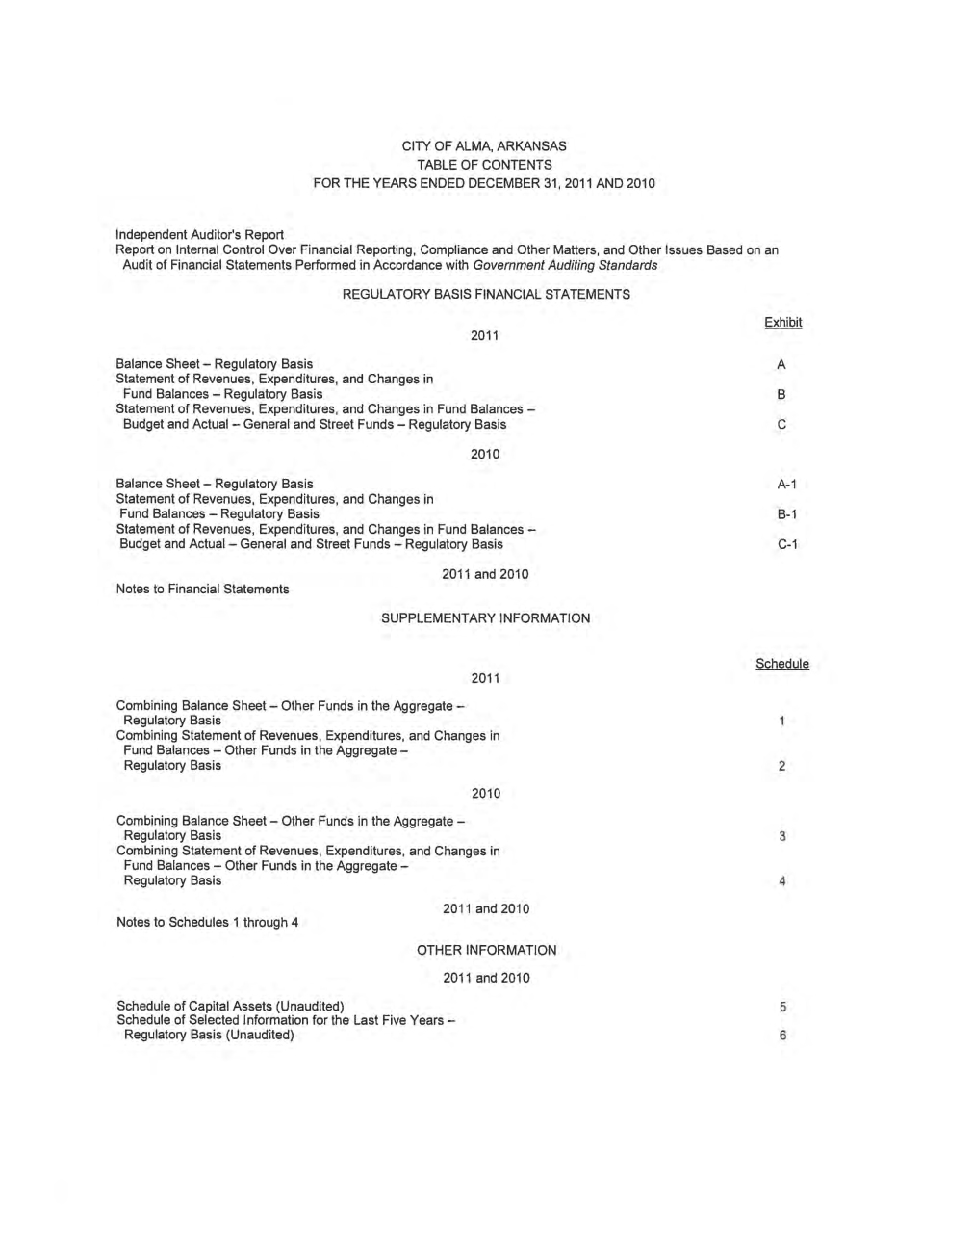
Local regulatory basis report
Trend Data
Notes:
A Small Government Annual Financial Report (SGAFR) will have two sections rather than three.
INTRODUCTORY SECTION & FINANCIAL SECTION (trend tables will be presented in the financial section).

Slide 34
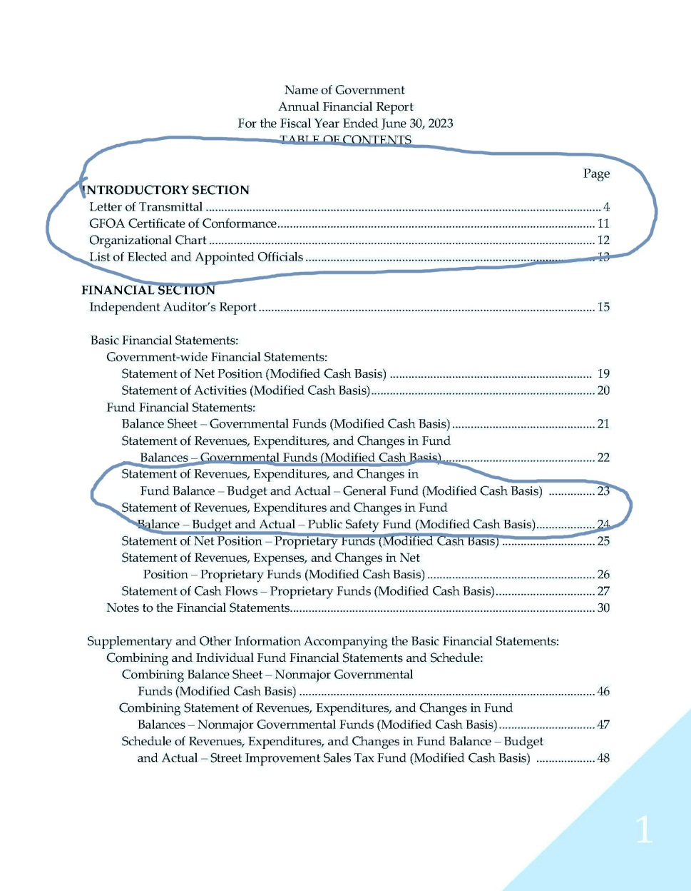
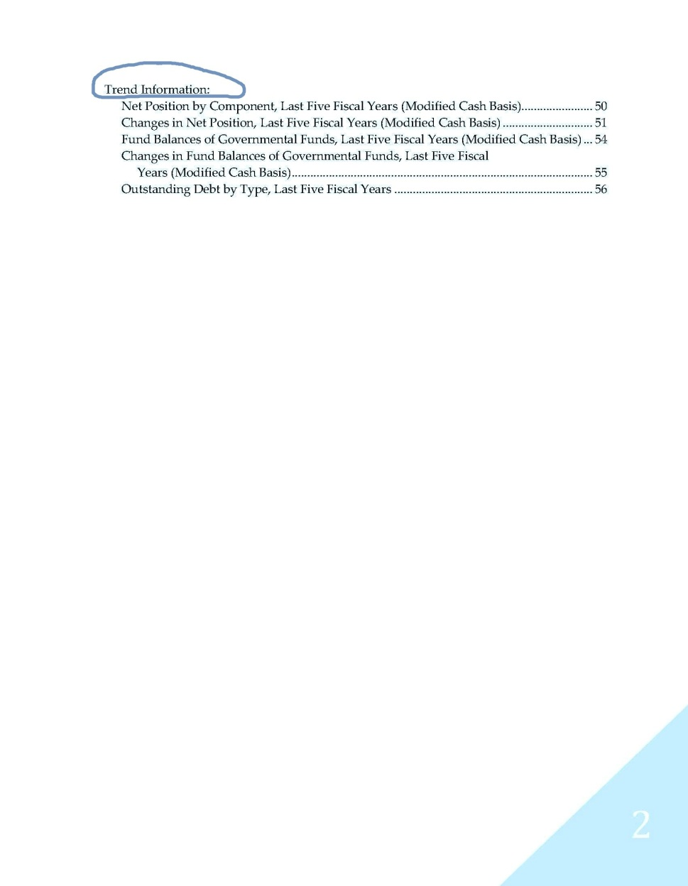
Sample SGAFR
Notes:
Two sections: Introductory section and Financial Section (financial section contains information that would be in a CAFR’s statistical section).

Slide 35
Presentation
AU-C Section 800, Exhibit B
  If GAAP set forth requirements that apply to the presentation of financial statements, then cash and modified cash basis financial statements may either comply with those requirements or provide information that communicates the substance of those requirements.
  GASB presentation requirements generally apply, in substance, to cash and modified cash basis basic financial statements of state and local governments issuing a complete set of financial statements (i.e., government-wide and fund financial statements).

Slide 36
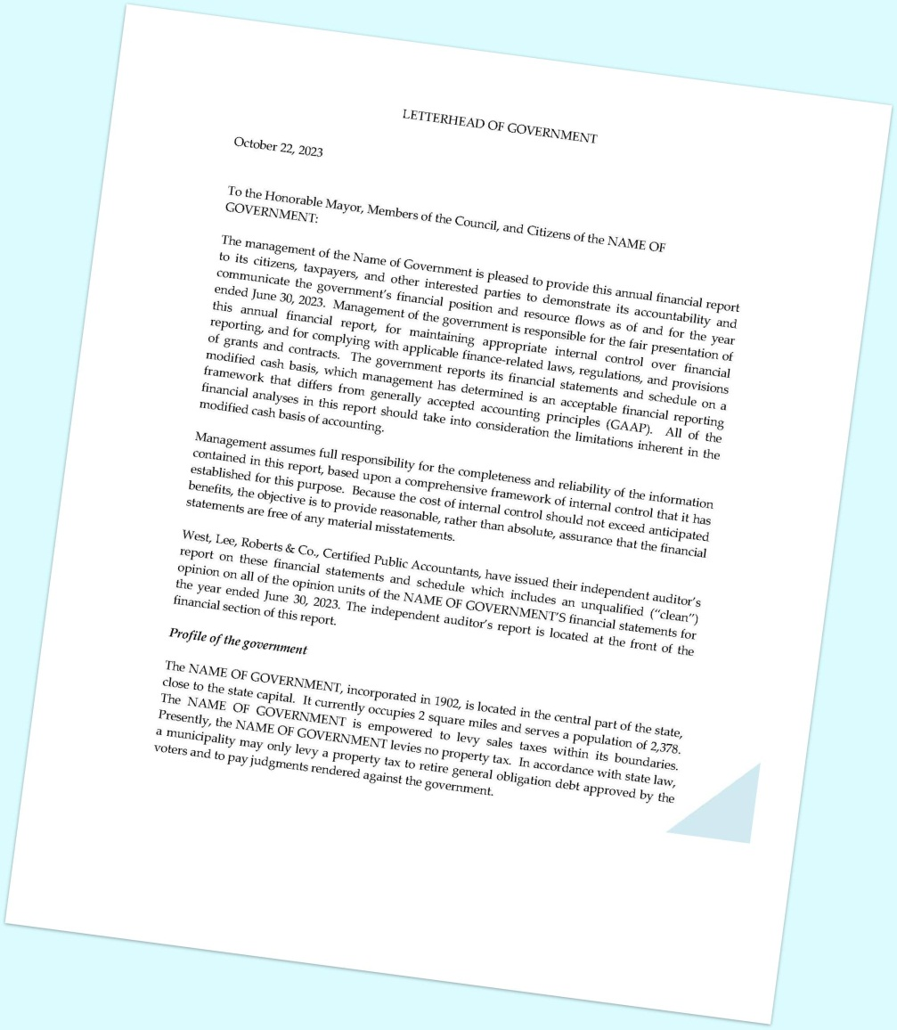
Introductory section:
Letter of transmittal
The program requirements for the letter of transmittal combine the suggestions for the letter of transmittal found in a CAFR and some of the requirements for management’s discussion and analysis (MD&A) from GAAP guidance.
  Basic letter of transmittal discussion (GAAFR text)
    Formal transmittal of report
    Profile of government
    Local economy
    Acknowledgements
  MD&A-type discussion topics
    Condensed financial data
    Narrative analysis of government-wide results
    Narrative analysis of major fund results
    Narrative analysis of general fund budget results, if applicable.

Slide 37
Local regulatory basis report
Currently no narrative introduction or analysis whatsoever
    Add narrative “letter of transmittal” with elements from GAAP MD&A and GFOA recommended topics for the letter of transmittal.

Slide 38
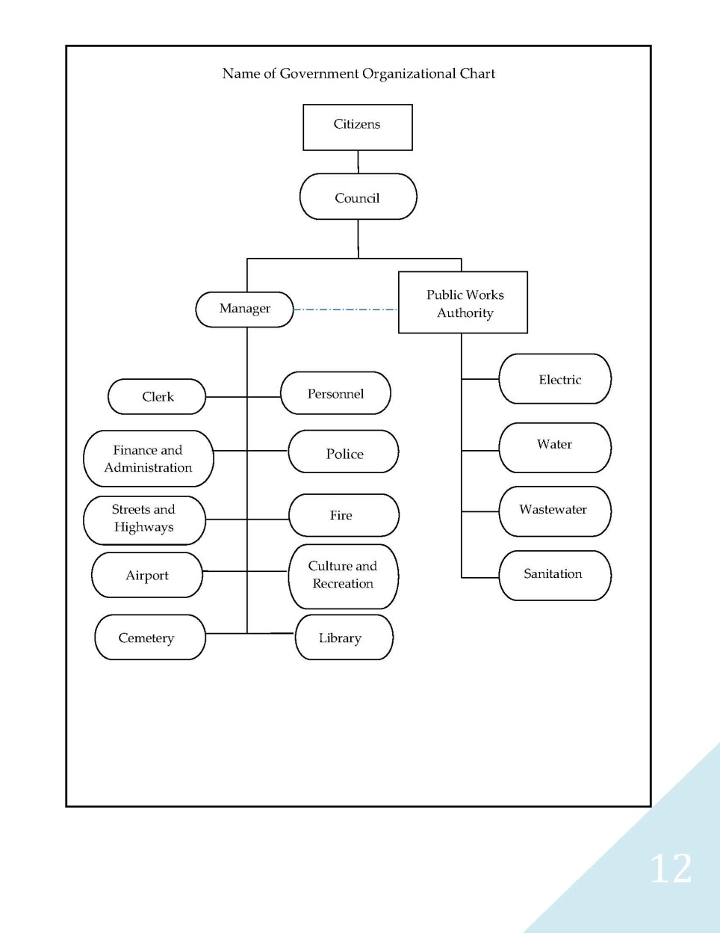
Introductory section:
Organizational chart
Create an organizational chart that demonstrates the structure of your entity
  Formatting is up to your discretion

Slide 39
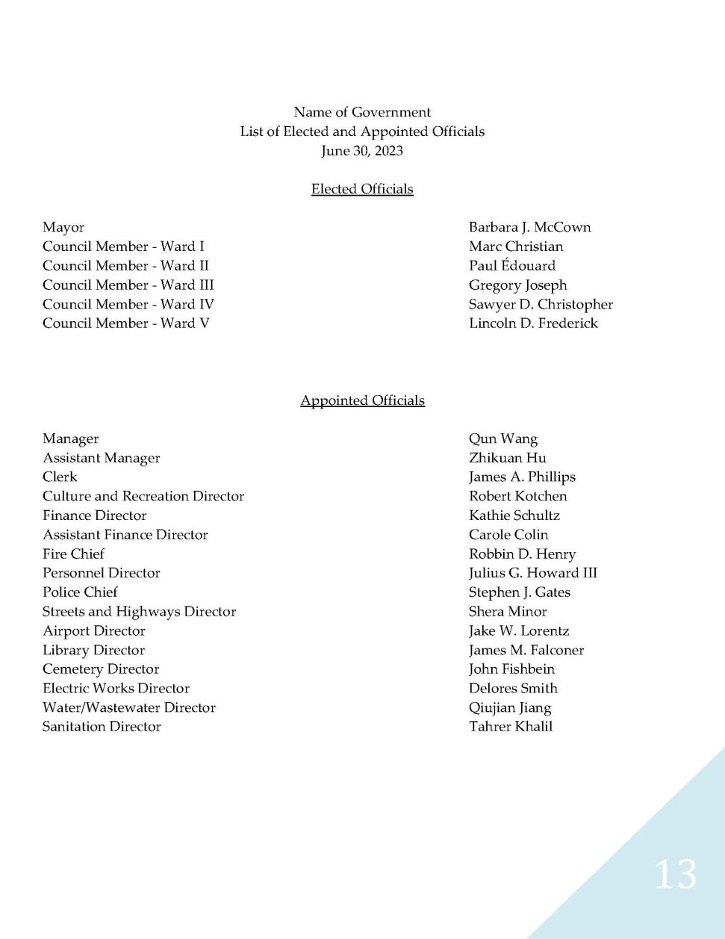
Introductory section:
List of principal officials
Compile a list of officials in place either at the time the report was issued or during the fiscal year of the report (if different).
  Formatting is up to your discretion.

Slide 40
Basic financial statements
Requirements of GAAP for basic financial statement presentation, but applied in a manner consistent with a modified cash basis and program requirements.
  Basic financial statements consistent with GAAP but reported on a modified cash basis.
  Possible combination of government-wide and fund financial statements.
    Same modified cash basis for presenting data in both
  Budgetary comparisons for the general fund and major special revenue funds with legally adopted annual (or biennial) budgets must be presented as a basic financial statement.

Slide 41
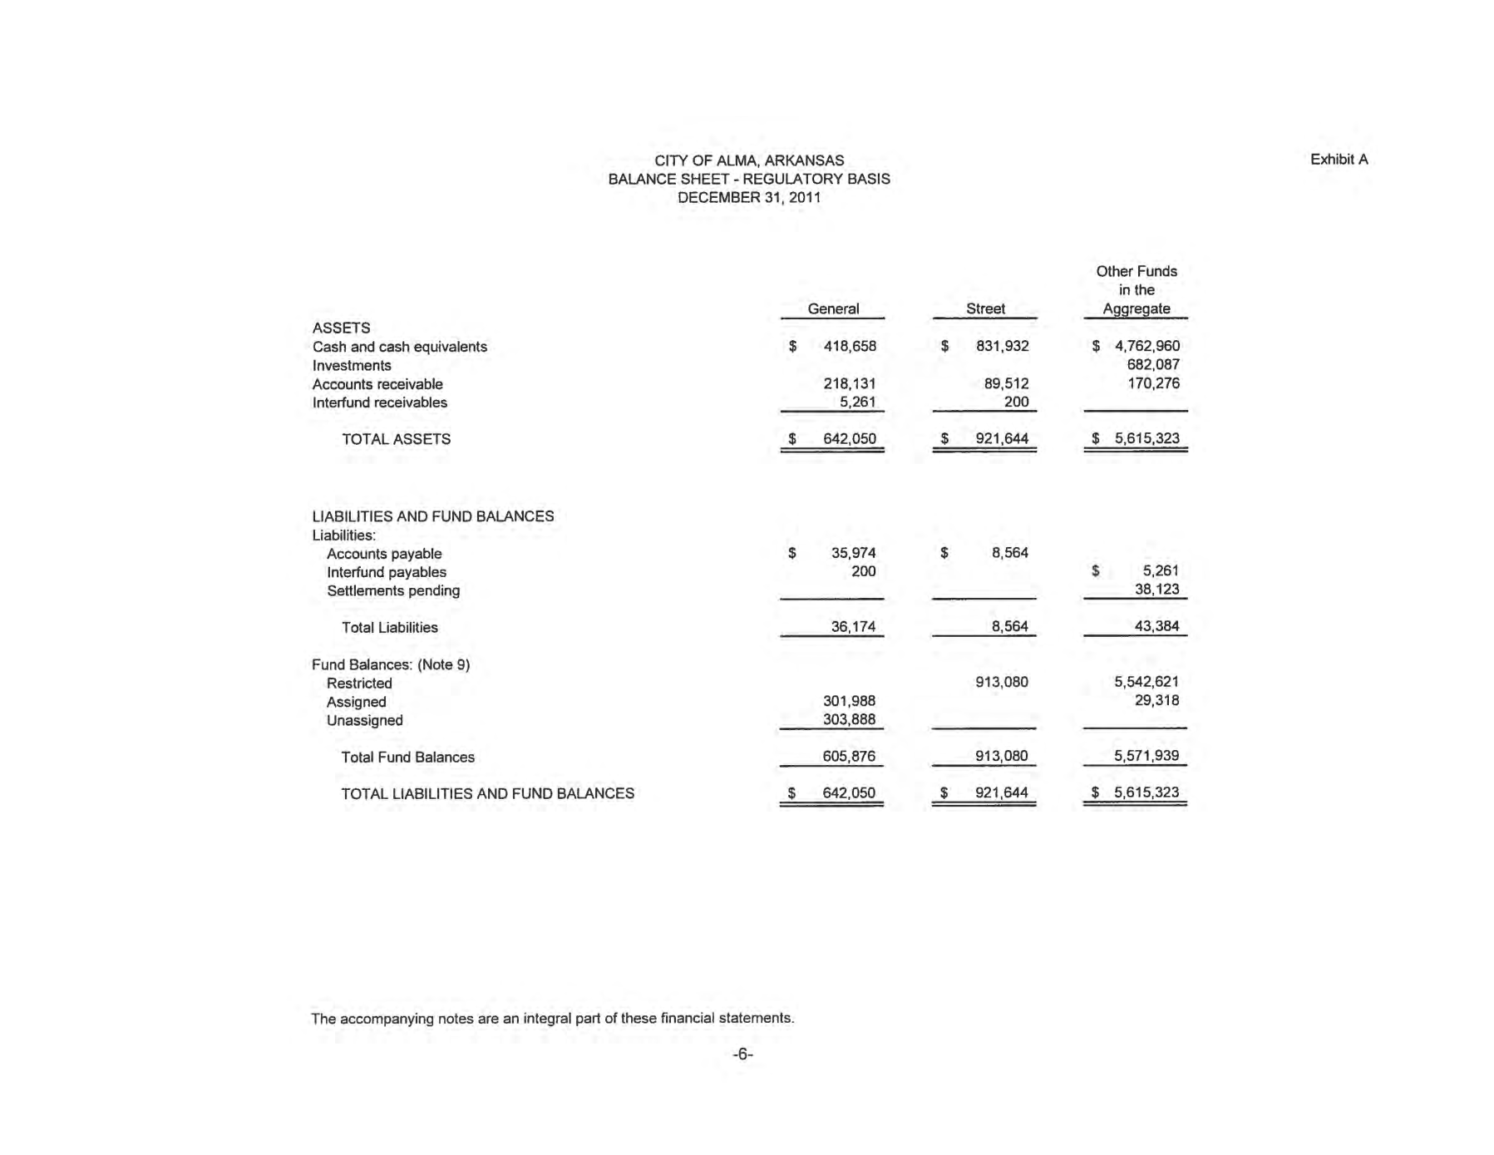
Local regulatory basis report
Total Column

Slide 42
Required supplementary information (RSI)
By definition, not required for reports not presented in accordance with GAAP.
Program requirements
  Budgetary comparisons for the general fund and major special revenue funds with legally adopted annual (or biennial) budgets (normally reported as RSI in GAAP) must be presented as a basic financial statement.
  Certain relevant information normally required to be presented as part of management’s discussion and analysis (MD&A) in connection with GAAP financial reports must be incorporated into the letter of transmittal.
Notes:
RSI = MD&A and budgetary comparisons

Slide 43
Budgetary comparisons
Since required supplementary information is only required by GAAP, this removes the option of presenting budgetary comparisons for the general fund and major special revenue funds as either basic financial statements or separately in the RSI.
  Thus, the Certificate of Conformance Program Policy requires that budgetary comparisons for the general fund and major special revenue funds be presented as basic financial statements.
Local regulatory basis report is already presented in this way.

Slide 44
Note disclosure
Similar to those required by GAAP if relevant to any of the items recognized under the modified cash basis.
Other note disclosures related to matters not presented on the face of the financial statements, as considered necessary or required by the program guidelines.
Notes:
Basically the same note disclosures required by GAAP.

Slide 45
Note disclosure specifics
Same disclosures for the summary of significant accounting policies, when applicable to the modified cash basis.
Not required to disclose capital assets.

Slide 46
Note disclosure specifics cont.
Program policy requires a disclosure for long-term liabilities.
  Debt, compensated absences, claims and judgments, and pension-related liabilities.
    List of debt, when it was issued and for what purpose.
    Changes from the previous year’s balance (increases and decreases).
    Debt service payments for the next five years and in five-year increments thereafter.
Otherwise, similar to typical disclosures, when applicable to the modified cash basis.
Local regulatory basis report already discloses liabilities. The only thing missing is the changes in balances.

Slide 47
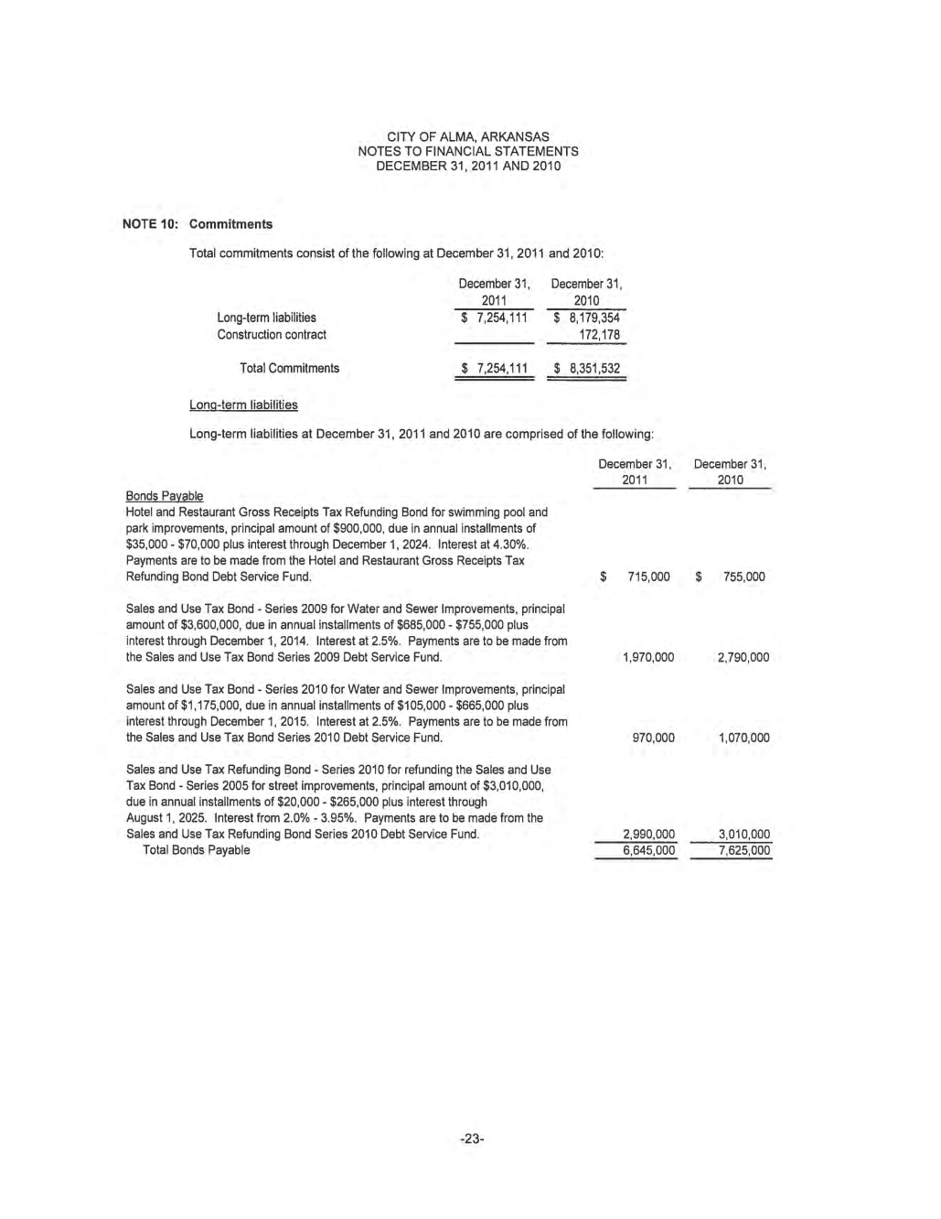
Local regulatory basis report

Slide 48
Other financial section information
Program requirements
  Combining and individual fund financial statements and schedules
    Including budgetary comparisons presented at the legal level of budgetary control for all individual governmental funds with legally adopted annual or biennial budgets.

Slide 49
Other financial section information (cont.)
NEW
Program requirements cont.
  Schedules of five-year trend data, as applicable:
    Net position – government-wide financial statements – modified cash basis,
    Changes in net position – government-wide financial statements – modified cash basis,
    Fund balances – governmental funds – modified cash basis,
    Revenues, expenditures, and changes in fund balances – governmental funds – modified cash basis, and
    Outstanding debt by type

Slide 50
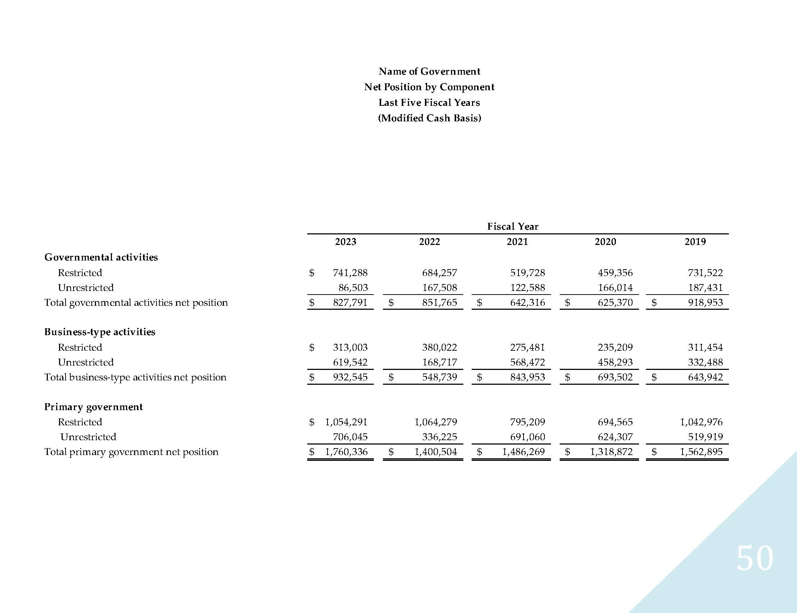
Trend information example

Slide 51
Questions?
Krisztina Dommer
Senior Manager
Government Finance Officers Association
312-578-5469
Kdommer@gfoa.org

