Slide 1
Arkansas Government
Finance Officers Association
48th Annual Conference
July 30, 2026

Slide 2
Arkansas Legislative Audit
Joe Archer, CPA
Deputy Legislative Auditor
Candice Gasaway, CPA
Audit Manager
Counties and Municipalities

Slide 3
Legislative Audit Management
Legislative Auditor
  Kevin William White, CPA, JD

Slide 4
Arkansas Legislative Audit
Provides Audits/Reports:
State Agencies
Public Educational Institutions
Cities, Counties (75), and PAs
Special Reports

Slide 5
State of Arkansas
500 Municipalities
  460 use ALA (2025 engagements)
  40 hire private CPAs
75 Counties
  AR Law requires ALA audit

Slide 6
Legislative Joint Auditing Committee (LJAC)
44 Legislators
3 Standing Committees
    State Agencies
    Educational Institutions
    Counties and Municipalities

Slide 7
Legislative Joint Auditing Committee (LJAC)
Meets
Full - 2nd Friday
Standing - Preceding Thursday
August 13 and 14
www.arkleg.state.ar.us

Slide 8
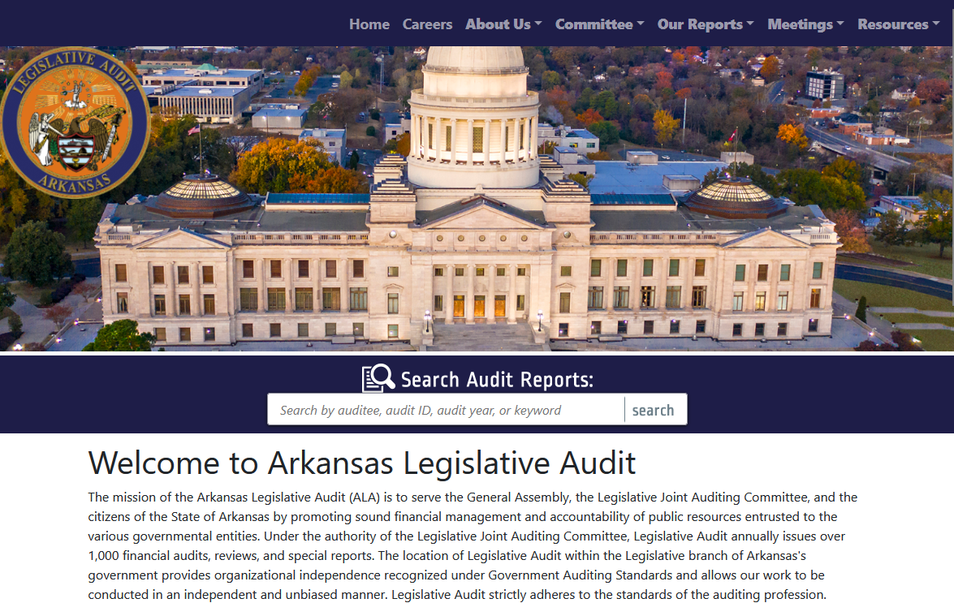
www.arklegaudit.gov

Slide 9
Preparing for Your Audit
https://arklegaudit.gov/resources
Preparing for a Legislative Audit of a Municipality
Arkansas Municipal Accounting Handbook
Report on Compliance with Ark. Code Ann. § 14-58-101 (Municipal Audit by Independent Accountant)

Slide 10
www.arklegaudit.gov

Slide 11
Preparing for a Legislative Audit of a Municipality
List of Required Records
Applicable Arkansas Codes
Suggested Segregation of Duties

Slide 12
Arkansas Municipal Accounting Handbook
Prepared by the Arkansas Municipal League
Guide to prepare for audit

Slide 13
Report on Compliance with
Ark. Code Ann. § 14-58-101
Requires annual audit/AUP
Legislative Audit or private CPA

Slide 14
Report on Compliance Ark. Code Ann. § 14-58-101 (Cont.)
Audit Requirement –
  Ark. Municipal Accounting Law
  Ark. Code Ann. §§ 14-59-101 – 119
  District Court Accounting Law
  Ark. Code Ann. § 16-10-209
  Others

Slide 15
Report on Compliance with
Ark. Code Ann. § 14-58-101 (Cont.)
Ark. Code Ann. § 10-4-412
  Regulatory Basis
  Annual Resolution requiring GASB

Slide 16
Report on Compliance with
Ark. Code Ann. § 14-58-101 (Cont.)
Ark. Code Ann. § 10-4-412
(June 30, 2024)
  Private audits to be filed with Legislative Auditor within 10 days of report date
  18 months delinquent – turnback MAY be escrowed
  Additional 12 months – turnback MAY be redistributed

Slide 17
Report on Compliance (Cont.)
Ark. Code Ann. § 10-4-429
  Report Security Incidents
      5 days
      https://arklegaudit.gov/

Slide 18
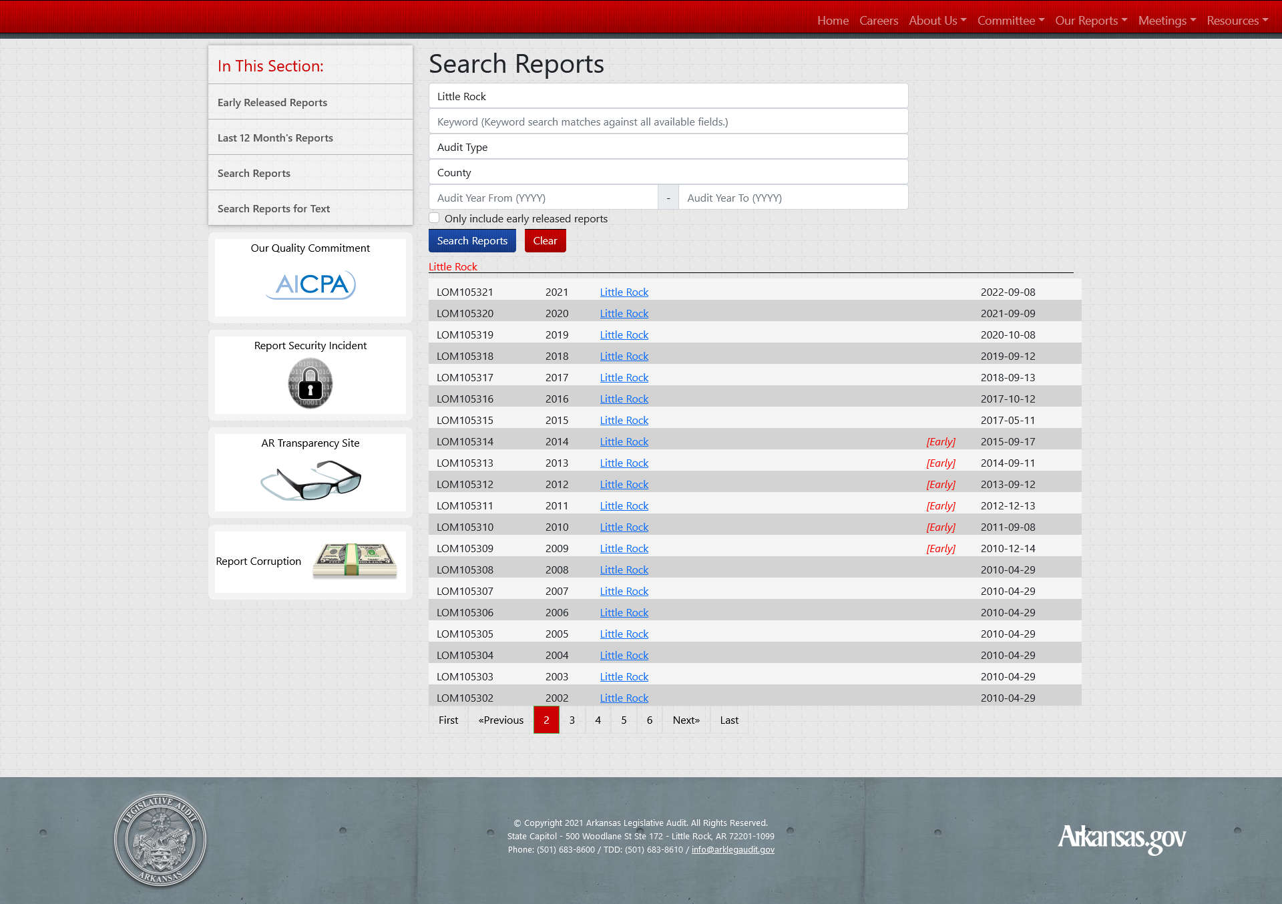

Slide 19
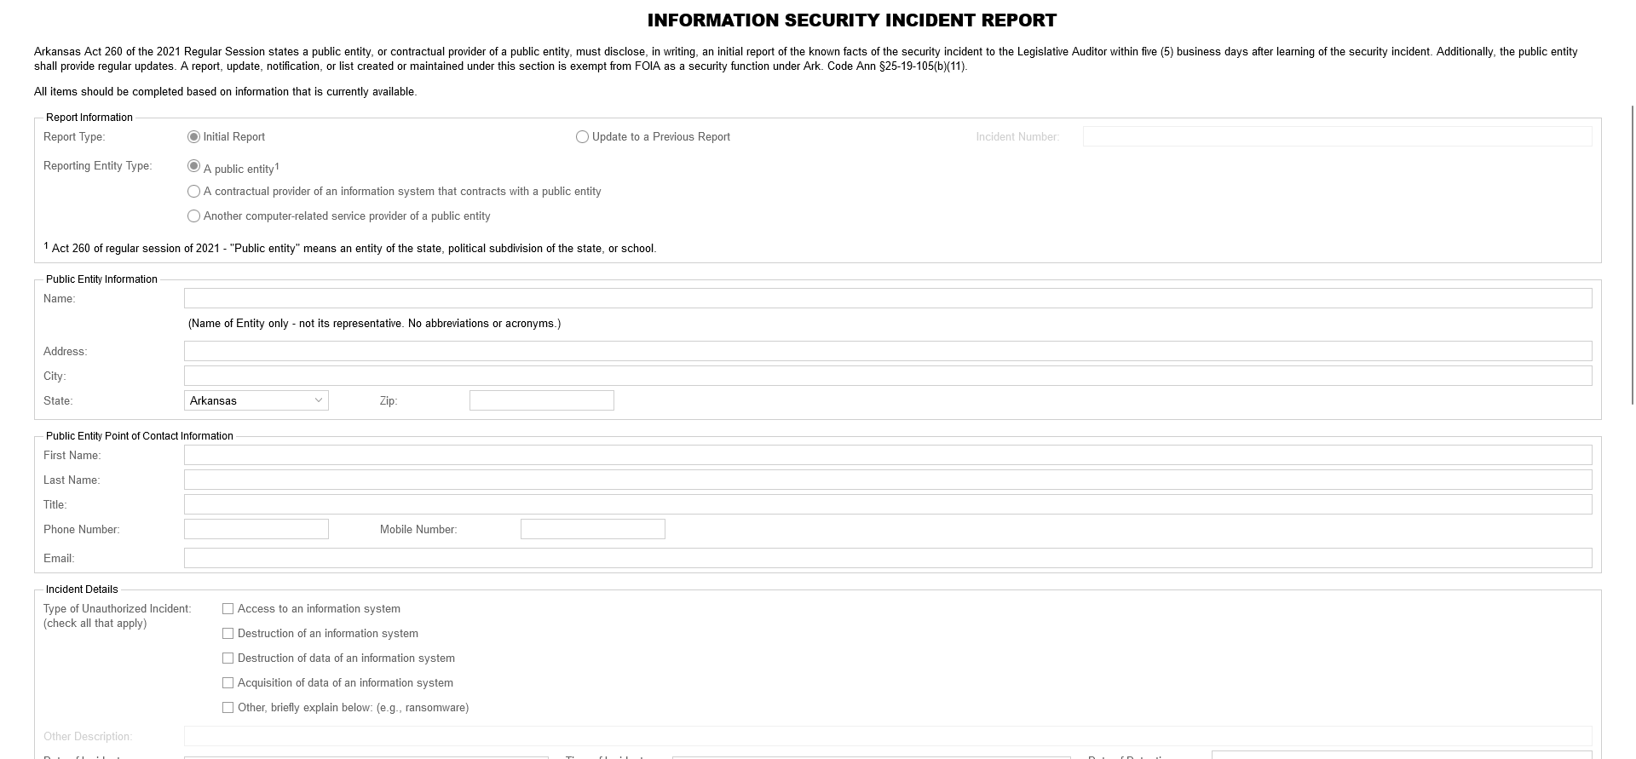
Report Security Incident

Slide 20
Report on Compliance (Cont.)
Ark. Code Ann. § 25-1-124
  Report Loss of Funds
      $ 1,000 in a calendar year
      5 days
      kevin.white@arklegaudit.gov

Slide 21
Preparing for Your Audit
https://arklegaudit.gov/resources
Preparing for a Legislative Audit of a Municipality
Arkansas Municipal Accounting Handbook
Report on Compliance with Ark. Code Ann. §14-58-101 (Municipal Audit by Independent Accountant)

Slide 22

Preparing for Your Audit (Cont.)

Slide 23
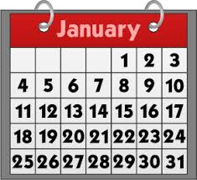
Audit Prep Starts the First Day of the Audit Period

Slide 24
Preparing for Your Audit (Cont.)
Determine your audit needs:
  Water/Sewer
  Federal expenditure documentation
      $1Million
      Grant agreements

Slide 25
Preparing for Your Audit (Cont.)
Communication between auditor and entity
    When
    How
  It’s important to have an open line of communication with your auditor!

Slide 26
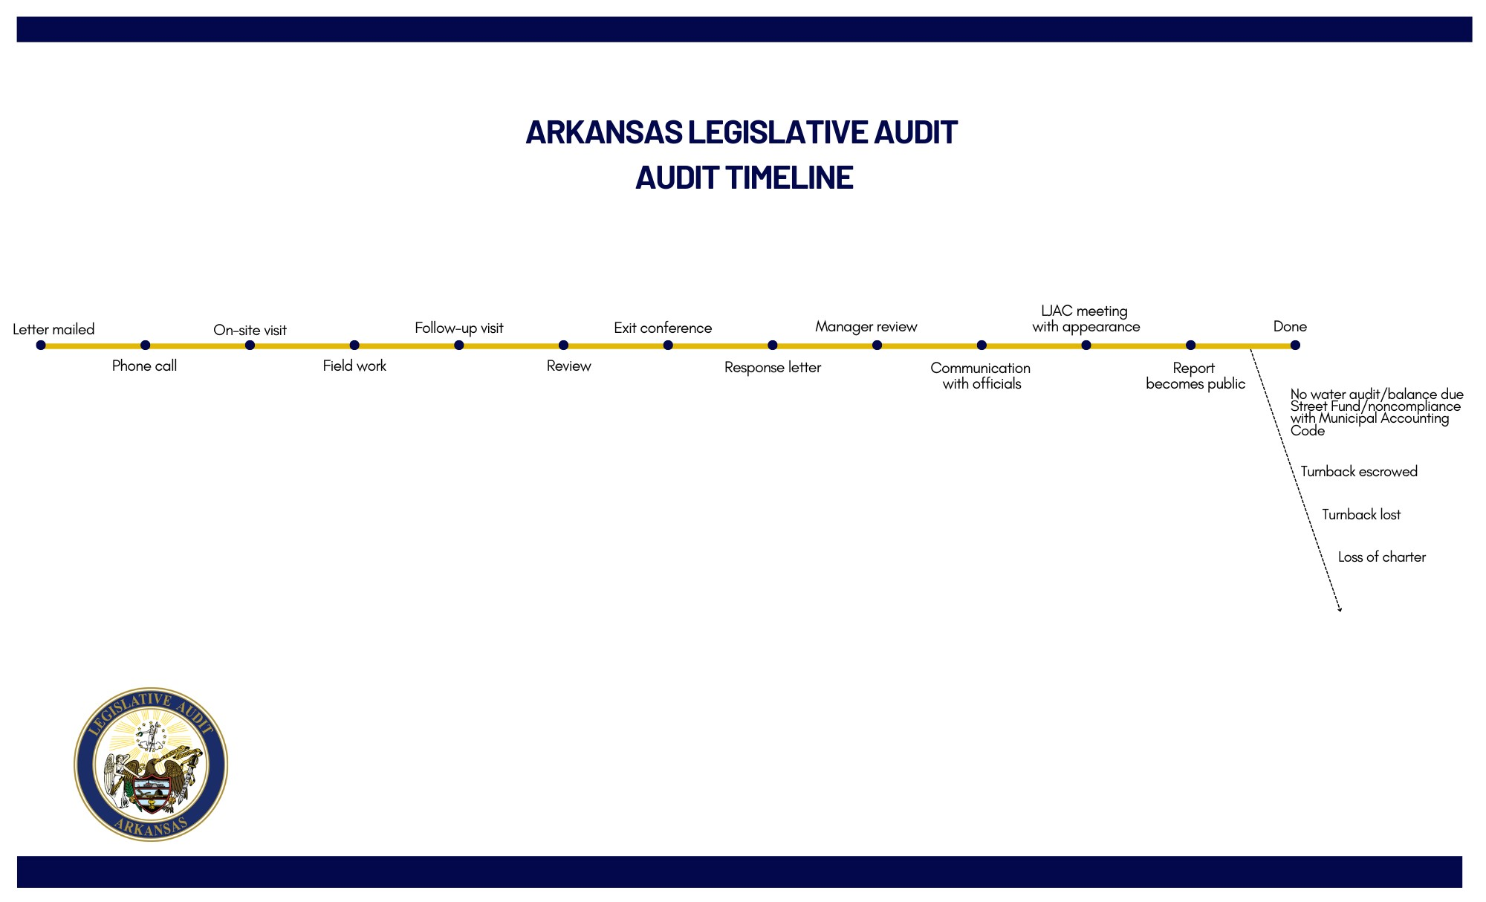
Audit Timeline

Slide 27
What Happens
If a City Has Findings?
Written response to findings
Ethics or shortage findings to PA/AG
Court-related findings to AOC/Chief Justice of Supreme Court
Report becomes public (usually on Thursday)

Slide 28
www.arklegaudit.gov

Slide 30
Act 111 of 2025
Legislative Audit to Develop a Comprehensive Financial Management System for Cities of the Second Class and Incorporated Towns

Slide 31
Act 111 of 2025 (Cont.)
  2nd class cities and incorp. towns only
  Fiscal year ended December 31, 2029

Slide 32
Act 24 of 2025
To Amend The Law Concerning Annual Appropriations For Local Government
  PY Budget including amendments
  Co. Judge/Quorum Ct. not paid
  City – Limited to necessary operations

Slide 33
Act 671 of 2025
To Amend the Duties of a
Municipal Treasurer…
(Ark. Code Ann. § 14-59-115)
  Required 8 hours of training
  Effective July 1, 2026

Slide 34
Private Audits
Amend Ark. Code Ann. § 10-4-412 – Private Municipal and Water Audits
18 months escrow turnback
30 months redistributed turnback
Effective June 30, 2024
PrivateReports@arklegaudit.gov

Slide 35
Arkansas Legislative Audit
Top 10
Municipal Findings
in ALA Reports

Slide 36
1. Budgets
  Failure to prepare
  Failure to adopt by ordinance or resolution
  Minutes did not indicate adoption
  Expenditures exceed
  Ark. Code Ann. §§ 14-58-202, -203

Slide 37
2. Bank Reconciliations
  Failure to prepare
  Inaccurate
  Journals to bank (deps/wds)
  Lack of review by someone other than the preparer
Ark. Code Ann. § 14-59-108

Slide 38
3. Errors in Financial Records
  Material misstatements
  Errors in receipts/disbursements journals
  Ark. Code Ann. §§ 14-59-110, 111

Slide 39
4. Misuse of Restricted Funds
  Street turnback and property taxes
  Other (sales taxes)
Ark. Code Ann. §§ 14-59-104,
26-79-104, 27-70-207

Slide 40
4. Misuse of
Restricted Funds (Cont.)
Act 709 of 2021 and Act 127 of 2023
(Ark. Code Ann. § 27-70-207)
Repay restricted Street/Road funds (Highway State turnback, Ark. Code Ann. § 27-70-207) by end of 2022 or lose these turnback funds
Exceptions
  Ord or Res repay 10% of general revs/year
  LJAC approval to pay < 10% per year

Slide 41
5. Review of Prior Report
Report not reviewed
Review not documented in minutes
Ark. Code Ann. § 10-4-418

Slide 42
6. Undocumented Expenditures
Undocumented or inadequately documented expenditures
Ark. Code Ann. § 14-59-105

Slide 43
8. Police/Court
  Ending bank balance unidentified
  Deposit errors (not intact/timely)
  Inaccurate settlements
Ark. Code Ann. §§ 16-10-201 – 211

Slide 44
9. Water and Sewer Audits
Audit or AUP & Compilation not obtained
  Water (100/2,000)
  Sewer (100/2000)
Ark. Code Ann. § 14-234-119
Act 907 of 2021

Slide 45
9. Water and Sewer Audits (Cont.)
Amend Ark. Code Ann. § 10-4-412 – Private Municipal and Water Audits
18 months escrow turn back
30 months redistributed turn back
Effective June 30, 2024
PrivateReports@arklegaudit.gov

Slide 46
10. Payroll Taxes
Failure to withhold/remit to IRS/DFA
Failure to submit tax forms
(W-2/941)
Money owed to IRS/DFA

Slide 47
Honorable Mention:
Fixed Assets
  Failure to prepare a list
  Inaccurate
  No policy adopted by council
  Additions/Deletions not authorized
Ark. Code Ann. § 14-59-107
Notes:
Governing body shall adopt a policy defining fixed assets. At a minimum , the policy shall set forth the $ amount and useful life necessary to qualify as a fixed asset.

Slide 48
Honorable Mention
A city or a town may not become a stockholder in, appropriate money for, or lend credit to private corporations or individuals.
    Exception for Economic Development
    Arkansas Constitution Article 12, § 5

Slide 49
Honorable Mention
Cities conducting business with an employee or official without an authorizing ordinance
Ark. Code Ann. § 14-42-107 (Ethics)

Slide 50
Questions?

Slide 51
Joe Archer
Deputy Legislative Auditor
joseph.archer@arklegaudit.gov
Candice Gasaway
Audit Manager
Candice.Gasaway@arklegaudit.gov

