Slide 1
NOTE: To change this logo image with your own.
1- Right Click on top of the faded image.
2- Choose “Change Picture”
3- Choose option “From File”
4- Locate file and Open
Sales & Use Tax 101
Arkansas Department of Finance & Administration
Office of Field Audit

Slide 2
Sales vs Use tax
Gross Receipts (Sales) Tax
Use Tax is a companion to Sales Tax
Use Tax statutes only clarify the portion of the law where Use Tax and Sales Tax differ

Slide 3




Sales vs
Use Tax
Taxable and exempt items are the same under both taxes.
State rates for both taxes are the same.
SIMILARITIES
Local Tax administration is the same.
Reduced rates are the same.

Slide 4
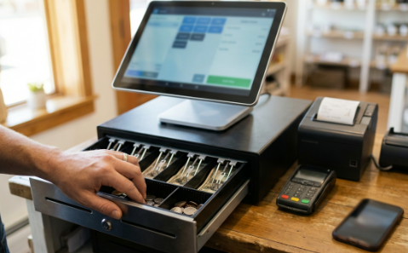

NOTE: This may look strange and cluttered, but it plays and looks differently in slideshow mode, (hit F5 to play)
So change the text and what you need…then push play to see the results.
SALES VS USE TAX
DIFFERENCE
NOTE: To change this picture with your own.
1- Right Click on top of the faded image.
2- Choose “Change Picture”
3- Choose option “From File”
4- Locate file and Open
VS
SALES TAX
USE TAX
Seller is responsible for collecting and remitting the tax on sales of tangible, personal property, specified digital products, and taxable services.
Purchaser is responsible for accruing and remitting the tax on purchases of tangible, personal property, specified digital products, and taxable services.

Slide 5





NOTE: To change this logo image with your own.
1- Right Click on top of the faded image.
2- Choose “Change Picture”
3- Choose option “From File”
4- Locate file and Open
Sales Tax
Collected and reported by in-state sellers.
Tax jurisdiction is based upon the destination of the goods sold or services rendered.
Online sellers may also collect this tax if they have a physical presence in Arkansas or have $100,000 in sales or 200 transactions in the state in a year.
Examples: Brick and mortar stores like Walmart, Target, etc. Online sellers like Amazon, Wayfair, etc.

Slide 6
COMPENSATING USE TAX
Accrued by in-state purchasers on their online or out-of-state purchases
Tax jurisdiction still based on destination of goods sold or services rendered
Example: Purchases from online or out-of-state sellers who do not collect Arkansas tax

Slide 7

NOTE: To change this logo image with your own.
1- Right Click on top of the faded image.
2- Choose “Change Picture”
3- Choose option “From File”
4- Locate file and Open
Compensating Use tax
Compensating use tax applies to services in the same way it does tangible personal property
Services purchased and performed out of state that would have been taxable if purchased in Arkansas are subject to use tax
Example – Laptop is shipped to Missouri for repair. Repair services occur in Missouri, and laptop is shipped back to Arkansas. Services are used/consumed here and are taxable under Compensating Use Tax

Slide 8
IMPORTANT NOTE!
Purchasers are only responsible for Use Tax when:
  Taxable items or services are purchased from outside Arkansas, AND
  No Arkansas tax was collected on the transaction.
Purchasers are only responsible for tax on purchases from in-state sellers or service providers when:
  They gave the seller an exemption certificate stating they should not be charged tax, AND
  The item or service is used in a manner not subject to exemption.

Slide 9
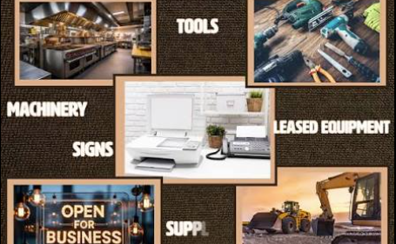

NOTE: This may look strange and cluttered, but it plays and looks differently in slideshow mode, (hit F5 to play)
So change the text and what you need…then push play to see the results.
PROPERTY, SPECIFIED DIGITAL PRODUCTS, AND SERVICES
NOTE: To change this picture with your own.
1- Right Click on top of the faded image.
2- Choose “Change Picture”
3- Choose option “From File”
4- Locate file and Open
VS
Property & Specified Digital Products
Services
These items are assumed to be taxable unless an exemption applies.
Services are assumed to be not taxable unless the service is specifically taxed in the law.

Slide 10

Rule Number Change
Old – Gross Receipts (GR) and Compensating Use (UT) Rules
New – Code of Arkansas Rules (CAR) codeofarrules.arkansas.gov
Sales and Use Tax Rules can be found in Title 26 Part 30.
New Rule numbers are still the same Rules – updating them from 2008 until the present is taking some time…

Slide 11


UTILITIES
GR-6 / 26 CAR § 30-301
Water
  Sewer services – not taxable
  Used in commercial poultry operations – not taxable
Electricity
Natural Gas
Reduced rate for electricity and natural gas used in manufacturing

Slide 12
Taxable services
GR-9 / 26 CAR § 30-502
INITIAL INSTALLATION
REFINISHING
ALTERATION/ADDITION
REPLACEMENT
CLEANING
REPAIR

Slide 13
taxable Services
Motor Vehicles Electrical Devices Clocks
Aircraft Furniture Engineering Instruments
Farm Machinery Rugs, including Carpets Medical Instruments
Farm Implements Flooring Surgical Instruments
Motors of All Kinds Upholstery Machinery of All Kinds
Tires Household Appliances Bicycles
Batteries Television & Radio Office Machines
Boats Jewelry Office Equipment
Electrical Appliances Watches Shoes
Tin & Sheet Metal Mechanical Tools Shop Equipment

Slide 14
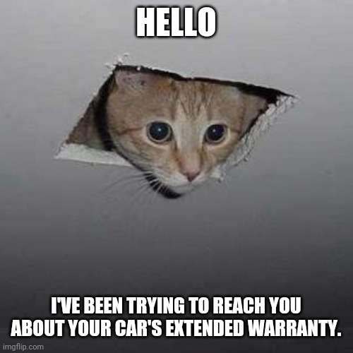
SERVICE CONTRACTS
If the contract, agreement, or warranty covers taxable services, then the contract, agreement, or warranty is subject to tax.
If tax is paid on the contract, agreement, or warranty, subsequent parts and service under the contract, agreement, or warranty are not subject to tax.
Deductibles are subject to tax as they are over and above the amount upon which tax was paid

Slide 15
TAXABLE SERVICES
Parking a vehicle or allowing a vehicle to be parked (GR-9(B)/ 26 CAR § 30-502(b)(5))
Television, radio, and video (GR-9.1 / 26 CAR § 30-503)
Lawn care (commercial) and landscaping (all) (GR-9.2 / 26 CAR § 30-504)
Cleaning/Janitorial (GR-9.4 / 26 CAR § 30-506)
Wrecker and towing (GR-9.5 / 26 CAR § 30-507)
Collection and disposal of solid waste (GR-9.6 / 26 CAR § 30-508)
Cleaning parking lots and gutters (GR-9.7 / 26 CAR § 30-509)
Dry cleaning and laundry (GR-9.8 / 26 CAR § 30-510)
Body piercing, tattooing, electrolysis (GR-9.10 / 26 CAR § 30-512)

Slide 16
TAXABLE SERVICES
Pest control (GR-9.11 / 26 CAR § 30-513)
Security and alarm monitoring (GR-9.12 / 26 CAR § 30-514)
Boat storage and docking (GR-9.13 / 26 CAR § 30-515)
Camping or trailer spaces (GR-9.14 / 26 CAR § 30-516)
Locksmith (GR-9.15 / 26 CAR § 30-517)
Pet grooming and kennel (GR-9.16 26 / CAR § 30-518)
Initial installation (GR-9.17 / 26 CAR § 30-519)
Printing and Photography (GR-10 / 26 CAR § 30-521)

Slide 17
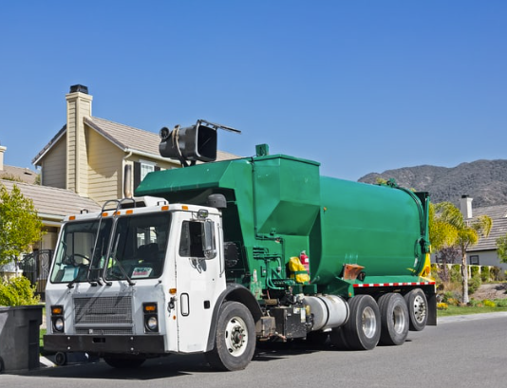
Collection & disposal of solid waste
GR-9.6 / 26 CAR § 30-508
Solid waste does include yard waste
Solid Waste is not:
  Sewage
  Radioactive waste
  Recyclable materials removed from the waste stream
  Waste tires
  Hazardous materials
  Landfill tipping fees may be exempt as sales for resale

Slide 18

Contractor Services
GR-21 / 26 CAR § 30-1003
Contractors are deemed to be the users of all property used in
completion of a contract and should pay tax on their materials used
Some contractors act as a contractor and a retailer
HVAC
Electrician
Plumber

Slide 19

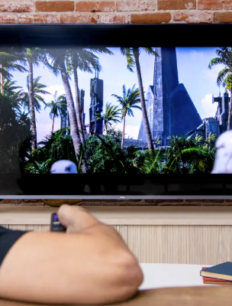
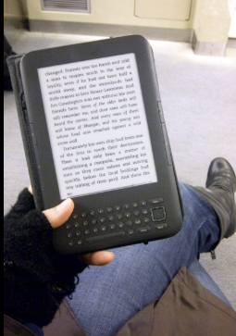
SPECIFIED DIGITAL PRODUCTS
ACA 26-52-103
Digital Audio Work
Ringtones, subscription music services like Apple Music, Spotify, Amazon Music, etc.
Digital Audio-Visual Work
Training videos (not live), subscription video services like Hulu, Netflix, etc.
Digital Books
Purchased eBooks, subscription book services like Audible

Slide 20



Exemption for Motor Vehicles
Purchased by Local Governments
GR-34(E) / 26 CAR § 30-1109
Motor Vehicles sold to counties and municipalities are exempt.
Exemption applies whether vehicles are licensed for highway use or not
Examples:
Passenger cars and trucks, semi-trucks, buses, motorcycles, riding lawn mowers, golf carts, etc.
Exception for heavy equipment
Exemption does not apply to heavy equipment like forklifts, cranes, backhoes, excavators, bulldozers, road graders, skid steer loaders, asphalt pavers, concrete pavers, etc. See Arkansas Code Annotated Section 26-52-318 for list.

Slide 21
Exemption for Pollution Control Machinery
GR-66 / 26 CAR § 30-1150
Machinery and equipment used to prevent or reduce air or water pollution.
Written certification from ADEQ or EPA required.
Machinery and equipment used to remove contaminants from wastewater in a wastewater treatment plant .
Chemicals that act directly on air or water to remove
or alter an impurity in the air or water.
Exemption does not include:
Collecting wastewater from outside the treatment plant and delivering it to the plant.
Disposing of solids or other contaminants removed from the wastewater
Chemicals used to test air or water.

Slide 22
NOTE: This may look strange and cluttered, but it plays and looks differently in slideshow mode, (hit F5 to play)
So change the text and what you need…then push play to see the results.
LOCAL CAP REBATES
GR-92 / 26 CAR § 30-1225
Counties and cities are eligible for the local cap rebate on transactions over $2,500.
Sales Tax Paid to a Vendor
  Claim the rebate on your Excise Tax Report *preferred method
  Claim the rebate on Form 179A available on the Sales Tax website
Self-rebate on transactions over $2,500 reported for Compensating Use Tax – only accrue/report on the first $2,500 for local tax purposes
Rebates must be claimed within one year

Slide 23
NOTE: To change this logo image with your own.
1- Right Click on top of the faded image.
2- Choose “Change Picture”
3- Choose option “From File”
4- Locate file and Open
Local tax information available to the public
Monthly electronic reports of taxes collected per local jurisdiction are available to the public
  The amount of tax revenue generated per NAICS code;
  Local cap rebates claimed; and
  Amounts collected in audits for the specified period.
Monthly reports for the most current 3 years are available from the Sales & Use Tax website at https://dfa-localtaxes.ark.org/
Amounts are shown for a specific NAICS code if there are at least 3 business using the NAICS code for the jurisdiction

Slide 24
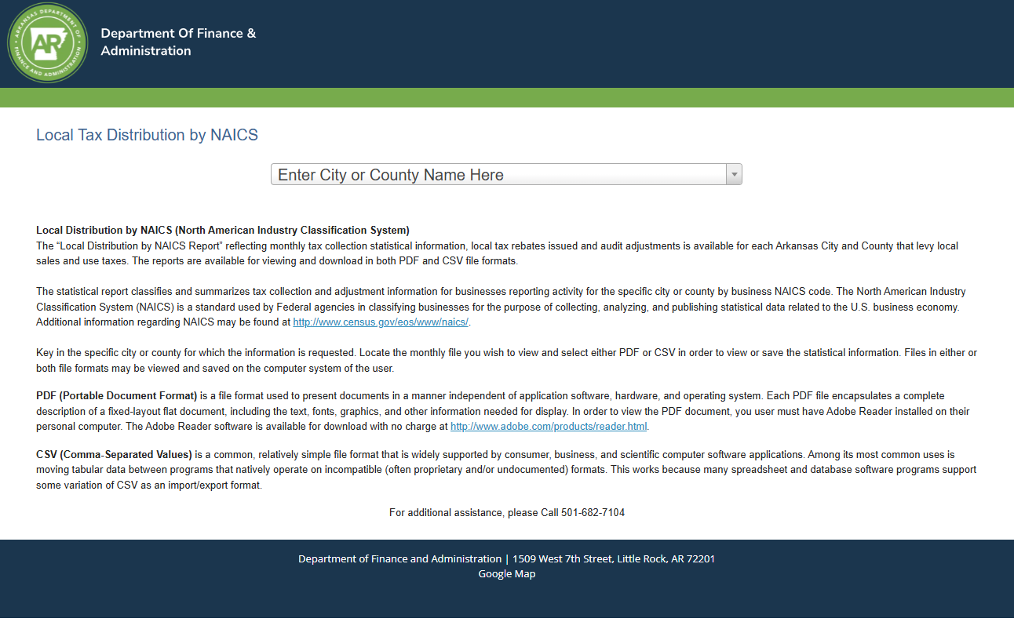

Slide 25
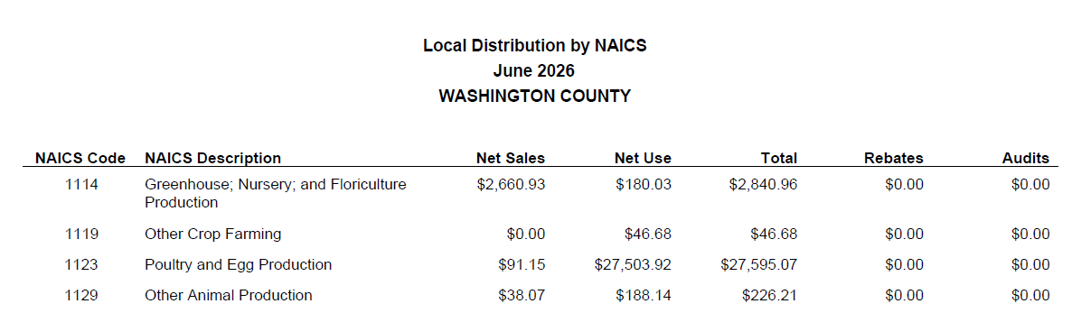
Reports can be generated in Excel or pdf format.
Amounts shown are tax amounts reported or refunded during the selected period for all registered businesses for the selected jurisdiction.

Slide 26

LOCAL CAP REBATE INFORMATION
Local jurisdiction must keep the information in the report confidential.
DFA will provide monthly reports with the business name and amount of credit or rebate awarded.
Local jurisdictions must register with DFA through the Arkansas Taxpayer Access Point (ATAP).

Slide 27
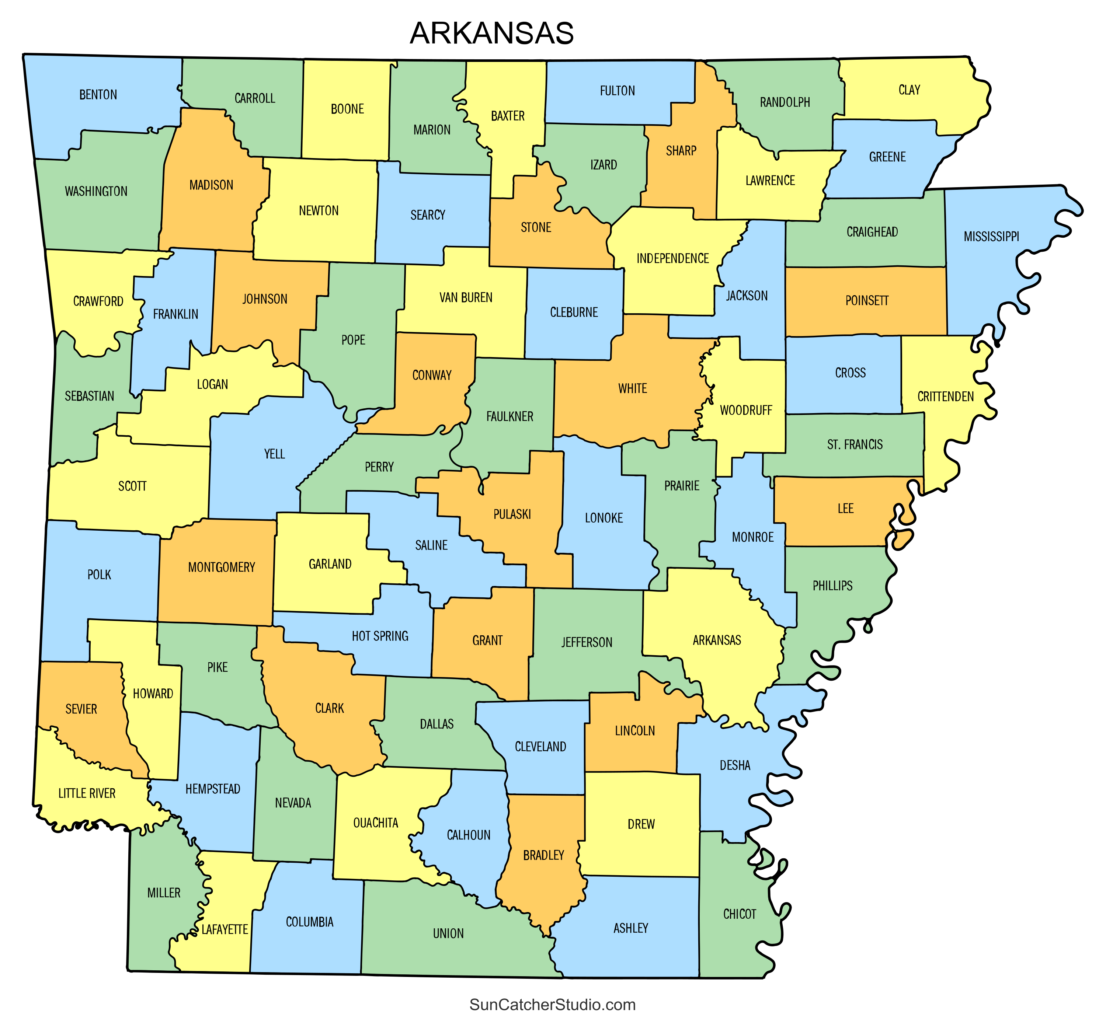
Jurisdiction Tax Collected
Electronic reports are available for local jurisdictions containing the following:
  Total number of permitted business
  Number of permitted business per NAICS code
  Amount of tax revenue generated per NAICS code
  Jurisdiction must register through ATAP
  Information received is confidential.

Slide 28
Field Audit Contact Information
Central Field Audit – Tommy Nabors, Manager 501-682-4600 tommy.nabors@dfa.arkansas.gov
NE Field Audit – Cathy Coker, CPA, Manager 870-932-5670 cathy.coker@dfa.arkansas.gov
NW Field Audit – Patti Gilliland, Manager 479-271-8108 patti.gilliland@dfa.arkansas.gov
Southern Field Audit – Anita Campbell-Ross, Manager 501-262-7929
anita.campbell-ross@dfa.arkansas.gov

Slide 29
Website Information
Sales and Use Tax
https://www.dfa.arkansas.gov/office/taxes/excise-tax-administration/sales-use-tax/
Sales and Use Tax Forms
https://www.dfa.arkansas.gov/office/taxes/excise-tax-administration/sales-use-tax/sales-and-use-tax-forms/
Local Tax Lookup Tools
https://www.dfa.arkansas.gov/office/taxes/excise-tax-administration/sales-use-tax/local-tax-lookup-tools/

Slide 30
Questions?

