Slide 1

Passing a Sales Tax Bond – What Works?
July 30, 2026

Slide 2


Discussion Panelists
Mayor Joe Hurst
City of Van Buren
joehurst@cityofvanburenar.gov
Mayor Molly Rawn
City of Fayetteville
mayorsoffice@fayetteville-ar.gov
George Shelton / Principal
(479) 236-7473
George@CompanyPolitics.com
Company. Politics.
Fayetteville / Oxford / Washington
www.companypolitics.com
Leigh Ann Biernat
EVP, Head of Public Finance
Stephens Inc.
leighann.biernat@stephens.com

Slide 3
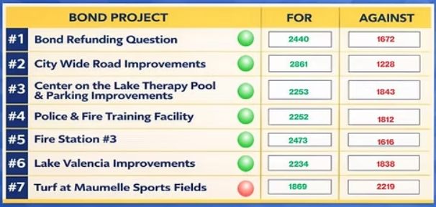
City of Maumelle – Example of Multiple Ballot Items
On the March 3rd 2026 ballot, Maumelle voters approved to extend the existing ½-cent sales tax for the purpose of funding key community improvement projects through the issuance of capital improvement bonds. Projects considered by voters:
 | City Wide Road Improvements
 | Center on the Lake Therapy Pool & Parking Improvements
 | Police & Fire Training Facility
 | Fire Station #3
 | Lake Valencia Improvements
 | X Turf at Maumelle Sports Field
3

Slide 4
Arkansas City Sales Tax Ballot Items: A Non-Exhaustive List
(2024 – 2026)
Year​ | Pass​ | Fail​ | Total​
2024​ | 39​ | 3​ | 42​
2025​ | 20​ | 4​ | 24​
March 2026​ | 19​ | 2​ | 21​
Total | 78 | 9 | 87
Summary: 78 of 87 ballot items passed (90%).
NOTE: Ballot items were sales tax related and may or may not have included bonds. Information compiled form various sources. May not represent all sales and use tax elections in Arkansas for timeframe presented.
4

Slide 5

0.5% SALES AND USE TAX
Adoption of a 0.5% local sales and use tax within the City of Van Buren, the net collections of which remaining after deduction of the administrative charges of the State of Arkansas and required rebates will be used for one or more of the following: (a) to pay and secure the repayment of bonds approved by the voters and issued by the City from time to time to finance capital improvements, (b) for park and recreational purposes and (c) for fire, police and other emergency services purposes. The levy of the tax is not dependent on any bonds being approved or issued.
3 Ballot Items
New Permanent Tax
New Bond Tax – 2 ballot items
PARK AND RECREATIONAL IMPROVEMENT BONDS
Bonds of the City of Van Buren in the maximum aggregate principal amount of $36,800,000 to finance all or a portion of the costs of new park and recreational facilities, including particularly, without limitation, a community center with swimming facilities, pickleball, basketball and volleyball courts, a walking track and meeting rooms and any furnishings, equipment and parking, landscaping, signage, drainage, lighting, street and utility improvements related thereto and, in order to pay the bonds, the levy and pledge of a 0.5% local sales and use tax within the City.
FIRE IMPROVEMENT BONDS
Bonds of the City of Van Buren in the maximum aggregate principal amount of $8,200,000 to finance all or a portion of the costs of new facilities and apparatus for the fire department, including particularly, without limitation, a fire station and any furnishings, equipment and parking, landscaping, signage, drainage, lighting, street and utility improvements related thereto and, in order to pay the bonds, the levy and pledge of a 0.5% local sales and use tax within the City.

Slide 6

On March 3, 2026, Fayetteville voters approved
a $375.5 million bond issue.
The 2026 Bond continues the City’s existing one-cent sales tax.
This allows the City to refund the remaining 2019 bond debt and reinvest approximately $335 million into projects.
Water and sewer infrastructure
Parks and Recreation
Animal Services
Pedestrian Infrastructure
Road Improvements
Recycling and Sustainability facilities and equipment
Aquatic Recreation Center
Fire Safety
9 Ballot Items
Rededicate existing tax (refund existing bonds)
Bond Projects – 8 ballot items

Slide 7
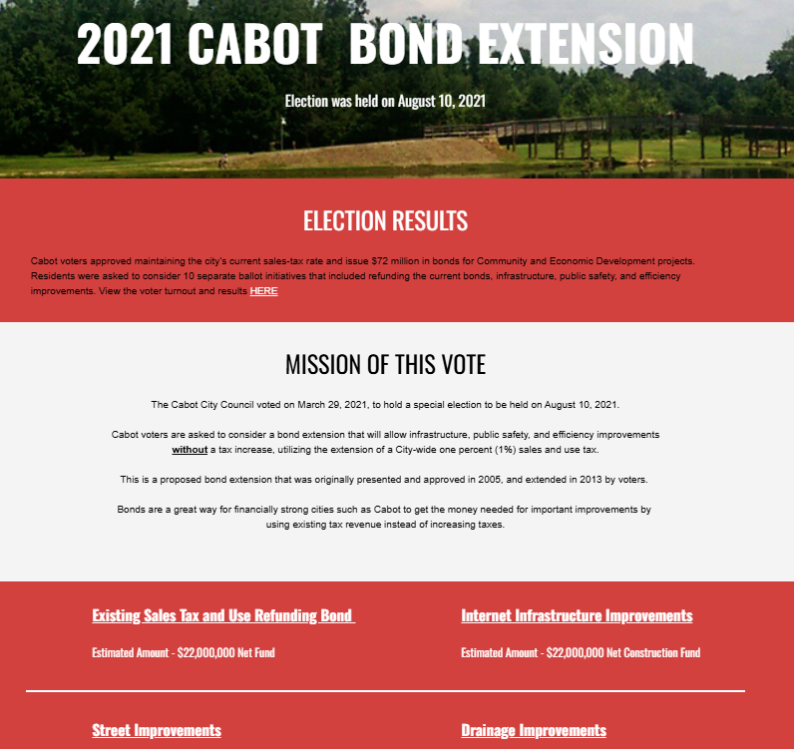
Bond Election Website Example

Slide 8
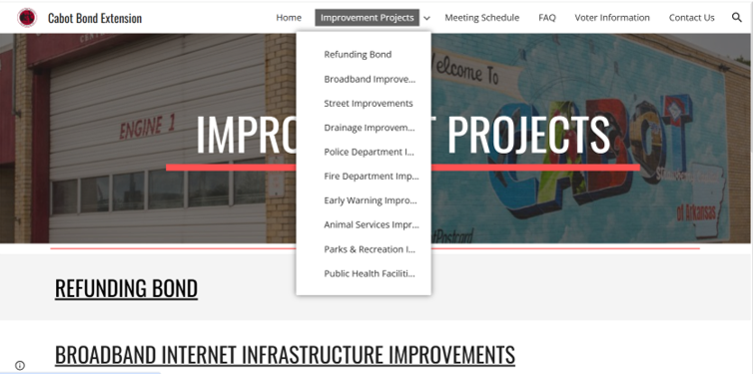
Bond Election Website Example

Slide 9
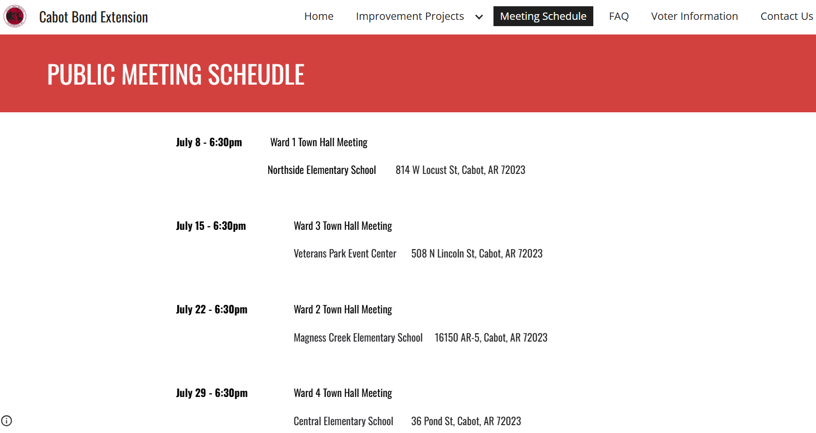
Bond Election Website Example

Slide 10
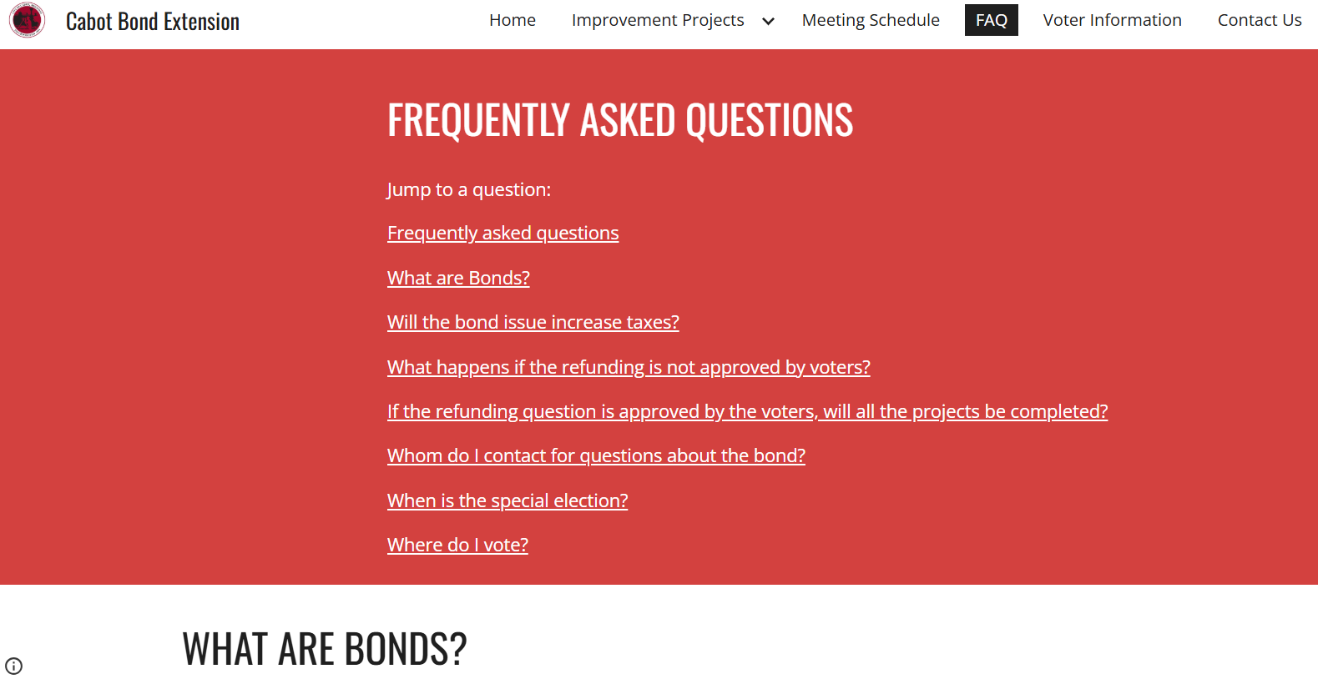
Bond Election Website Example

Slide 11
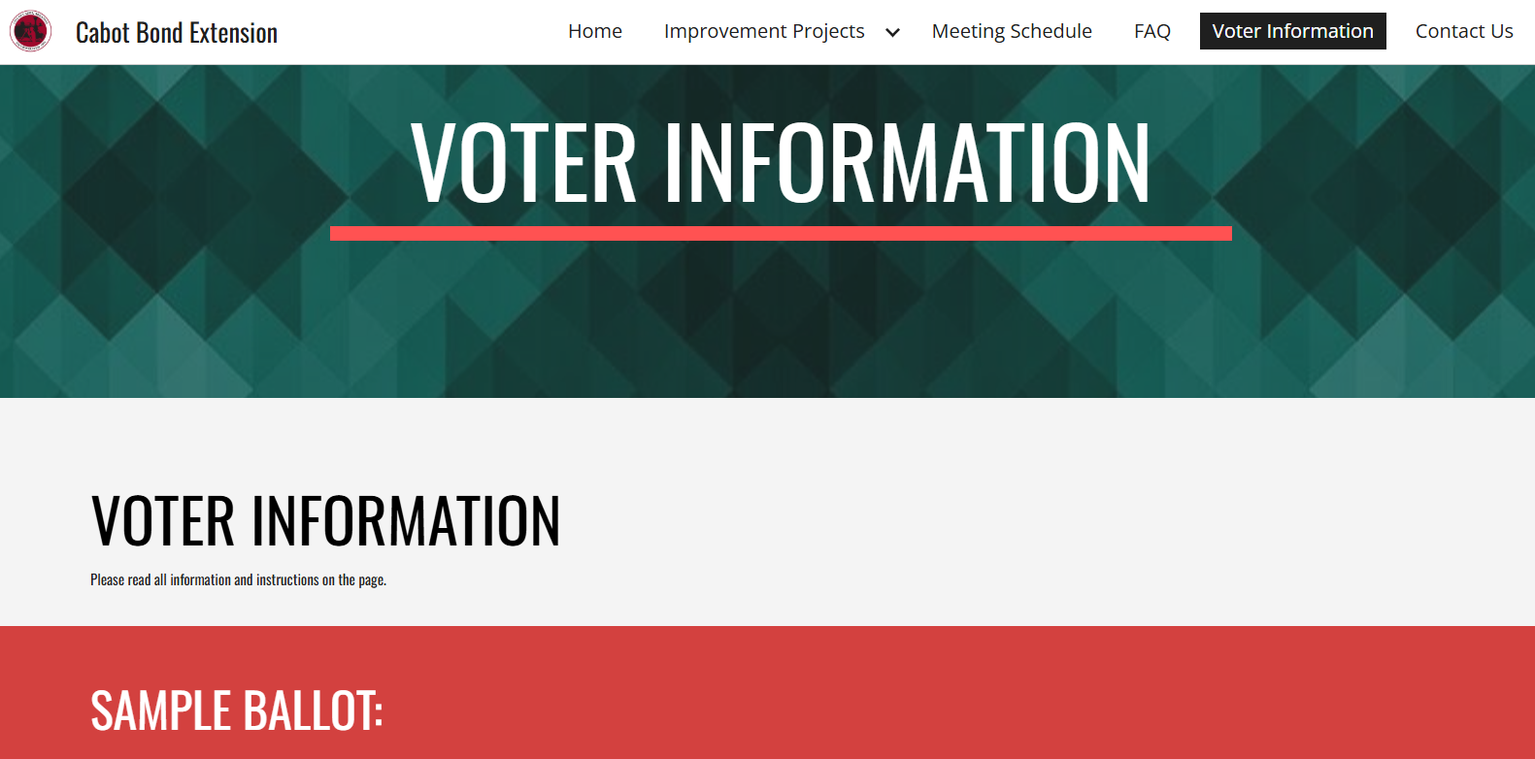
Bond Election Website Example

Slide 12
City Bond Election Website Example Links:
 | City of Cabot www.cabotbond.com
 | City of Maumelle www.maumellebond.com
 | City of Fayetteville www.fayetteville-ar.gov/4509/2026-Bond-Information
 | City of Springdale www.springdalear.gov/page/bond-program
 | City of Bentonville www.bentonvillebond.com

Slide 13
ELECTION REMINDERS FOR YOU

Slide 14
Election Reminders – Ark. Code Ann. § 7-1-103 (Excerpts)
The following are excerpts of Arkansas Code Annotated § 7-1-103 (Miscellaneous misdemeanor offenses — Penalties — Definitions). “Public servant” is defined in Ark. Code Ann. § 21-8-402.
Ark. Code Ann. § 7-1-103(a)(2)(A)(i):
“It shall be unlawful for any public servant, as defined in § 21-8-402, to devote any time or labor during usual office hours toward the campaign of any other candidate for office or for the nomination to any office.”
Ark. Code Ann. § 7-1-103(a)(2)(B):
“It shall be unlawful for any public servant, as defined in § 21-8-402, to circulate an initiative or referendum petition or to solicit signatures on an initiative or referendum petition in any public office of the state, county, or municipal governments of Arkansas or during the usual office hours or while on duty for any state agency or any county or municipal government in Arkansas.”
Ark. Code Ann. § 7-1-103(a)(2)(C):
“It shall be unlawful for any public servant, as defined in § 21-8-402, to coerce, by threats or otherwise, any public employee into devoting time or labor toward the campaign of any candidate for office or for the nomination to any office[.]”
Ark. Code Ann. § 7-1-103(a)(3)(A):
“It shall be unlawful for any public servant, as defined in § 21-8-402, to use any office or room furnished at public expense to distribute any letters, circulars, or other campaign materials unless such office or room is regularly used by members of the public for such purposes without regard to political affiliation. It shall further be unlawful for any public servant to use for campaign purposes any item of personal property provided with public funds.”
Ark. Code Ann. § 7-1-103(a)(3)(B):
“As used in subdivision (a)(3)(A) of this section, ‘campaign materials’ and ‘campaign purposes’ refer to: (i) The campaign of a candidate for public office; and (ii) Efforts to support or oppose a ballot measure, except as provided in § 7-1-111[.]”
Penalties for violations are set out in Ark. Code Ann. § 7-1-103(b).
Note: The above are selected excerpts only; other provisions may apply. This information is provided for informational purposes only and is not legal advice. Please consult your city attorney or other legal advisors for such advice.

Slide 15
Election Reminders – Ark. Code Ann. § 7-1-111 (Excerpts)
The following are excerpts of Arkansas Code Annotated § 7-1-111 (Use of public funds to support or oppose ballot measure — Definitions).
Ark. Code Ann. § 7-1-111(a)(3) (definition of “public servant” for this section):
“(A) Except as provided in subdivision (a)(3)(B) of this section, ‘public servant’ means an individual who is: (i) Employed by a governmental body; (ii) Appointed to serve a governmental body; or (iii) Appointed to a governmental body. (B) ‘Public servant’ does not include: (i) An elected official; or (ii) A person appointed to an elective office.”
Ark. Code Ann. § 7-1-111(b):
“It is unlawful for a public servant or a governmental body to expend or permit the expenditure of public funds to support or oppose a ballot measure.”
Ark. Code Ann. § 7-1-111(c):
“This section does not: (1) Limit the freedom of speech of a public servant or government body, including without limitation verbal expressions of views supporting or opposing a ballot measure; (2) Prohibit a governmental body from expressing an opinion on a ballot measure through the passage of a resolution or proclamation; (3) Prohibit the incidental use of state resources by a public servant, including without limitation travel costs, when speaking at an event in which a ballot measure is discussed if the subject matter of the speaking engagement is within the scope of the official duties and responsibilities of the public servant; or (4) Prohibit the dissemination of public information at a speaking engagement and the incidental use of state resources in the analysis and preparation of that public information if the subject matter of the public information is within the scope of the official duties and responsibilities of the public servant.”
Ark. Code Ann. § 7-1-111(d)(1):
“Except as provided under subdivision (d)(2) of this section, a violation of this section is a Class A misdemeanor.” Additional consequences are set out in § 7-1-111(d)(2).
Note: The above are selected excerpts only; other provisions may apply. This information is provided for informational purposes only and is not legal advice. Please consult your city attorney or other legal advisors for such advice.

Slide 16
Disclaimers
This communication has been prepared for informational purposes only. It is not a solicitation, recommendation or offer to buy or sell any security and does not provide information on which an investment decision to purchase or sell any securities could be based. It does not purport to be a complete description of the securities, markets or developments referred to in this communication. Information included in the communication was obtained from sources considered to be reliable, but Stephens has not independently verified such information and does not guarantee that it is accurate or complete. No representation or warranty, express or implied, is made as to the accuracy, completeness, or correctness of any such information. To the full extent permitted by law, neither Stephens nor any other person accepts any liability whatsoever for any direct, or indirect or consequential loss or damage arising from any use of the information contained in this communication. No subsequent publication or distribution of this communication shall mean or imply that any such information remains current at any time after the date of preparation of this communication. Stephens does not undertake to advise you of any changes in any such information. Additional information is available upon request.
The views and opinions expressed in this communication are those of the author, or the person(s) to whom such view or opinion is attributed, and do not necessarily reflect the opinions of Stephens or any other person or entity. This communication is not intended to forecast or predict future events. Past performance is not a guarantee or indication of future results. Any expressions of opinion or forward-looking statements included in this communication are based on information available on the date of preparation, speak only as of such date and are subject to change without notice. No assurance can be given that any of such opinions or statements will prove correct.
Nothing in this communication should be viewed as accounting, tax, regulatory or legal advice; please contact your professional accounting, tax, regulatory or legal advisors for such advice. Stephens Inc. Member NYSE, SIPC

