Slide 1
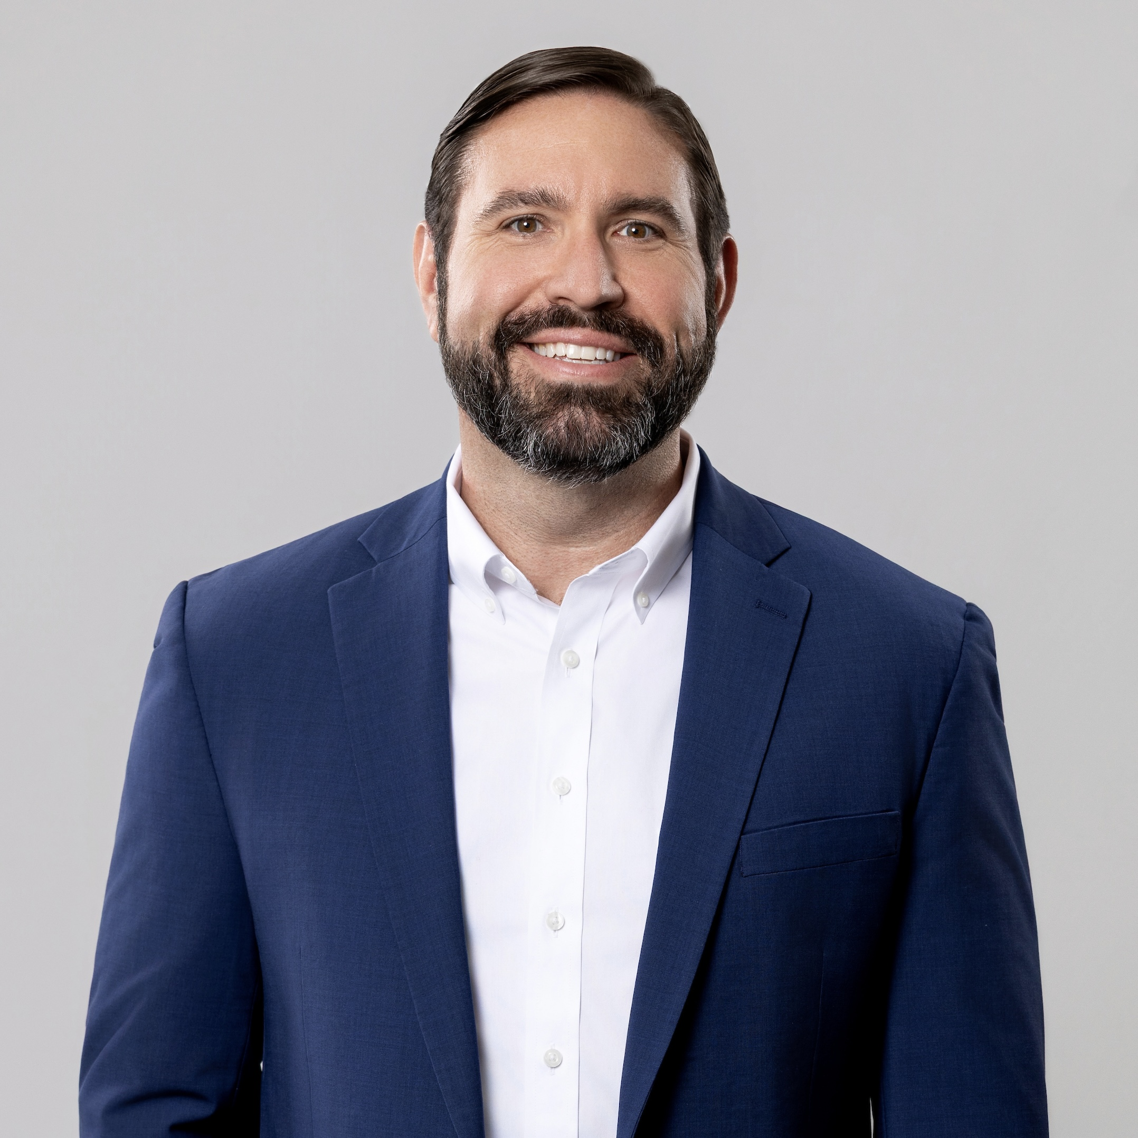
Ethics in Public Finance:
Trust, Controls, and the
Legal Consequences of
Small Compromises
Arkansas Government Finance Officers Association 48th Annual Conference
Blake Pennington
Senior Assistant City Attorney
City of Fayetteville, Arkansas
Notes:
Welcome everyone. Today's session covers ethics in public finance from a practical, legal standpoint. Not just as an abstract principle, but as something that has real consequences for the people in this room, for the organizations you serve, and for the public that depends on you.
The title is intentional. We're going to talk about trust and what it means to hold public resources on behalf of others. We're going to talk about the systems that protect honest people and catch dishonest ones. And we're going to talk about legal consequences because the gap between a small compromise and a criminal conviction is often shorter than people realize.
This is not a compliance lecture. It's a conversation about what it actually means to do this job well.

Slide 2
Agenda
Ethical Standards
Case Studies
Ethical Risk Areas & Real-World Scenarios
Practical Decision-Making
Notes:
Here's how we'll move through the session. We'll start with ethical standards and work toward practical tools you can use on Monday morning.
The case studies are real, the scenarios are real, and the legal consequences are real.
Feel free to ask questions or talk to each other as we go, especially if you’ve been in any of the situations we’re talking about.

Slide 3
Ethical Standards

Slide 4
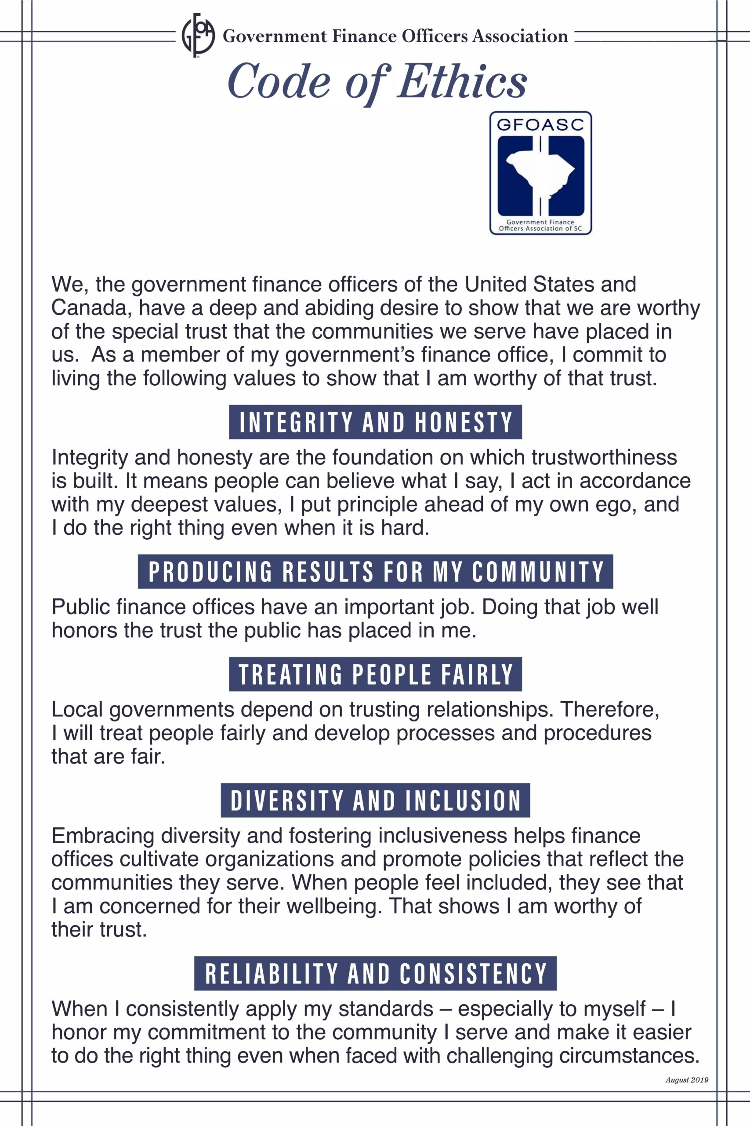
Why Do Ethics Matter?
Finance officers are stewards of public trust, not just recordkeepers. The GFOA Code of Ethics requires treating people fairly, producing reliable work, and preserving public trust.
Notes:
A lot of us view finance people as accountants, budget analysts, or just people who tell us there’s no money for a project we want. But the more accurate description is steward. You are holding public funds on behalf of the people in your community and you are responsible for protecting it.
Public money is not an abstract concept. You are responsible for safeguarding taxes paid by residents, fees collected from businesses, and grants awarded by state and federal agencies. When those funds are mismanaged , even if there is no bad intent, real services don't get delivered, real people are hurt, and real legal consequences follow.

Slide 5

Attorney’s Perspective
Ethical finance practices protect public funds, public confidence, elected officials and staff, the organization’s legal position, and individual careers.
Bad finance facts make bad legal facts.
Notes:
From a lawyer’s standpoint, the finance department is the place where a lot of liability either starts or could have been prevented. Contracts get signed by the Mayor or City Manager then you process POs, make wire transfers, and cut checks. Budgets are presented to the City Council or Board of Directors and the public. Each one of those is a legal document as much as it is a financial one.
When something goes wrong – whether it’s a misspent grant, a fraudulent payment, or a misrepresented budget - the question investigators ask isn't just what happened. It's who knew, when did they know it, and what did they do about it. Those of you in this room are almost certainly going to be in that chain.
The phrase "bad finance facts make bad legal facts" means this: the work you do and the paper trail you create becomes the evidence in any future dispute, audit, investigation, or prosecution. You are building the record every day so make sure it's one you'd be comfortable defending if you’re sitting in the witness chair.

Slide 6
GFOA Code of Ethics
INTEGRITY AND HONESTY
PRODUCING RESULTS FOR MY COMMUNITY
TREATING PEOPLE FAIRLY
DIVERSITY AND INCLUSION
RELIABILITY AND CONSISTENCY
Notes:
I took some time to review the GFOA Code of Ethics.
INTEGRITY AND HONESTY means you manage public resources transparently, avoid conflicts of interest, and provide complete and accurate information even when the truth is difficult or unpopular.
PRODUCING RESULTS FOR MY COMMUNITY means you maintain professional expertise, exercise sound judgment, and deliver high-quality work that advances your community’s long-term financial health.
TREATING PEOPLE FAIRLY means you apply policies consistently, respect the rights and concerns of others, and use decision-making processes that are objective, fact-based, and understandable.
DIVERSITY AND INCLUSION means you seek input from people who are going to be affected by financial decisions, recognize personal and institutional biases, and consider whether resources and services are accessible across the community.
RELIABILITY AND CONSISTENCY means you produce accurate and timely information, follow established financial policies, and meet commitments so officials, employees, and residents can depend on your department.
Public trust is built when ethical values are reflected consistently in our everyday decisions—not just when a major issue arises.

Slide 7
Case Studies: When Ethics Fail
Real consequences from real governments
Notes:
We're going to look at four real cases now. All of them have something to say about how ethical failures actually develop and what could have stopped them.
I want you to resist the temptation to think "that couldn't happen here." That’s probably what Dixon, Illinois and Homewood, Alabama thought. These are not unique failures – they’re patterns worth studying.

Slide 8

Case Study: Rita Crundwell
Where: Dixon, Illinois (Pop. 15,000)
When: 1991 - 2011
What: $53 million stolen
How: Secret bank account and total control over financial process
Notes:
Rita Crundwell was the comptroller and treasurer of Dixon, Illinois for more than two decades. She was trusted, respected, and had nearly unchecked control over the city's finances. That trust, combined with no meaningful oversight, allowed her to steal more than $53 million over 22 years.
She created a secret bank account in the City’s name. She transferred money from legitimate City accounts through another City fund and ultimately into the secret account that she alone controlled. She created 159 fictitious invoices to make the transfers appear legitimate. She used the money for horses (including a $225,000 horse named Pizzazzy Lady), vehicles (4 dozen trucks were found at the time of her arrest), real estate (horse farm and a vacation home in Florida), credit cards, and other personal expenses. Meanwhile the City was struggling to fund basic services.
In 1991, the first year (or the first year they discovered) she transferred just under $200,000 into that secret account. That increased to a high of $5.8 million in 2008 and to tell you just how much that meant to the City of Dixon, their entire budget in 2008 was $9.3 million. She stole on average $2.5 million a year over the course of her scheme.
She was caught in 2012 when a city clerk covering during Crundwell's vacation noticed an unusual bank account. The employee covering her duties requested statements for all City bank accounts and discovered the previously unknown account. The employee informed the mayor, who contacted law enforcement. She was sentenced to nearly 20 years in federal prison.
How did she get away with it for so long? Crundwell controlled virtually every part of the financial process. She could move the money, create the supporting documentation, explain the resulting budget shortfalls, and control access to the bank statements. She personally collected the City’s mail and separated statements for the secret account before other employees could see them. When departments experienced budget cuts, she blamed the economy and delayed state payments.

Slide 9

Case Study: Harriette Walters
Where: Washington, DC
When: 1989 - 2007
What: $48 million stolen
How: Fraudulent property tax refund scheme with family and friends
Notes:
The D.C. case is different because it wasn't just one person. Harriette Walters managed Washington DC’s real-property-tax refund process. She prepared 226 fraudulent refund vouchers and used her authority and knowledge of the process to guide them through approval. Refund checks were delivered to relatives, friends, and other conspirators, who deposited or cashed them and divided the proceeds with her. A bank employee was eventually recruited into the conspiracy. At the beginning of the scheme, Walters prepared individual fraudulent property tax refund vouchers that were in amounts just over $4,000.00. The amount Walters stole each year also generally increased, from just over $30,000 in 1989 to a high of $8.6 million in 2004.
How she was caught: She was caught when bank security officer became suspicious after Harriette’s niece deposited a D.C. government check into a business account but could not produce appropriate documentation. The bank froze the account and contacted the FBI, which traced the transaction back to Walters.
How did she get away with it? Walters understood where the controls were weak and had enough authority to shepherd fraudulent refunds through the system. This conspiracy also extended beyond the government office: relatives, friends, co-workers, and a banker helped move or conceal the proceeds. The fraudulent refunds began relatively small and grew over time, eventually exceeding $500,000 for a single voucher.
By the time it was discovered, more than $48 million had been stolen. Ultimately 11 people were sentenced in the case. Walters got 17.5 years. The others, who were her friends and family members received sentences ranging from 1 year to 9 years.
The lesson here is about normalization. The first fraudulent check is the most important moment. Everything after that is just scale. Ask yourself: are there things happening in your office that have become normal, but that wouldn't survive scrutiny from an outside set of eyes?

Slide 10
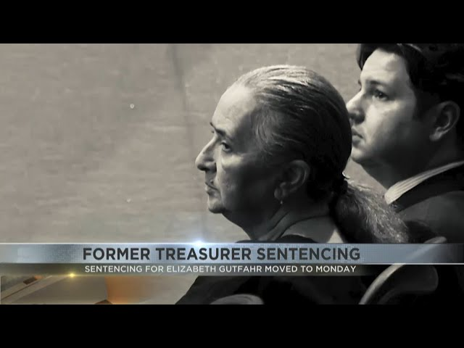
Case Study: Elizabeth Gutfahr
Where: Santa Cruz County, Arizona (Pop. 50,000)
When: 2014 - 2024
What: $39 million stolen
How: Secret bank accounts; failure to follow policies and internal controls
Notes:
Elizabeth Gutfahr took office as the Santa Cruz County Treasurer in 2012. Beginning in 2014, she wired public money to accounts held in the names of fake companies she had created. She then used the money for real estate, ranch renovations, a cattle business, and vehicles. She concealed the transfers by failing to record unauthorized wire transfers, and by falsifying accounting records, cash reconciliations, and investment reports.
This is another example of a scheme that started small and then grew. She made 2 wire transfers to her accounts in 2014 totaling $250,000. In the last year of the scheme that grew to 20 wire transfers totaling $10 million.
How was she caught? The bank’s anti-money-laundering team flagged the County’s account after $4.55 million was transferred to business accounts connected to Gutfahr. The alert finally provided information outside the records and reports she controlled.
How did she get away with it? The County technically had dual authorization for wire transfers, including separate passwords and multifactor-authentication tokens. But the chief deputy shared her password and token with Gutfahr after being told they were needed to move money to an investment earning a better interest rate. Gutfahr could therefore act as both the initiator and approver. The control existed on paper but had been completely neutralized in practice.
This was a total system failure, The Arizona Auditor General found that other county officials and employees failed to review cash reconciliation reports. When interviewed, members of the County Board of Supervisors said they didn’t know how county departments submitted reports, did not understand the purpose of those reports, and had not even seen the most recent cash reconciliation report.
The Auditor General also discovered that Gutfahr was providing loans and gifts to employees in her office. These kinds of things are designed to build loyalty and make it harder for subordinates to report bad acts.

Slide 11

Case Study: Robert Burgett
Where: Homewood, Alabama (Pop. 28,000)
When: 2023-2024
What: $1 million stolen
How: Secret bank account; total control over financial process; no oversight
Notes:
Robert Burgett, the former finance director of Homewood, Alabama pleaded guilty to wire fraud and was sentenced to federal prison for diverting nearly $1 million in city funds.
The details of every case like this are different, but the structure is the same: access, opportunity, and insufficient oversight. As finance director, Burgett ran Homewood’s Finance Department, had access to the City’s accounting records, possessed signatory authority over City bank accounts, and could initiate and execute electronic fund transfers.
Burgett transferred City money into an account held in the name of a business he controlled. That entity was not an authorized City vendor and had provided no goods or services to Homewood. He then moved most of the money from the business account into his personal bank account. He attempted to make the transfers look legitimate by using vague or misleading descriptions in Homewood’s accounting journals such as: “Health insurance payment” or “Contractual services”
The State of Alabama conducted a special review and identified several conditions that created the opportunity. The report’s executive summary was more than 5 pages long if that tells you anything. Basically, Homewood was a hot mess.
No oversight by the City Council or Mayor
Complete lack of internal controls over wire transfers
Bank reconciliations were not always performed promptly or at all.
Bank statements and reconciliations weren’t always kept in the City’s files.
The finance director was not consistently required to produce the monthly financial reports called for by City policy.
Burgett was the worst of the bunch, but the Department found that several employees had used city funds for personal expenses and were required to repay those amounts.

Slide 12
Ethical Risk Areas and
Real-World Scenarios

Slide 13
Common Ethical Risk Areas
Risk Area | Common Form | Red Flag | Control Needed
Vendor Relationships | Favoritism, gifts, kickbacks | Unusual awards | Bid process review
Purchasing Cards | Personal purchases | Unusual charges | Monthly reconciliation
Payroll & Overtime | Ghost employees, inflated OT | Unexplained increases | Supervisory approval
Budget Reporting | Soft misstatements | Numbers that shift | Independent review
Grant Compliance | Political pressure | Restriction violations | Expenditure tracking
Every government finance office faces these recurring risk areas. Awareness is the first line of defense.
If you recognize these in your own organization, that is where controls need attention.
Notes:
This table covers categories that come up most often in government finance audits, investigations, and prosecutions.
Vendor relationships are a common risk because they involve ongoing contact between finance staff and people who have a financial interest in your decisions. A gift or a holiday basket may create a dynamic that can compromise objectivity over time.
Purchasing cards are high-risk because they combine personal convenience with public funds. The line between a legitimate work expense and a personal one can feel blurry in the moment.
Payroll and overtime are attractive targets because the amounts are large and the detail is difficult to audit without dedicated effort. Ghost employees can happen but fudging time sheets is a lot easier.
Budget reporting risks are subtler. Presenting numbers in a way that's technically defensible but misleading can feel like ordinary communication. But presenting a rosier picture than the facts support is a form of dishonesty that creates serious legal exposure.
Grant compliance failures are particularly dangerous because they often trigger federal involvement. Restricted funds must be spent for their designated purpose. That is not a suggestion.

Slide 14
“Small Compromise” Scenarios
“Acme, Inc. always takes care of us at the holidays.”
“We already know who we want. This bid process is just a formality.”
“It’s always been done this way. Why would anyone ever question it?”
“The mayor really wants this done. Just make it work.”
Notes:
These scenarios are designed to sound familiar. Most of you have heard something like one of these and some of you may have said something like one of these, under pressure, without thinking through what it meant.
The vendor scenario: accepting regular gifts from a vendor isn't goodwill. It's a relationship that creates an obligation whether you feel it or not. At the very least, it creates an appearance of conflict that can undermine your credibility in any procurement decision involving that vendor.
The bid process scenario: if the outcome is predetermined, the process is a fraud. It exposes the government to legal challenge and puts anyone who participated in it at risk.
I know at least once in your career you’ve heard somebody say “we’ve always done it like this” even when the policy says that’s not how you do it.
The political pressure scenarios are some of the hardest. When a supervisor or elected official asks you to do something you're not comfortable with, the pressure to comply is real. We'll talk about how to handle that professionally.

Slide 15
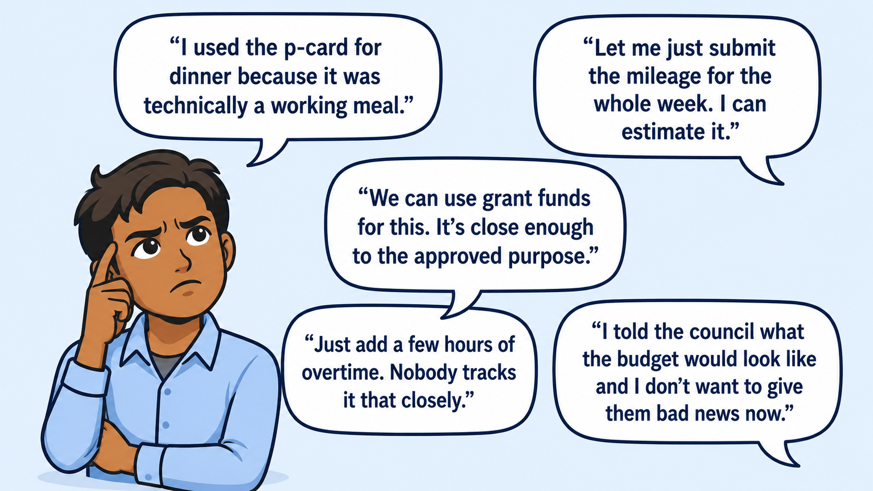
More Real-World Scenarios
Notes:
The mileage scenario: submitting estimated mileage without documentation isn't a minor shortcut. In a grant-funded context, it can be a federal false claims issue.
The grant funds scenario is one of the most consequential on this list. Federal grant restrictions are not flexible. "Close enough to the approved purpose" is not an acceptable standard. The consequences include repayment, debarment, and in serious cases, criminal exposure.
The overtime scenario connects to payroll risks discussed earlier. Even small informal adjustments to overtime records create audit exposure and can become patterns.
The budget scenario is about integrity in communication. Correcting a prior statement is almost always better than defending a misrepresentation.

Slide 16
Practical Decisionmaking

Slide 17

Ethics and Internal Controls
Control | Purpose | Protects Against
Segregation of Duties | No single person controls full transaction | Fraud, error
Independent Review | Outside set of eyes on work product | Bias, mistakes
Documentation | Written record of decisions | Gaps, disputes
Reconciliation | Matching records between systems | Discrepancies
Reporting Channels | Safe path to report concerns | Concealment
Notes:
Internal controls are not bureaucracy. They are the practical implementation of the ethical principles we've been discussing. They protect the organization, and they protect you personally.
Segregation of duties is the single most important control in a finance office. When one person can initiate, approve, and record a payment, fraud becomes possible without any external assistance.
Independent review catches errors and it catches manipulation.
Documentation is evidence. Contemporaneous notes made at the time of a decision are far more credible than after-the-fact explanations.
When accounts don't reconcile, something happened that needs explaining. Letting reconciliations slide is how discrepancies go undetected for months or years and cities end up with millions of dollars missing.
Reporting channels matter because people who see problems need a safe way to report them. If the only path is to confront a supervisor directly, most people won't take it.

Slide 18

Confidentiality vs. Transparency
Public Records:
  Budgets, financial statements, audit reports, most expenditures
Confidential Records:
  Personnel records, tax records, utility customer information, information that could harm competitive advantage
Key Rules
  Never use confidential information for personal or political advantage
  When in doubt, ask before disclosing
Notes:
We operate under open records laws that require significant transparency. At the same time, specific categories of information must be protected. Knowing which is which is a core competency.
The public has the right to see budgets, adopted financial statements, audit reports, most expenditures
What must stay confidential is specific: personnel records, tax records, utility customer information, and information that could harm competitive advantage. These protections exist for real reasons.
The most important rule on this slide is the last one: when in doubt, ask before disclosing. The consequences of an improper disclosure can include legal liability and individual discipline. The consequences of a brief delay to consult the City Attorney are almost never serious and we would much rather prevent an issue than deal with one after it’s blown up.

Slide 19
Confidentiality: Where It Becomes an Ethical Issue
Using non-public budget or contract data for personal gain
Sharing personnel information that should be kept private
Discussing pending bond issuances or major financial decisions with people who could benefit from that information
Responding to press or public records requests without legal review when the request touches sensitive categories
Notes:
These scenarios represent the ways confidentiality becomes an ethical and legal issue.
Using non-public information to benefit someone you know is a classic conflict of interest that also constitutes misuse of confidential information. This isn’t just an ethical issue; it’s against the law. Ark. Code Ann. § 21-8-304(a). Violation is a Class B misdemeanor in the State of Arkansas and can get you up to 90 days in jail and a $1,000 fine.
Most of us have an instinct to be helpful and answer somebody’s questions immediately. The answer "let me check before I respond" is not evasion. Improper disclosure can create liability so take the time to check with a supervisor or your legal department. The Arkansas Freedom of Information Act is a great tool to ensure transparency but there are also many exemptions and violations can lead to criminal charges.
Whistleblowing is an interesting issue. When you are in possession of confidential information that suggests wrongdoing, there is going to be a proper way to disclose that – whether it’s the Attorney General’s office or another state agency like Legislative Audit, using those channels is protected activity. Going to a reporter or posting about it on social media is not the same thing and won’t protect you the same way.

Slide 20

Objectivity Under Pressure
Finance staff often have to say difficult things:
  “No.”
  “Not that way.”
  “We need documentation.”
  “That may create an audit or legal issue.”
Professionalism means being helpful without becoming permissive.
Notes:
This slide is about one of the hardest parts of the job: being the person who says no, especially to people above you in the org chart.
Finance officers are not order-takers. Your professional and legal obligation is to provide accurate information, follow proper process, and flag problems. That’s true even when it's inconvenient and even when someone above you wants a different answer.
"No" is a complete sentence, but it's more effective with a professional explanation. "We can't do it that way because..." keeps the conversation open and positions you as a problem-solver rather than an obstacle.
The phrase "that may create an audit or legal issue" is professional and powerful. It shifts the frame from personal disagreement to institutional risk. Most elected officials are going to respond differently when they understand there are actual consequences.
Professionalism means you can be helpful without becoming a doormat. You can help someone accomplish a legitimate goal through a proper process. You shouldn’t help someone accomplish an improper goal by bending the rules.

Slide 21
Practical Ethical Decision-Making Test
Is it legal?
Is it authorized?
Is it documented?
Is it consistent with policy?
5. The Comfort Test
Would I be comfortable explaining this decision to:
      An auditor?
      Your legal department?
      A prosecutor or judge?
      A reporter?
      A taxpayer?
Notes:
This five-question test is something you can use when you're not sure about a decision. Walk through these questions before you act.
First, is it legal? Now, something can be legal and still be unethical. But if it's not legal, the analysis ends there.
Second, is it authorized? Does a resolution, ordinance, budget, or grant agreement actually allow this? Authorization is separate from legality because something can be legal in general but not authorized in your specific context.
Third, is it documented? If you can't point to a record of the decision and the basis for it, that's a problem.
Fourth, is it consistent with our internal policies? Your organization's own policies exist for reasons. Bypassing them even once creates exposure.
Fifth, the comfort test may be the most powerful. That list includes actual people who might eventually scrutinize this decision. If you're not comfortable with explaining your actions to any one of them, it’s time to stop and reconsider.

Slide 22
Professional Competence: The Duty to Know
Understanding the legal framework governing your organization
Staying current on applicable standards and best practices
Knowing the limits of your own knowledge and seeking expert help when a transaction exceeds your expertise
Keeping up with technology, cybersecurity risks, and financial software changes that affect your department
“I Didn’t Know” doesn’t cut it
Notes:
Professional competence isn’t just about credentials. It's about the ongoing obligation to know what you need to know to do your job properly and ask for help when you don’t.
The legal framework point is foundational. Government finance officers operate within a dense web of legal requirements: state statutes governing fund accounting, debt issuance, investment policy, and financial reporting. Don’t be afraid to call a lawyer.
You know much better than me what standards and best practices you should be following. Staying current is a continuous obligation, not something you satisfy once at the start of your career and hopefully that’s why you’re all at this conference.
Knowing when to ask for help is a competence, not a weakness. A person who plods through a complex transaction without the appropriate expertise (and without asking for help) is not being competent — they're being reckless.
"I didn't know" doesn’t cut it. In legal terms “ignorance of the law is no excuse.”

Slide 23
Due Diligence: What It Looks Like in Practice
Review documents before signing off. Don’t assume someone else checked
Verify that any banking changes are legitimate before processing
Reconcile accounts on a regular schedule
Read audit findings carefully and track management responses through to completion
Document the basis for significant financial decisions so the reasoning is clear if ever reviewed
Notes:
Due diligence is what professional competence looks like in practice, day to day.
In a busy office, the pressure to move quickly can lead to big problems. Approving a wire transfer or check request without proper backup or certifying a financial statement you haven't examined are not just ethical lapses. They are potentially serious legal liabilities.
Reconciliation discipline can catch discrepancies early. Reconciliations that are months behind allow problems to compound. Don’t just wait until audit season.
Audit findings are not necessarily the end of the world and they definitely aren’t the end of the story. It's the beginning of a management response and remediation process. Finance officers who treat findings as something to just acknowledge and forget rather than problems to fix are failing a basic due diligence obligation.
The standard isn’t perfection — it's the reasonable exercise of professional judgment. Turning a blind eye isn’t judgment. It's negligence.

Slide 24

Building an Ethical Culture
Encourage questions before problems become crises
Reward transparency; treat honest mistakes differently from concealment
Keep policies usable and current
Train supervisors across the city, not just finance staff
Document decisions as you go
Rotate duties and require vacation coverage to prevent over-reliance on one person
Notes:
Ethical culture is not created by a single policy or annual training. It is created by the everyday systems that make it easier for employees to ask questions, disclose mistakes, and make defensible decisions.
Encourage questions: We want employees to raise questions when something first feels unclear, not after a questionable transaction has already occurred or Legislative Audit is sniffing around. When I first started, my boss told me “You don’t have to tell me good news, but I need to hear any bad news immediately.”
Reward transparency: People are more likely to report mistakes when they believe they will be treated fairly. An employee who promptly discloses an accidental error should be treated differently from someone who hides the error, alters records, or repeats the conduct after being warned.
A policy is not effective if it just exists in a binder and isn’t actually used. It needs to reflect current operations, use language employees can understand, and provide practical guidance. Policies should also be reviewed periodically.
Many financial decisions begin somewhere else. Department directors approve purchases, authorize overtime, manage grants, and review time records. We have bond funds and impact fees that are restricted and the departments that manage bond projects need to know the rules.
Contemporaneous documentation is usually more accurate and more credible than an explanation reconstructed months later. A short email or note explaining who was consulted, what information was considered, and why the decision was made can be extremely valuable during an audit, records request, or later review.
When only one employee understands a process, that creates both an operational risk and an internal-control risk. The goal is not to suggest that employees are untrustworthy; it is to design a system that protects both the organization and the employee. This also helps create better trained employees and can help with succession planning.

Slide 25
Every receipt, report, reconciliation,
and recommendation is part of
the public’s trust.
BLAKE PENNINGTON
SENIOR ASSISTANT CITY ATTORNEY
CITY OF FAYETTEVILLE
PHONE: (479) 575-8312
bpennington@fayetteville-ar.gov
Notes:
We've covered a lot of ground today — ethics, controls, case studies, scenarios, confidentiality, and professional competence. But it all comes back to this.
Every financial transaction your office touches is part of the public record. Every reconciliation you complete or don't complete shapes the accuracy of that record. Every report you issue either does or doesn't reflect reality. Every recommendation you make either is or isn't independent.
When people lose trust in their government's finances (when they believe the books are cooked, contracts are rigged, or money is being taken) they lose trust in the institution itself. That's not easily recovered. And it starts with individual decisions made by individual people, often under pressure, often in moments that felt small at the time.
You are the stewards of that trust. The work you do matters far beyond the spreadsheets and the journal entries and the budget presentations. It matters because government works when people believe it works and you build that trust one transaction at a time.

