Slide 1
AGFOA
Federal Updates Impacting Governments and Finance Officers
A Federal Update
July 31, 2026

Slide 2

Notes:
As part of our ongoing commitment to advancing the public finance profession and supporting the professionals who make it thrive, I’m excited to announce an important change to the way we offer GFOA memberships. Starting in August 2025, we will be transitioning to a new membership model that will offer unlimited access for all members within most governments, all for a single annual price.
This change will ensure that every team member, from entry-level to experienced professionals, can access the full range of GFOA’s training, resources, and networking opportunities, without any additional fees or restrictions on the number of members you can include.
More Access for Everyone and Simplified Pricing with the same commitment to high quality resources.
in the big yellow box on that page is the form that they can share with their coworkers to activate their free memberships. The other boxes on that page link to join forms for non-members, in case you come across one
If anyone has any questions along the way, or want to check on their specific agency – you can come connect with me after this and I can direct you to our membership team, or you can email them directly at membership@gfoa.org.
We’re happy to help anyone that needs membership guidance and we at GFOA are all super excited for this new model to bring more government voices to the table to promote excellence and innovation in public finance.

Slide 3
U.S. Big Themes
President Trump Round 2

Slide 4
U.S. Big Themes
Shifting Federal Priorities
Just Say No to Regulations
A Skinny Administrative State
“Fend for Yourself” Federalism**
Frenetic International Relationships

Slide 5
Rescissions Rundown

Slide 6
“Leaked” Terminated Grants List
Environmental Justice Collaborative Problem-Solving Cooperative Agreement Program
Environmental and Climate Justice Block Grant Program
Environmental Justice Government-to-Government (EJG2G) Program
Financial Assistance For Community Support Activities To Address Environmental Justice Issues
Office of Buildings and Industry
Office of Sustainable Transportation and Fuels
Office of Renewable Energy

Slide 7
Education Funding at Risk
On June 30, the Trump administration announced an “impoundment” that withholds federal funding for education of up to $6.8 Billion Specifically:
Title I-C for migrant education ($375 million)
Title II-A for professional development ($2.2 billion)
Title III-A for English-learner services ($890 million)
Title IV-A for academic enrichment ($1.3 billion)
Title IV-B for before- and after-school programs ($1.4 billion)

Slide 8
Impoundment Control Act of 1974
Step 1: President withholds Congressionally appropriated funds
Step 2: President issues a “special message” (GAO)
Deferral – temp withholds funds not longer than FY
Rescission – cancels budget authority
Step 3: Congress agrees and has 45 days to pass a bill authorizing the rescission
Pauses disbursement from an agency
Stops an authorized appropriation
Congress can pass the bill or not pass the bill
An authorization can be in any passed legislation
Is it illegal for the President NOT to distribute Congressionally appropriated funds?
Impoundments have occurred throughout history for a variety of reasons: cost savings, policy disagreements, and changes in relevant circumstances

Slide 9
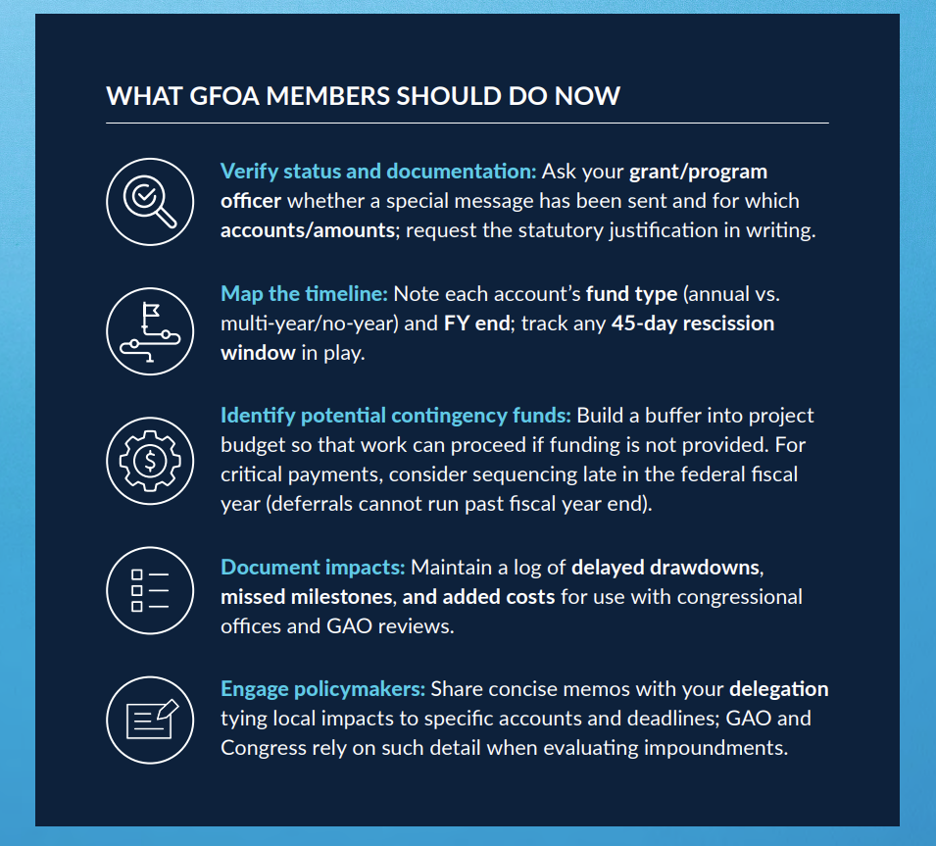
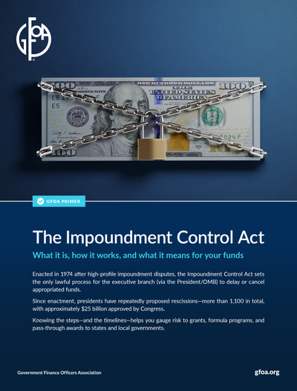
New Member Resource

Slide 10
Where Are We Going
OBBBA

Slide 11
Tax Bill: What did we end up with?
Provision | House Version | Senate Version | Enacted
State and Local Tax Deduction (Local) | $40K cap for tax filers | $40K cap temporary for filers | Temporary
Inflation Reduction Act (territories, states, local) | Phase out for investments in solar, other eligible | Phase out (faster) excise tax on solar and wind, “Foreign Entities of Concern” inserted | Faster phase-out and FEOC intact
Low Income Housing Tax Credit (LIHTC) (states, local) | More (temporary) flexible for States and Cities | More flexible but permanent | Permanent
Child Tax Credits (bona fide residents territories) | Temporary $2500/Child | Permanent $2000/Child | Permanent
Opportunity Zones (territories, states, local) | Extension | Extension | Extension
Medicaid (Territories, states) | Work Requirements, non-citizen tightening | Work requirements, non-citizen tightening, qualification | Senate
Municipal Securities | No change | No change PLUS Spaceports | Added use

Slide 12
One Big Beautiful Bill Act
2025
Jan. 1
Jul. 4
Jul. 4
Jul. 4
No tax on tips & overtime
SALT cap expansion
Child Tax Credit increase
Tax-exempt municipal bonds preserved
OZs made permanent in tax code
Clean energy foreign entity restriction applies to projects initiated in tax years after Jul. 4, 2025
New work requirements passed into law for SNAP
2027
2026
Jan. 1
Jan. 1
Jan. 1
Jan. 1
Deadline for states to implement Medicaid work requirements
Solar/wind credit phaseout and supply chain restrictions begin
Elimination of financial incentive for Medicaid expansion
Permanent expansion of LIHTC
2028
2029
2030
Oct. 1
Jan. 1
Jan. 1
Jan. 1
Cost-sharing for SNAP food benefits begin for states
Existing state-directed payment limits for Medicaid reduced by 10%
No tax on tips & overtime expires
SALT cap reverts to $10,000
Notes:
Timeline Overview

Slide 13
DISCLAIMER: EMPLOYERS HAVE REPORTING RELIEF IN 2025
On November 5, the IRS announced relief for employers in reporting qualified overtime compensation on official tax statements (Notice 2025-62), like Form W-2
Employers may still choose to provide employees with estimates of qualified overtime pay this year, but this is optional and at the discretion of the employer in tax year/calendar year 2025
IRS Notice 2025-69 provides options for employees to calculate the deduction based on the type of overtime they receive
Employers will be required to provide employees with statements beginning in tax year 2026
Notes:
EMILY – 3 minutes
REASONS FOR RELIEF:
IRS announced in August that there would be no changes to forms W2 or 1099 for 2025, meaning there is nowhere to report qualified overtime compensation (QUALIFIED OVERTIME COMP IS DIFFERENT THAN OVERTIME COMP – we will get into this) separate from total overtime
This deduction is retroactive to tax year 2025- with guidance released in late November this would have only given employers 2 months to calculate qualified overtime for employees before tax forms have to be filed on January 31

Slide 14
IRS Guidance
August 7, 2025
IRS announces no changes to W-2 and 1099 in 2025
November 21, 2025
IRS publishes guidance on the deduction for tax year 2025
July 4, 2025
H.R. 1 signed into law, establishing deduction
November 5, 2025
IRS announces transition relief for employers in 2025
Tax Years 2026 – 2028
IRS will provide updated W-2 and 1099 forms and instructions for employers reporting qualified overtime compensation
Notes:
PAIGE – 2 minutes
WHERE ARE WE? What has happened? What is to come?

Slide 15
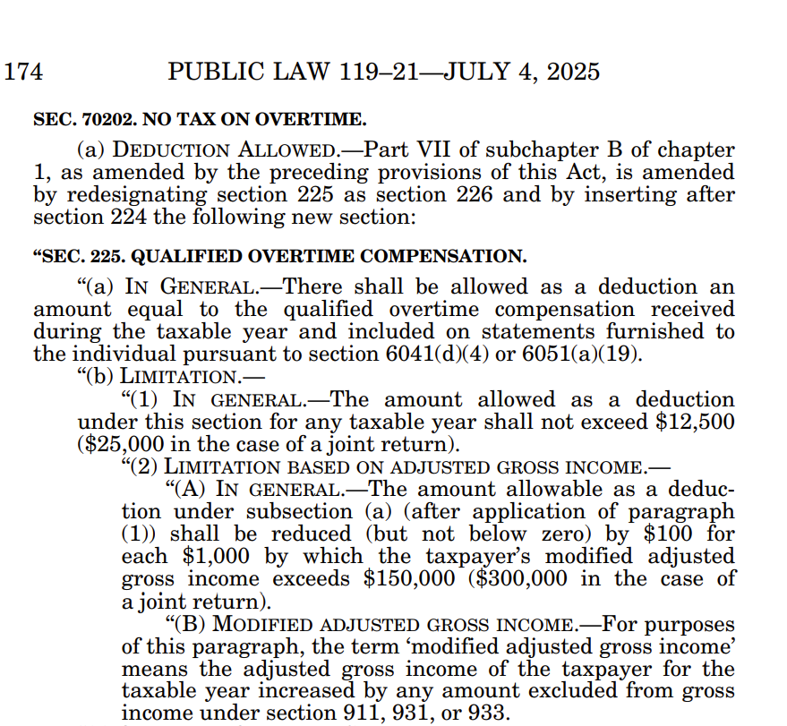
Section 70202 of H.R. 1
Section 70202 of H.R. 1 amended IRC §225 to allow individual taxpayers to deduct qualified overtime compensation from their taxable income
  Above-the-line deduction
  Retroactive to tax year 2025, expires in 2028
Individual taxpayers can deduct up to $12,500 in qualified overtime compensation from federally taxable income
  For joint filers, the limit is $25,000
The deduction phases out at $100 per $1,000 of income in over $150,000 in modified adjusted gross income
  For joint filers, the deduction phases out at $300,000 MAGI
  Ex.) An individual with a MAGI of $200,000 in 2025 would be able to deduct $7,500 this year
Notes:
PAIGE – 3 minutes
- Congress could look to extend the deduction in 2028 but Cost $89.6 billion/10 years

Slide 16
Qualified Overtime Compensation
KEY DEFINITIONS
Qualified Overtime Compensation
“overtime compensation paid to an individual required under section 7 of the Fair Labor Standards Act of 1938 that is in excess of the regular rate at which such individual is employed”
“Overtime Premium”
The amount of overtime pay that exceed regular pay (i.e. the half portion of time-and-a-half)
Taxpayers can only deduct the overtime compensation that exceeds their regular pay and is required by section 7 of the Fair Labor Standards Act (FLSA) – this means only FLSA-covered, non-exempt employees can claim the deduction
Overtime or premium pay for certain work that is required by state law but is not covered/ineligible to be covered by FLSA is NOT ELIGBLE FOR DEDUCTION
For state and local government employees, FLSA generally requires at least 1.5x regular rate of pay for any hours over 40 per week
Only the “half” portion of time-and-a-half pay is eligible to be deducted
Ex.) Employee A earns $30/hour in regular wages and $45/hour time-and-a-half. Only the FLSA-covered overtime amount of $15 is deductible “overtime premium”
Notes:
EMILY - 5 minutes
However, some FLSA-ineligible employees are eligible for overtime under State law or are paid premium rates for certain work for other reasons. Overtime compensation paid to FLSA-ineligible employees is not qualified overtime compensation within the meaning of section 225(c) with respect to such employment, regardless of applicable State law provisions or other circumstances causing these amounts to be paid.
Consequently, individuals who are not furnished a separate accounting of qualified overtime compensation in box 14 of Form W-2 (or on a separate statement) must make a reasonable effort to determine whether they are considered FLSA-eligible employees, which may include asking their employers or other service recipients about their status under the FLSA

Slide 17
Qualified Overtime Compensation – Alternate FLSA
Only FLSA-covered overtime is qualified, but this includes alternate FLSA structures authorized by 29 USC § 207
State and local government employees: FLSA allows certain state and local government employees to receive compensatory time instead of cash overtime payments (§207(o))
Compensatory time overtime is earned at a rate of 1.5x hours for each hour worked eligible for overtime payment (dependent on work period structure)
Compensatory time is not limited to 40-hour work week structures and public safety employees are eligible
Public safety employees (police and firefighters): FLSA allows for 1.5x overtime to be calculated based on work periods of at least 7 days but less than 28 (§207(k))
Overtime is due to when hours of numbers work bear same relationship to 212 (fire) or 171 (police) as the number of days in the work period bears to 28
  Ex.) Overtime is due after 106 hours worked in a 14-day workweek for fire fighters and 86 hours during a 14-day work period for police
Hospitals and residential care workers: FLSA allows for 1.5x overtime to be calculated based on the “8/80” system that uses work periods of 14 consecutive days (§207(j))
Overtime is due under the 8/80 system for hours that exceed 8 hours/day and 80 hours/14 days
Non-discretionary bonuses and shift differentials are included in the rate of regular pay
Notes:
PAIGE – 5 minutes

Slide 18
Method G – Alternate FLSA Overtime
Method G (IRS No. 2025-69, page 25) outlines how qualified, alternate FLSA-covered overtime compensation can be calculated in 2025.
Identify which alternate FLSA rule applies (i.e. 207(k), 207 (j), 207(o))
Determine total FLSA overtime hours using the relevant threshold
  Fire & Law Enforcement (207(k)): 7 to 28 day work periods
  Hospital & Residential Care workers (207(j)): 8/80 rule
  State & Local Compensatory Time: dependent on employee
Find or reconstruct overtime pay using information on employer provided pay stubs using applicable reasonable method
  If pay stub shows “FLSA overtime premium”: use it (Method A)
  If only combined overtime wages are shown: divide by 3 (Method B)
  If overtime is paid at double and the “premium” is listed: divide by 2 (Method C)
  If overtime is paid at double time: divide combined amount by 4 (Method D)
Determine the FLSA overtime premium (this is always the extra ½ of the time-and-a-half overtime rate required by law)
Compensatory Time
Government employees who earn compensatory time may only deduct the comp time if it is paid out as wages and appears on their W-2.
Compensatory time is deductible in the year it is paid, not the year it is earned.
Earning comp time = not deductible
Getting paid out for comp time in wages later = deductible
Notes:
Paige – 5 minutes

Slide 19
Reporting Requirements
The Law
In Practice (2026-2028)
  H.R. 1 requires employers to:
    Report qualified overtime compensation on appropriate tax forms like the employees' W2
    Furnish employees with statements separately accounting for qualified overtime compensation
  H.R. 1 allows the Secretary of Treasury to provide employers with transition relief as it relates to these reporting requirements
    The IRS announced reporting relief for employers on 11/5
  Many state and local governments provide overtime that is much generous than what is required by FLSA, or compensatory time
    Only the overtime up to what FLSA requires is eligible to be deducted, meaning employers will have to calculate FLSA-covered overtime premium separately to be reported on official tax forms
    REMEMBER: the IRS provided transitional relief in reporting for employers in 2025, meaning this calculation is optional this year
If employers choose to report the amount of qualified overtime in 2025, you may do so using Box 14 of Form W-2
Employers MUST report the amount of qualified overtime in 2026, you use Box 12 "TT" of Form W-2
Notes:
EMILY – 8 minutes

Slide 20
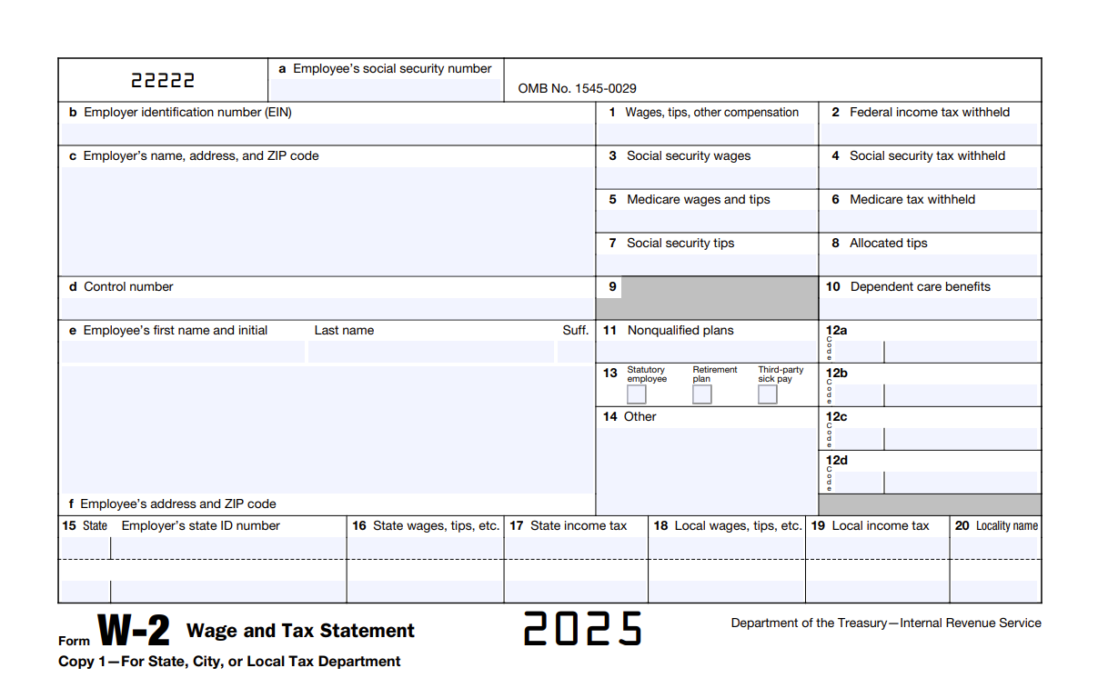
Notes:
EMILY – 1 minute
Just a visualization of Box 14 – where to report for 2025 if employers choose to

Slide 21
ARPA
Desk Reviews Begin

Slide 22
ARPA Desk Reviews Begin: REMEMBER
Dust off your Policies and Procedures that prevent Fraud, Waste and Abuse
All expenditures are subject to Audit (local, state or federal)
Document retention requirements – 5 years after last reporting period
To issue payments to individuals/businesses, most (if not all) are required to have master data to payee: W-9, TIN, etc.
Subrecipients are required to comply with the same rules as their prime recipients

Slide 23
ARPA: GFOA/NACo/NLC Closeout Guidance
Key Deadlines remaining
  September 30, 2026: deadline to expend and liquidate all surface transportation and Title I Funds
  December 31, 2026: deadline to expend and liquidate all SLFRF Funds
Guidance link https://gfoa-craftcms.files.svdcdn.com/production/general/Rollout-of-ARPA-Closeout.pdf?dm=1783536271

Slide 24
GFOA/NACo/NLC Closeout Guidance
Example of liquidated:
  Contractor submits invoice on November 30, 2026.
  Government processes payment on December 15, 2026.
  Payment clears the bank on December 18, 2026.
Example not liquidated:
Invoice received December 20, 2026.
Check issued January 5, 2027.
❌ Not liquidated by December 31, 2026

Slide 25
STEP 1 Stay on Top of Reporting Requirements
▪ Continue submitting Project & Expenditure (P&E) reports, either annually or quarterly, until Treasury formally completes closeout for your award. For many recipients, reporting may continue through April 30, 2027, unless Treasury initiates early closeout.
▪ For more information on how to report or solve common issues, see https://www.nlc.org/article/2026/02/09/faqs-meeting-the-2026-arpa-slfrf-reporting-deadline/

Slide 26
STEP 2 Prepare Payments for Liquidation
▪ Only expenditures that are administrative in nature and are related to the closeout of the award may be liquidated by April 30, 2027 (120 calendar days after the end of the period of performance). See Treasury’s FAQ 14.6 for more information
▪ Establish burn rate for projects to ensure spending remains on track. Conduct frequent reconciliations, internal monitor meetings, and check ins (no less than monthly) to track progress and burn rates
▪ Check on outstanding projects and subawards
▪ Ensure funds are spent in accordance with federal and state requirements

Slide 27
GFOA/NACo/NLC Closeout Guidance
STEP 3 Be Invited to Closeout
Recipients that have fully expended SLFRF funds, completed all required reports, and maintained an active SAM.gov account may be invited to close out on a rolling basis via email from SLFRF@Treasury.gov
  Treasury has indicated that having an active SAM.gov registration is a condition precedent to receiving an invitation to close out. In the meantime, keep your SAM.gov registration active, ensure points of contact are accurate in the Treasury Portal, and review Treasury’s Closeout How To Guide and Checklist
  Once Treasury enables closeout access in the Treasury Portal, invited recipients may begin the process through the “Closeout Reports” section and complete the required closeout certification

Slide 28
GFOA/NACo/NLC Closeout Guidance
STEP 4 Prepare for Desk Review
Identify policies and procedures that seek to prevent fraud, waste and abuse that your organization maintains
Prepare all agencies and subrecipients up front by distributing your entity’s award letter, eligible expenditures, and submitted program reports to support a coordinated approach to information gathering and closeout preparation
Prepare payee information and ensure all documentation related to obligations and expenditures is organized
Recipients should maintain records in accordance with federal record retention requirements and be prepared for audits or desk reviews after closeout. Retain copies of contracts and agreements for five years after closeout
Record (print or image) and store each periodic report submitted to federal agencies for easy recall; build a file storage and retrieval SOP before closeout that mirrors your P&E reporting structure so any record can be pulled within a committed timeframe
For those prime recipients that reclassified either their own spend or a subrecipients spend, maintain a funds reclassification log.

Slide 29
Understanding the Proposed Changes to 2 CFR 200
What the OMB Uniform Guidance Proposed Rule Means
GFOA Federal Liaison Center
Notes:
Good Morning

Slide 30
FIND MORE ON THIS HERE
Regulation for Federal Financial Assistance

Slide 31
What is Uniform Guidance?
aka Uniform Grants Guidance aka UGG aka 2 CFR Part 200
Established in 2014​
Combines “circulars” with directives on federal government spend​
Significant re-writes in October 2020 and October 2024​​
Congress Appropriates
Establishes Legislative Intent
Agencies Organize
Design Reporting Requirements
Define How to Report
OMB Oversees
Uniform Grants Guidance
Guidelines for Audits
Notes:
The federal uniform guidance found at 2 CFR 200 (also referred to as Uniform Grants Guidance or UGG) was established in 2014 to consolidate federal grants management and combined "circulars" with directives on federal government spending into a single, comprehensive framework. In other words, the federal uniform guidance outlines how the federal government expects federal funds to be managed and expended. The uniform guidance was updated in October 2020 and October 2024, however this proposed rule currently under consideration is one of the more significant re-writes of the UGG.

Slide 32
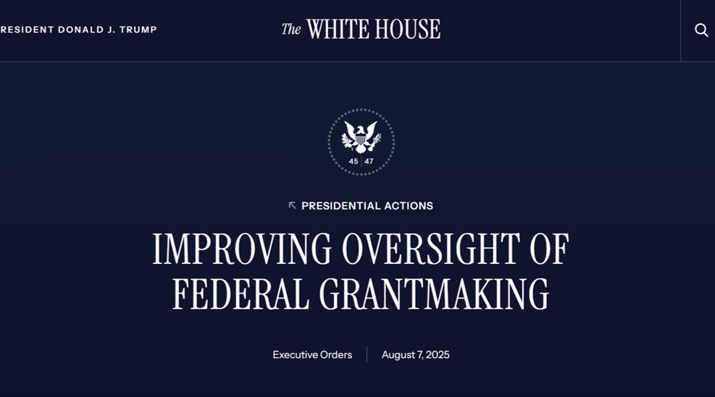
Is This New? No, Not Really.
"There is a strong need to strengthen oversight and coordination of, and to streamline, agency grantmaking to address these problems, prevent them from recurring, and ensure greater accountability for use of public funds more broadly. The Government holds tax revenue in trust for the American people, and agencies should treat it accordingly"
Executive Order on Improving Oversight of Federal Grant Making
Notes:
​These changes that have been proposed by the OMB and across federal agencies were not unexpected
​
On August 7 of last year, the White House distributed an executive order addressing oversight of agency grantmaking. The EO articulated many of the key principles that we are seeing today. ​
​
Only now, it's specific, official rulemaking and has a stated implementation goal of October 1, 2026 – yes, you heard that right – implementation in four months.
Billions allocated to state and local governments to satisfy the legislative intent – UGG provides an audit (aka Single Audit)​
S/L Have Responsive Systems of Internal Controls in place​ to manage federal awards and remain in compliance with federal requirements. The changes represent a significant expansion of federal government oversight in federal grant making.
Historically, grants management focused on three things: program performance, financial accountability, and compliance. The proposed rule suggests federal agencies may increasingly focus on national policy priorities, workforce verification, recipient eligibility, reputational concerns, and real-time monitoring. Grants management is expanding beyond finance and compliance into risk management and governance.

Slide 33
Proposed Rewrite of Uniform Guidance
The proposed rewrite of 2 CFR 200 represents the most significant overhaul of federal grants administration since the original Uniform Guidance was implemented. Read OMB’s proposed rule here
Potential Impacts
Expanded termination authority
New stop-work authority
Increased payment verification
E-Verify requirements
Enhanced subrecipient oversight
Greater federal discretion
Increased compliance burden

Slide 34
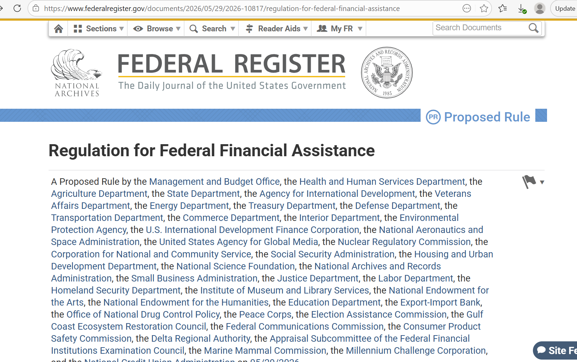
Four Broad Sections
Administrative Changes
Pre-Award Rules
Grant Administration (post-award) Rules
Audit
Notes:
For simplicity, we've grouped the proposed changes into four categories: administrative changes, pre-award requirements, post-award administration, and audit impacts. We'll walk through each area and discuss not only what's changing but what questions recipients should be asking today. ​
​
There are many great summaries of the proposed rewrites already available so we are not going to try and go into every item but highlight the most significant items.

Slide 35
1. Administrative Changes
KEY CHANGE: Uniform Guidance Becomes Regulation
Current Environment
Agency implementation varies
Guidance often subject to interpretation
Proposed Environment
OMB rules automatically apply government-wide
Agencies no longer separately adopt changes
RISK - Less flexibility and more direct federal control
Notes:
The first administrative change is that Uniform Guidance becomes regulation. This is a foundational change that will impact how these grants are administered government wide.
Historically, agencies had to separately adopt certain Uniform Guidance updates. Under the proposal, Uniform Guidance changes would automatically apply government-wide. That means less variation between agencies but also less flexibility. For recipients, this could result in faster implementation of future changes and fewer opportunities for agency-specific interpretation. This means that the proposed implementation date of October 1st is a very real milestone to be preparing for. We have heard from agency sources that they are already working on implementation plans including re-writes of their own agency grant policies and procedures.

Slide 36
1. Administrative Changes
KEY CHANGE: Discretionary Terminations
Federal agencies could terminate awards on a discretionary basis if:
Not achieving program goals
Not supporting agency priorities
No longer in the federal government's interest
Questions Recipients Should Ask:
How will priorities be measured?
Can priorities change mid-award?
How should recipients manage this risk?
Notes:
The next administrative change has to do with termination language. This proposal significantly expands agency authority to terminate awards. Traditionally, termination was tied to noncompliance or performance issues. The proposed language introduces broader concepts like agency priorities and the national interest. The challenge for recipients is understanding how those terms will be defined and whether priorities could shift during a multi-year award.

Slide 37
1. Administrative Changes
KEY CHANGE: Senior Level Appointee
Senior Level Appointee
Ensures thorough pre-issuance reviews
Use independent judgement when evaluating Federal award proposals
Deploys peer review as applicable to ensure advisory recommendations
Implementing Executive Orders in Grant Requirements
Diversity, Equity, Inclusion, and Accessibility (DEIA)
Gender ideology
Disparate impact liability
Faith-based organization protections
Immigration and workforce verification requirements
National policy priorities
Notes:
Finally, this slide reflects the increasing integration of executive branch priorities into grants administration. The proposal formalizes senior-level review of awards and incorporates several policy areas directly into the grant review process. Recipients should recognize that grant administration may increasingly intersect with broader policy objectives. ​
​
Additionally the proposed rewrite calls for the incorporation of Presidential Executive Orders in the Uniform Guidance. Without commenting on the merits of the Eos themselves, this is concerning that they are being incorporated into wide reaching federal regulations. We know that national priorities shift greatly between administrations, especially between political parties, and adding these Eos to regulations would make amending these priorities much more difficult for future administrations

Slide 38
2. Pre-Award Changes
KEY CHANGE: Changes to NOFOs
Streamlining Processes
Agencies must post NOFOs on grants.gov
Applications through grants.gov
Executive summary with key eligibility information & dates on grants.gov
Encourages statement of interest (SOI) pre-application phases in certain cases
Improving Access
Plain language requirements
Minimum posting period of 30 days
Green lights pre-grant technical assistance
Notes:
NOFOs are a fundamental part of getting the word out – and Government Finance Officers have long supported streamlining and using plain language to enhance the number of potential applicants for competitive grants. ​
​
Many of us know that some public entites have struggled to navigate a fragmented framework with different terms, timelines and submission expectations. This proposed changes to the NOFO process take a step closer to information access for entities – diving closer in to this proposal may reveal assistance that has long been warranted...and commenters may want to acknowledge how any proposed change to improve and streamline the grant application process. ​

Slide 39
2. Pre-Award Changes
KEY CHANGE: Pre-Award Risk Reviews
New Merit & Expanded Risk Reviews
Merit reviews
  Factors related to: President’s national priorities, “unlawful DEI”
Risk reviews
  Adds to the list: membership and affiliations, questionable practices
Do Not Pay system for States & eVerify for all
Questions Recipients Should Ask:
Will evaluation criteria be defined?
Will agencies provide a list of practices or organizations that raise risk?
Will factors and risks be weighed equally?
Notes:
​
​
A pre-screening stage may lower the upfront burden on applicants by allowing them to submit a shorter preliminary concept before investing resources in a full proposal, which could ultimately improve access for communities with limited administrative capacity. However, it also creates an additional gatekeeping step, and if evaluation criteria are not clearly defined, applicants may have little transparency into why they were or were not invited to submit a full application​
​
A brief description of the merit review process is included in the NOFO template found in Appendix I – but we are left with little detail about the evaluation criteria. ​
​
What we do know from the proposal is that the evaluations will include references to "questionable practices, memberships, affiliations, and other publicly accessible information" - it may be useful for us to know – what do these terms mean? Can we see a list? And how will the factors be weighted.​
​
We mention on this slide expanded requirement for States to utilize Do No Pay and for everyone eVerify - Additional pre-award review requirements, combined with the potential administrative conditions like confirming payee eligibility on Do Not Pay for states and eVerify for all recipients, may increase the administrative cost of participation before funds are even awarded. For some local governments, particularly those pursuing smaller grants, that added burden may alter the cost-benefit analysis of whether seeking federal support remains worthwhile

Slide 40
3. Grant Administration
KEY CHANGE: Subrecipient Monitoring
New monitoring requirements include:
All down-stream entities must be subaward or contract
  Applies to internal transfers to related entities
All subawards and contracts must be logged in SAM.gov
  Failure is grounds for termination for non-compliance
Ensure activities do not cause “reputational harm” to recipient or federal agency
Federal agency could terminate award to recipient based on subrecipient actions
Questions Recipients Should Ask:
How will transfers between government departments be treated?
How does OMB define reputational harm?
Will there be opportunities to correct SAM.gov reporting?
Notes:
Moving on to general framework issue #3 – grants administration...​
​
Having subrecipients isn't new – requirements for monitoring subrecipients spend is not new. GFOA has a few best practices on how best to do that. But this proposal would ​
​
A fundamental change is that this proposal requires FORMAL designation of all down-stream entites as a subaward or a contract. Misclassification could trigger SAM.gov reporting deficiencis and would form a basis for termination. ​
​
There's also a NEW provision that also would require pass-through entities to ensure subrecipients do not “significantly damage the reputation” of the pass-through entity, funding agency, or the U.S. government, but fails to specify any example of such reputational damage. Federal agencies would be required to monitor pass-through entities’ compliance with such subaward monitoring and management tasks and to take corrective action against pass-through entities as necessary, thereby increasing enforcement risk. ​
​
GFOA is seeking clarification on a number of items in here including

Slide 41
3. Grant Administration
KEY CHANGE: New Documentation Layers
Payment Justifications
Required for recipients and subrecipients other than states
  Applicable to advance payments & reimbursements
Recipients submit justification to agency
Subrecipients submit justification to recipient/pass-thru entity
Questions Recipients Should Ask:
Will there be limits to length and contents of justification?
Would OMB consider a phase-in?
Will recipients be expected to implement before federal agencies?
Notes:
The proposed rule requires payment justifications accompanied by brief written justifications be submitted by recipients to federal agencies and by subrecipients to the pass-through entities to receive federal payments from. The proposed rule specifically mentions these written justifications should be brief but mentions that they must include information on all activities of the federal award that corresponds to the payment request including project milestones, project activities, administrative activities and other requirements that must be completed under the award. Given the nature of projects funded by federal grants and federal grant compliance, there is a world where these written justifications could become lengthy.​
​
When multiplied across hundreds to thousands of awards, subawards, and contracts across the federal grant landscape, the administrative burden could become significant for all entities involved and federal fund delivery could be significantly delayed.​
​
Does OMB plan to direct federal agencies to place limits around the length and content of these written justifications to streamline and simplify efforts for the federal agency, grant recipients and pass-through entities, and subrecipients and contractors?

Slide 42
3. Grant Administration
KEY CHANGE: New Cost Restrictions
Added cost principles related to:
Advertising and public relations
Conferences
Memberships, subscriptions and professional activity costs
General cost of government outside of specified grant activities
Questions Recipients Should Ask:
How clear will the delineation between grant activities and general government activities be?
Will OMB or federal agencies provide further guidance specific to grant programs?
Notes:
​
​
While we appreciate that the proposed rule provides categorical exclusions from these restrictions when they are specifically allowed by statute or expressly permitted by the awarding federal agency, unclear cost restrictions add significant risk for grant recipients to fall out of compliance when expending federal funds.​
​
Of most concern to government finance officers is the new cost restriction related to the general cost of government, including costs related to the “general activities of the executive, legislative or judicial branches of government” and including costs related to the “general activities related to public safety, public information, citizenship, enrollment, or taxation that are not related to a specific Federal award.” Additionally, because state and local governments pursue and accept federal funds to implement programs they are authorized by law to carry out, practically any federal grant award carried out by a state and local government could be considered related to the general costs of government.

Slide 43
4. Audit and Update Frequency
KEY CHANGE: No Longer Annual Update
Anticipated Audit Impacts
No change to Single Audit but under review
Less frequent guidance for single audit process (§ 200.513)
  High risk programs
  Compliance factors
Questions Recipients Should Ask:
What occasions would trigger a compliance supplement update?
Will 2026 compliance supplement remain in effect until a new update is released?
Notes:
I just walked through the real meat of the proposed changes and how they will impact the grants management lifecycle. While there are no major changes to Single Audit requirements in this proposal, the audit environment continues to evolve. One area to watch is the Compliance Supplement. Less frequent updates may create uncertainty about current audit expectations, especially during periods of significant regulatory change and new program creation – think the recent COVID funding and the need for compliance supplement addendums.​

Slide 44




































Public Finance Network

