Slide 1



Internal Revenue Compliance and Tax-Exempt Bonds
Presented by:
John Albritton, Landmark
Michele Allgood, Mitchell Williams
Ryan Bowman, Friday, Eldredge and Clark
Jason Holsclaw, Stephens Inc.
48th Annual Conference • Rogers, Arkansas • July 2026

Slide 2
Discussion topics
1 | Municipal Bonds Overview
2 | What is Arbitrage Rebate?
3 | What is Private Business Use?
4 | Other Tax and Securities Considerations

Slide 3
What are Municipal Bonds?
A debt Instrument or “a loan” where an investor lends money to a corporation or public entity
Major categories of bonds include:
  Corporate Bonds
  Municipal Bonds
  U.S. Treasuries, notes, and bills
3

Slide 4
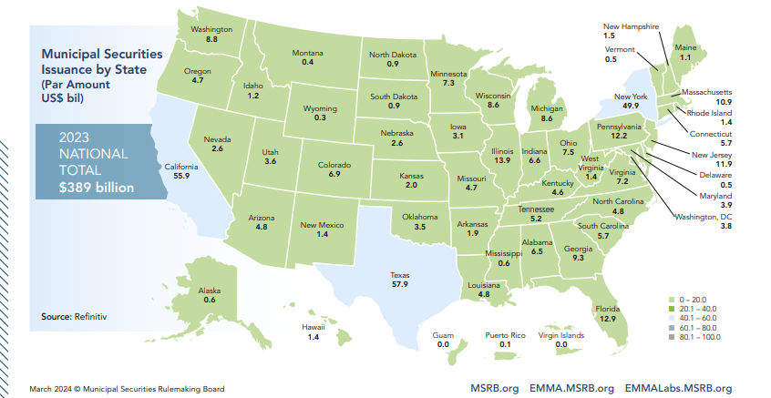
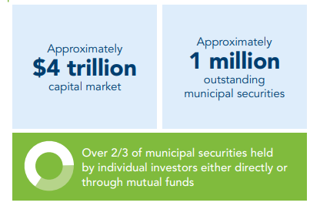
What are Municipal Bonds?
Municipal bonds may be generally classified according to their tax status:
Tax-Exempt Bonds. Interest paid to investors is exempt from federal income tax; which typically provide a lower cost of capital.
Taxable Bonds. Interest paid to investors is subject to federal taxes.
Facts about the municipal bond market
4

Slide 5
Bond Structure and pricing
Coupons. The rate assigned to a “bond.”
Yields. The return to the investor on a bond if held to maturity.
“Pricing of Bonds” – the relationship between the coupon and yield determines the bond price to the investor.
Coupon = Yield | Coupon > Yield | Coupon < Yield
Par Bond (Price = 100%) | Premium Bond (Price > 100%) | Discount Bond (Price < 100%)
5

Slide 6
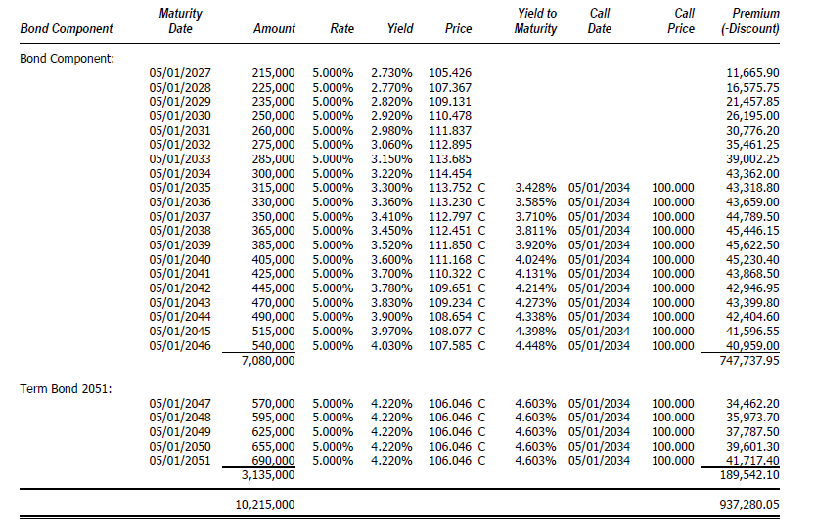
Bond Structure and pricing
6

Slide 7






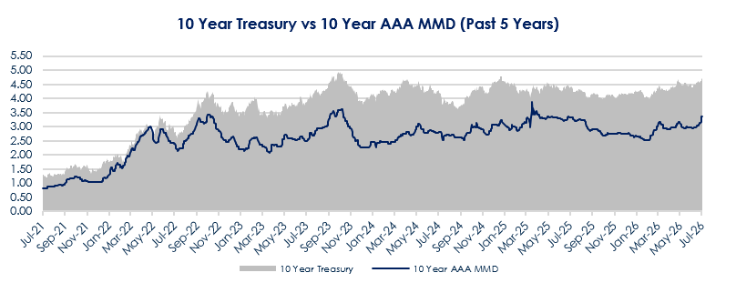
What factors Influence the Cost of capital?
Bond Structure ($ Amt., size)
Credit Quality
Supply of Municipal Bonds
Investor Demand
Overall Market Conditions
Tax Status (TE v Taxable)
7

Slide 8
Decision TREE FOR Financing Capital projects
KEY FACTORS IN STRUCTURING
Sizing of the Debt Issuance
Cost of Funds
Amortization
Use of Proceeds
Flexibility/
Optionality
Risk Appetite
How will this impact rating & operations
Structuring considerations for minimal interest expense
How will new debt factor into shape of portfolio?
Private Use Needs?
Reporting Requirements
Certainty around debt service payments
Call Features
Taxable
Tax-Exempt
Any anticipated uses of reserve funds?
Any other risks introduced by debt structure?
What is useful life of facility?

Slide 9
Benefit of Tax-Exemption
Tax-exemption is valuable in the current market
Tax-Exempt vs Taxable Yields
~ 1.0%
~ 1.5%
Source: Bloomberg and PFM Pricing Group
For illustrative purposes only.

Slide 10
Bond Proceeds Investment Considerations
Gross vs Net Funding
  Net funding will help to lower financing costs, particularly in a higher interest rate environment.
Asset-liability Matching
  As a best practice, the Government Finance Officers Association (GFOA) recommends cash flow requirements are matched with investment maturities.¹
Reinvestment Risk
  Money market funds and local government investment pools provide variable rates of return that may drop substantially if interest rates trend lower.
Budgetary Certainty
  Purchasing a portfolio of securities locks in earnings over an extended period of time.
Arbitrage Rebate and Yield Restriction
  Consider IRS rules regarding spending exceptions to arbitrage rebate, temporary periods, blending across different funds, and other factors that may impact retainable earnings.
¹ (March 4, 2022). Best Practices Investment of Management of Bond Proceeds. GFOA. https://www.gfoa.org/materials/investment-and-management-of-bond-proceeds.

Slide 11
Project Fund Considerations
Define the universe of permitted investments
  Can be found in bond indentures/resolutions, state laws, and/or investment policies
  Willingness to take on credit risk if permitted (e.g. commercial paper)
Obtain draw schedule
  Spending exceptions to arbitrage rebate (see table)
Importance of good liquidity vehicle
  Expense ratio / net yield
  Limitations on liquidity
Portfolio optimization
  Meet cash flows needs, size, and complexity
  Relative value analysis
  Consider liquidity buffer
Spending Exception | Expenditure of Proceeds Timeframe
Six-Month Spending Exception (All Gross Proceeds) | 6 months – 100%¹
Eighteen-Month Spending Exception (All New Money) | 6 months – at least 15% 12 months – at least 60% 18 months – 100%²
Two-Year Spending Exception (Construction Issues) | 6 months – at least 10% 12 months – at least 45% 18 months – at least 75% 24 months – 100%²
¹ Exceptions for 5% of the proceeds of the issue if spend within one year.
² De minimis (lesser of 3% of issue price or $250k) and reasonable retainage (5% spent in 12 months) exceptions may apply for last benchmark.

Slide 12
Discussion topics
1 | Municipal Bonds Overview
2 | What is Arbitrage Rebate?
3 | What is Private Business Use?
4 | Other Tax and Securities Considerations

Slide 13
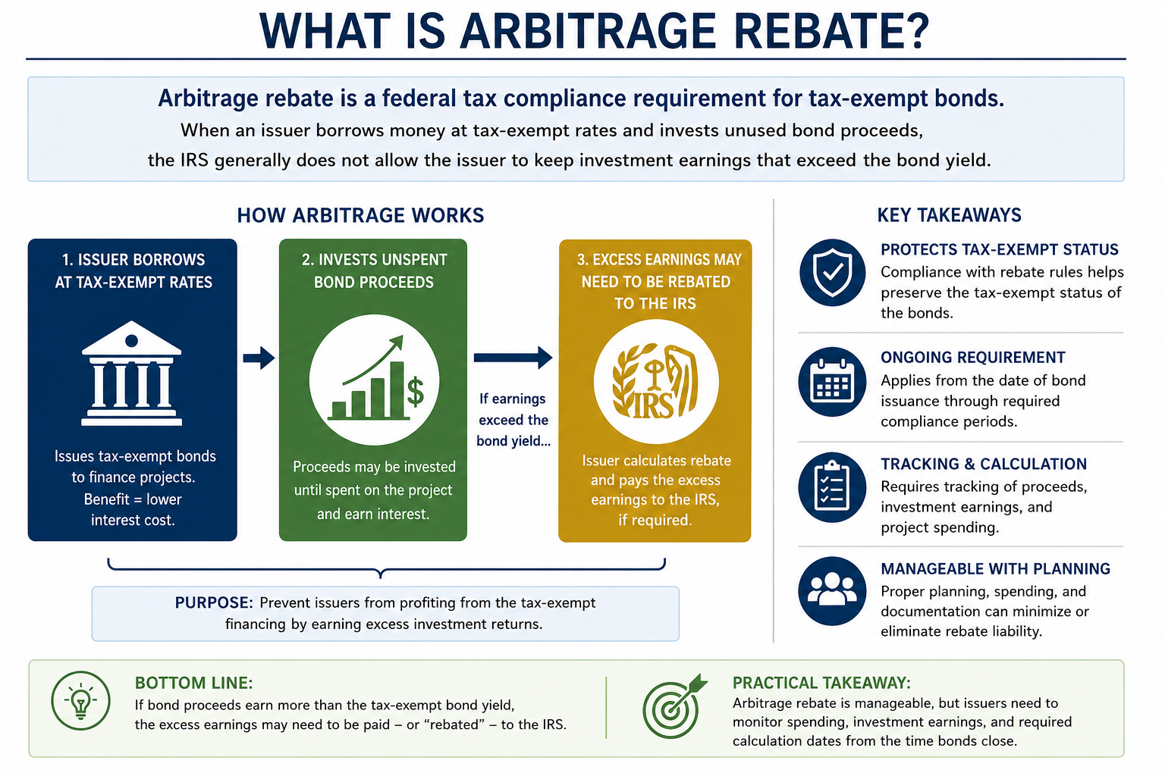
What is Arbitrage Rebate?
Arbitrage rebate is a federal tax compliance requirement for tax-exempt bonds.
When an issuer borrows money at tax-exempt rates and invests unused bond proceeds, the IRS generally does not allow the issuer to keep investment earnings that exceed the bond yield.
Excess earnings above bond yield may require payment to IRS

Slide 14
Purpose of Rebate Requirement
Basic Concept:
Compare actual earnings on nonpurpose investments to the earnings that would have occurred if those investments earned the bond yield.
Excess earnings generally must be rebated unless an exception applies.

Slide 15
What municipal bonds are subject to rebate?
Governmental bonds, qualified 501(c)(3) bonds, and other tax-advantage obligations may be subject to the arbitrage rules
Gross proceeds generally include sale proceeds, investment proceeds, transferred proceeds, replacement proceeds, and certain reserve or sinking funds.

Slide 16
What is the timing of rebate payment if required?
Rebate is generally calculated at least every five (5) years.
If rebate is owed, 90% of the liability must generally be paid within 60 days after each computation date.
A final computation is required when the issue is retired, and 100% of the remaining liability must be paid within 60 days.

Slide 17
Consequences for Noncompliance
IRS may treat the bonds as arbitrage bonds.
The interest paid to bondholders could become federally taxable.

Slide 18
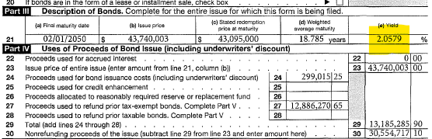
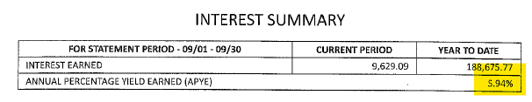
Illustration

Slide 19
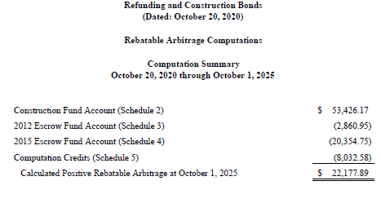
Illustration

Slide 20
Discussion topics
1 | Municipal Bonds Overview
2 | What is Arbitrage Rebate?
3 | What is Private Business Use?
4 | Other Tax and Securities Considerations

Slide 21

What is private business USE?
A special legal entitlement for the use of bond-financed property by a nongovernmental entity — including any business, corporation, or even the Federal Government.
Key Question
Was the facility in question financed with tax-exempt bonds?
10%
5%
de minimis allowance — Related Use
de minimis allowance — Unrelated Use

Slide 22






What Arrangements can result in private business USE?
Management &
Service Agreements
Naming Rights Arrangements
Leases & Subleases
Wholesale Water Contracts
Federal Prisoner Contracts
Any Other
Special Legal Entitlement

Slide 23
Management and other services agreements
Facilities owned by the city, but operated by an outside entity
Community Center
Aquatic Center
Other park & recreational facilities, such as ballparks
Safe Harbor: Revenue Procedure 2017-13
If a management agreement meets the safe-harbor provisions in Rev. Proc. 2017-13, it does not constitute private business use.

Slide 24

Naming rights arrangements
Is the facility bond-financed? Is it named after a person, or a business?
Named After a Person
Named After a Business
Generally not a problem.
A potential issue.
A practical approach: Name the building or room “in recognition of a gift by…” — with no legal entitlement for the business to keep the naming. Note: the IRS has issued no formal guidance on this topic.

Slide 25
Leases and subleases
When bond-financed property is leased to a nongovernmental party
Leases to Private Entities
Federal Offices
A lease that grants a nongovernmental business exclusive use of bond-financed property is a classic form of PBU.
Remember: the Federal Government is itself treated as a nongovernmental entity

Slide 26

Wholesale water contracts
Water contracts with a nongovernmental entity, such as a water association
When is it NOT a problem?
The purchaser is only required to purchase the amount of water it needs each month (no take-or-pay commitment)
The purchaser is itself a governmental entity — such as a public water authority, a public facilities board, or another city

Slide 27

Selling bond-financed property
The sale of bond-financed property can potentially amount to private business use that requires remedial action.
Especially Important in a Refunding Context
For a Refunding Bond Issue, ensure your bond counsel knows if property financed or refinanced with the bonds being refunded will potentially be sold.

Slide 28

Managing Private Business Activity: Pre-issuance
Plan ahead before the bonds are ever issued
Financings can be structured so that actual or anticipated PBU of a particular facility will not be a problem — if the financing team knows about the issue on the front end.
Bottom line: early disclosure to the financing team gives the most flexibility to structure around PBU.

Slide 29
Managing Private Business Activity: POST-issuance
What to do once bonds are outstanding
If an Opportunity Arises
If PBU Is Discovered After-the-Fact
Discuss it with bond counsel before moving forward.
Notify bond counsel as soon as possible.
Time matters — prompt disclosure preserves the widest range of remedial options.
The proposed PBU may be within allowable limits.
Bottom line: early disclosure to the financing team gives the most flexibility to structure around PBU.

Slide 30
Discussion topics
1 | Municipal Bonds Overview
2 | What is Arbitrage Rebate?
3 | What is Private Business Use?
4 | Other Tax and Securities Considerations

Slide 31
Why do I care why Martha Stewart went to jail?
Other tax and Securities considerations
Found guilty of conspiracy, obstruction of justice, and perjury (lying to federal investigators)
All related to “insider trading” - Buying or selling “security” using private information
Unfair advantage, breaks trust, and ruins market fairness
Security = tradable financial asset that holds monetary value
Examples = Wal-mart stock

Slide 32
U.S. Securities and Exchange Commission (SEC)
Other tax and Securities considerations
SEC was created by the Securities Exchange Act of 1934 following the 1929 market crash
Mission = protect investors, keep markets fair and orderly, and help companies/governments raise money
  Regulates the securities markets including brokers and dealers
  Example = underwriters
Has authority to enforce laws and punish people

Slide 33
Securities Act of 1933
Other tax and Securities considerations
Regulates the securities
  What rules have to be followed?
If it is a security, then it is either:
  Registered with the SEC
  Exempt
Exempt Securities – Section 3(a)(2)
  Securities issued or guaranteed by a state or its political subdivision
  Municipal bonds

Slide 34
Do “exempt securities” get a free pass?!?
Other tax and Securities considerations
Nope, just a few less rules.
Reves v. Ernst & Young (1990) = Intention of Congress in adopting the ’33 Act and ’34 Act “was to regulate investments, in whatever form they are made and whichever name they are called”
Rules that still apply – prohibition on fraudulent and deceptive practices
  Section 10(b)(5)
  Section 17a

Slide 35
Section 10(b) and Rule 10(b)(5)
Other tax and Securities considerations
Rule 10b-5 makes it unlawful for any person:
"(a) To employ any device, scheme, or artifice to defraud, (b) To make any untrue statement of a material fact or to omit to state a material fact necessary in order to make the statements made, in the light of the circumstances under which they were made, not misleading, or (c) To engage in any act, practice, or course of business which operates or would operate as a fraud or deceit upon any person, in connection with the purchase or sale of any security."

Slide 36
Rule 17(a)
Other tax and Securities considerations
"It shall be unlawful for any person in the offer or sale of any securities . . . by the use of any . . . instruments of transportation or communication in interstate commerce . . . (1) to employ any device, scheme, or artifice to defraud, or (2) to obtain money or property by means of any untrue statement of a material fact or any omission to state a material fact necessary in order to make the statements made, in light of the circumstances under which they were made, not misleading; or (3) to engage in any transaction, practice, or course of business which operates or would operate as a fraud or deceit upon the purchaser."

Slide 37
What is a material fact or omission?
Other tax and Securities considerations
A fact is "material" if there is a substantial likelihood that a reasonable investor would consider it important when making an investment decision.

Slide 38
How does this affect me?
Other tax and Securities considerations
Due diligence checklists – complete and accurate
  Do you have the right people answering the questions?
  “I don’t know” is probably not sufficient.
  Did you look? Did you ask?
Review the preliminary official statement
  Ask questions
  Give us your input
Opportunity to tell your story – but not the teen-ager version
  Don’t omit facts that aren’t in your favor

Slide 39
Disclosure is not one and done….
Other tax and Securities considerations
Rule 15c2-12 = regulates underwriters’, but not Issuers’, conduct in connection with the initial sale of municipal securities
  Obtain and review an official statement that is “deemed final” by an Issuer
  “reasonably determine” that the Issuer has undertaken in writing for the benefit of bondholders to provide certain on-going disclosure information to the Municipal Securities Rulemaking Board
    Continuing Disclosure Agreement

Slide 40
The final Official Statement that must be reviewed by the Underwriter is required to include…
Other tax and Securities considerations
terms of the proposed Issue of Securities;
financial information or operating data concerning all persons that are material to an evaluation of the offering, among other information; and
a description of the Continuing Disclosure Agreement and of any instances in the previous five years in which the Issuer failed to comply, in all material respects, with the obligations in any previous Continuing Disclosure Agreement.

Slide 41
Continuing Disclosure Agreement
Other tax and Securities considerations
Issuer must agree to provide:
  annual financial information and operating data (including audited financial statements, when and if available), and
  and timely notice of the occurrence of certain listed events to the MSRB through its EMMA portal

Slide 42
Listed Events
(Reported within 10 business days of occurrence)
Other tax and Securities considerations
(1) Principal and interest payment delinquencies;
(2) Non-payment related defaults, if material;
(3) Unscheduled draws on debt service reserves reflecting financial difficulties;
(4) Unscheduled draws on credit enhancements reflecting financial difficulties;
(5) Substitution of credit or liquidity providers, or their failure to perform;
(6) Adverse tax opinions, the issuance by the Internal Revenue Service of proposed or final determinations of taxability, Notices of Proposed Issue (IRS Form 5701-TEB) or other material notices or determinations with respect to the tax status of the security, or other material events affecting the tax status of the security;
(7) Modifications to rights of security holders, if material;
(8) Bond calls, if material, and tender offers;
(9) Defeasances;
(10) Release, substitution, or sale of property securing repayment of the securities, if material;
(11) Rating changes;
(12) Bankruptcy, insolvency, receivership or similar event of the obligated person;
(13) The consummation of a merger, consolidation, or acquisition involving an obligated person or the sale of all or substantially all of the assets of the obligated person, other than in the ordinary course of business, the entry into a definitive agreement to undertake such an action or the termination of a definitive agreement relating to any such actions, other than pursuant to its terms, if material;
(14) Appointment of a successor or additional trustee or the change of name of a trustee, if material;
(15) Incurrence of a financial obligation of the obligated person, if material, or agreement to covenants, events of default, remedies, priority rights, or other similar terms of a financial obligation of the obligated person, any of which affect security holders, if material; and
(16) Default, event of acceleration, termination event, modification of terms, or other similar events under the terms of a financial obligation of the obligated person, any of which reflect financial difficulties

Slide 43
Key takeaways
1
Know the thresholds for Tax Compliance
2
Loop in bond counsel early
Whether structuring a new financing or reacting to a new arrangement
10% for related use, 5% for unrelated use — track PBU against these de minimis limits
Monitor tax compliance and continuing disclosure reporting requirements and deadlines
3
Watch refundings closely
4
Document everything
Confirm whether financed property might be sold before the refunding closes
Document everything
Safe-harbor agreements, naming arrangements, and water contracts all deserve a paper trail

