Slide 1


Let’s talk Procurement
Amanda Beilfuss
Procurement Director
City of Fayetteville

Slide 2

What is Procurement?
The strategic end-to-end process of sourcing, negotiating, and acquiring goods or services from external suppliers in a transparent and ethical manner.

Slide 3
What makes a good Procurement professional?

Slide 4

COMMON TYPES OF PROCUREMENT:
Invitation to Bid
Request for Proposal
Request for Qualification
Cooperative Contracts
Bid Waiver/Sole Source
Auction

Slide 5
KNOW YOUR THRESHOLDS:
  Commodities/Equipment/Services
  State Agencies - $75,000
  City Municipalities – $35,000 ** (actually $42,921)
  Public Improvement
  State Agencies - $50,000
  City Municipalities - $50,000
** Beginning January 1, 2025, and on each January 1 at subsequent five-year intervals, the amounts under subdivisions (b)(1) and (2) of this section shall be adjusted to reflect the percentage increase in the Consumer Price Index for All Urban Consumers or its successor, as published by the United States Department of Labor for the five (5) years immediately preceding the percentage increase, and rounded to the nearest whole number (currently $42,921).

Slide 6
Invitation to Bid
Award to lowest responsive, responsible bidder
All bids received must be read publicly
Public Improvement vs. Commodity/Service
Requires a certified/budget amount to be announced at a public bid opening
Certified/budgeted amount not required at time of public bid opening
Advertise 1 time each week for not less than 2 consecutive weeks in local newspaper
1 advertisement in a local newspaper
Requires a bid security (no more than 5%)
Only bids within 25% of total amount can be considered
Up to 3 deductive alternates

Slide 7
Request for Proposal/Qualification
BOTH awarded by highest evaluated proposal
BOTH include evaluation criteria that is based on qualifications and experience
BOTH have several evaluators scoring each proposal
RFP vs. RFQ
Price is a partial evaluating factor and should be requested during RFP process
Price is NOT an evaluating factor and can NOT be considered and should NOT be requested during RFQ process
Can be used for other services with a 2/3 vote of the governing body
Can only be used for legal, financial advisory, architectural, engineering, construction management, and land surveying professional consultant services
Evaluation criteria is set by law

Slide 8




Cooperative contracts
Solicitations that have already been competitively bid on a national level
Saves time and money
Easy to register as a member
Audit and Vette ALL Cooperative Contracts!

Slide 9

BID WAIVER/SOLE SOURCE
Keep a level head and stand your ground.
You will hear EVERYTHING!

Slide 10

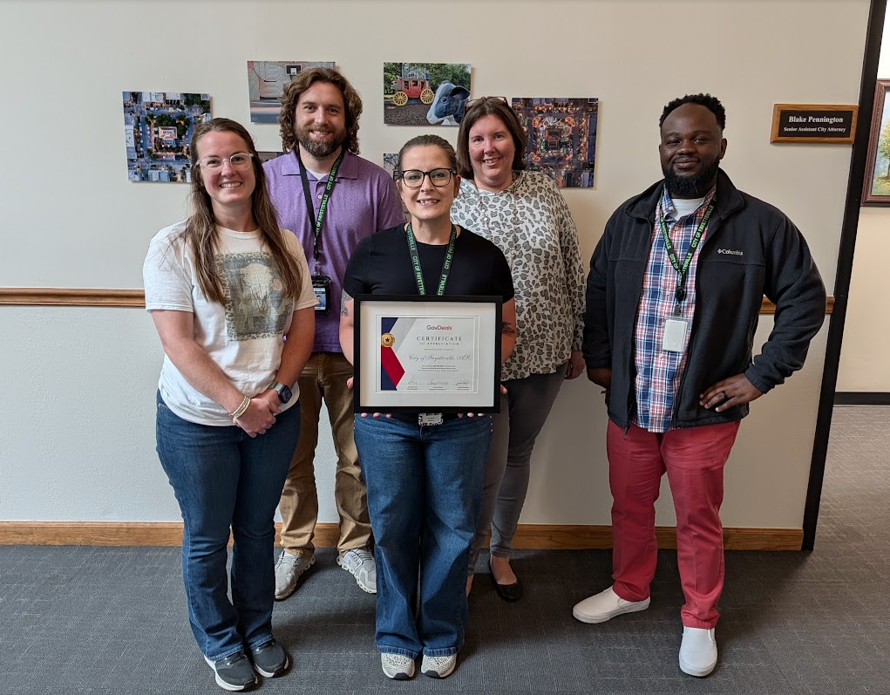
Auction
A fair, transparent way to get rid of surplus
Not in person – Online like Ebay
No cost to your entity
The City of Fayetteville
Over $10 Million in assets sold with GovDeals since 2010!

Slide 11




Helpful
Procurement
Resources

Slide 12
Surrounding area Procurement leaders
your legal department
Other departments
PEOPLE
Suppliers

Slide 13
Procurement Organizations
https://www.nigp.org/
https://www.arnigp.org/
Professional Development
Network with 19,000+ Procurement Professionals
Massive Document & Resource Library
Professional Certifications
Virtual and In-Person Education Offerings
Access to the NIGP Forum
Professional Development
Networking
Legislation Updates
Assistance with Professional Certifications
Dues: $195 a member per year (agency discounts)
Conference: August 23-26, 2026 in Columbus, OH
Dues: $50 a member per year (agency discounts)
Conference: Spring 2027 in Hot Springs

Slide 14
resource Websites
https://advance.lexis.com/container?config=00JAA3ZTU0NTIzYy0zZDEyLTRhYmQtYmRmMS1iMWIxNDgxYWMxZTQKAFBvZENhdGFsb2cubRW4ifTiwi5vLw6cI1uX
https://www.ecfr.gov/

Slide 15
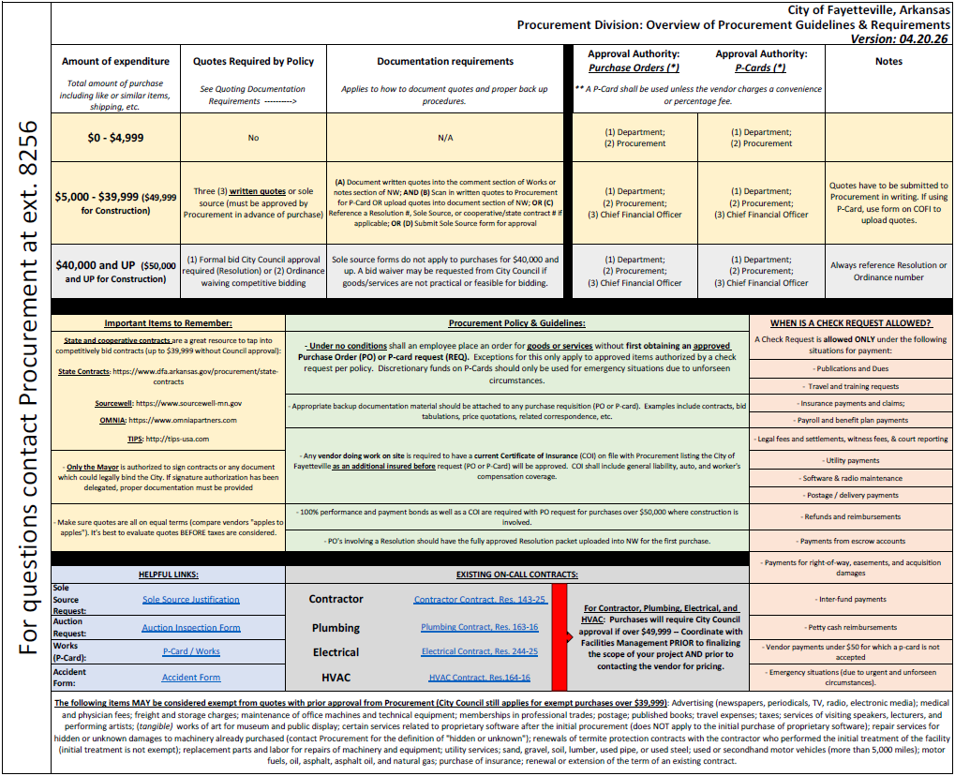

Slide 16


Questions?

Slide 17
Thank you!
Amanda Beilfuss
abeilfuss@fayetteville-ar.gov
(479) 575-8220

