Slide 1
ARKANSAS GOVERNMENT FINANCE OFFICERS ASSOCIATION
48th Annual Conference
Investing in Financial Markets
It's More Than Stocks & Bonds
Presented by
Mimi M. Hurst
Managing Director Stephens Inc.
Stephens Inc. | Member NYSE, SIPC | 111 Center Street, Little Rock, AR 72201 | stephens.com
This handout accompanies today's opening session and is intended to support a discussion of long-term investment principles: the historical unpredictability of asset class leadership, the value of starting early, and the advantage of tax-deferred compounding. This handout has been prepared solely for informative purposes and is not a solicitation, or an offer, to buy, sell or hold any security or a recommendation of the services supplied by any money management organization. It does not purport to be a complete description of the securities, markets or developments referred to in the report. We believe the sources to be reliable, however, the accuracy and completeness of the information is not guaranteed.

Slide 2
DIVERSIFICATION
The Unpredictability of Markets: Annual Returns by Various Sub Asset Classes, 2011-2025
No single asset class leads every year. The rankings shift meaningfully from one year to the next — a reminder that a diversified portfolio, rebalanced with discipline, is designed to capture opportunity across cycles rather than depend on predicting which category will lead next.
The “Crazy Quilt” of Performance by Various Sub Asset Classes, 2011–2025
2011 | 2012 | 2013 | 2014 | 2015 | 2016 | 2017 | 2018 | 2019 | 2020 | 2021 | 2022 | 2023 | 2024 | 2025
Municipal Bonds 13.98% | Mid Cap Value 18.51% | Small Cap Growth 43.30% | Mid Cap Value 14.75% | Large Cap Growth 5.67% | Small Cap Value 31.74% | Large Cap Growth 30.21% | Municipal Bonds 1.08% | Large Cap Growth 36.39% | Large Cap Growth 38.49% | Mid Cap Value 28.34% | Large Cap Value (7.54%) | Large Cap Growth 42.68% | Large Cap Growth 33.36% | Foreign Stock 31.22%
Taxable Bonds 7.84% | Small Cap Value 18.05% | Mid Cap Growth 35.74% | Large Cap Value 13.45% | Municipal Bonds 3.93% | Mid Cap Value 20.00% | Foreign Stock 25.62% | Taxable Bonds 0.01% | Mid Cap Growth 35.47% | Mid Cap Growth 35.59% | Small Cap Value 28.27% | Municipal Bonds (11.02%) | Mid Cap Growth 25.87% | Mid Cap Growth 22.10% | Large Cap Growth 18.56%
Large Cap Growth 2.64% | Foreign Stock 17.90% | Small Cap Value 34.52% | Large Cap Growth 13.05% | Taxable Bonds 0.55% | Large Cap Value 17.34% | Mid Cap Growth 25.27% | Large Cap Growth (1.51%) | Small Cap Growth 28.48% | Small Cap Growth 34.63% | Large Cap Growth 27.60% | Mid Cap Value (12.03%) | Small Cap Growth 18.66% | Small Cap Growth 15.15% | Large Cap Value 15.91%
Large Cap Value 0.39% | Large Cap Value 17.51% | Large Cap Growth 33.48% | Municipal Bonds 13.03% | Mid Cap Growth (0.20%) | Small Cap Growth 11.32% | Small Cap Growth 22.17% | Mid Cap Growth (4.75%) | Mid Cap Value 27.06% | Foreign Stock 8.28% | Large Cap Value 25.16% | Taxable Bonds (13.01%) | Foreign Stock 18.24% | Large Cap Value 14.37% | Small Cap Growth 13.01%
Mid Cap Value (1.38%) | Mid Cap Growth 15.81% | Mid Cap Value 33.46% | Mid Cap Growth 11.90% | Foreign Stock (0.39%) | Mid Cap Growth 7.33% | Large Cap Value 13.66% | Large Cap Value (8.27%) | Large Cap Value 26.54% | Taxable Bonds 7.51% | Mid Cap Growth 12.73% | Foreign Stock (14.45%) | Small Cap Value 14.65% | Mid Cap Value 13.07% | Small Cap Value 12.59%
Mid Cap Growth (1.65%) | Large Cap Growth 15.26% | Large Cap Value 32.53% | Taxable Bonds 5.97% | Small Cap Growth (1.38%) | Large Cap Growth 7.08% | Mid Cap Value 13.34% | Small Cap Growth (9.31%) | Foreign Stock 22.66% | Municipal Bonds 6.19% | Foreign Stock 11.26% | Small Cap Value (14.48%) | Mid Cap Value 12.71% | Small Cap Value 8.05% | Mid Cap Value 11.05%
Small Cap Growth (2.91%) | Small Cap Growth 14.59% | Foreign Stock 23.29% | Small Cap Growth 5.60% | Large Cap Value (3.83%) | Taxable Bonds 2.65% | Small Cap Value 7.84% | Mid Cap Value (12.29%) | Small Cap Value 22.39% | Mid Cap Value 4.96% | Small Cap Growth 2.83% | Small Cap Growth (26.36%) | Large Cap Value 11.46% | Foreign Stock 3.82% | Mid Cap Growth 8.66%
Small Cap Value (5.50%) | Municipal Bonds 10.01% | Taxable Bonds (2.02%) | Small Cap Value 4.22% | Mid Cap Value (4.78%) | Foreign Stock 1.51% | Municipal Bonds 7.47% | Small Cap Value (12.86%) | Municipal Bonds 9.29% | Small Cap Value 4.63% | Municipal Bonds 2.53% | Mid Cap Growth (26.72%) | Municipal Bonds 7.78% | Taxable Bonds 1.36% | Taxable Bonds 7.30%
Foreign Stock (11.73%) | Taxable Bonds 4.21% | Municipal Bonds (4.42%) | Foreign Stock (4.48%) | Small Cap Value (7.47%) | Municipal Bonds 0.49% | Taxable Bonds 3.54% | Foreign Stock (13.36%) | Taxable Bonds 8.72% | Large Cap Value 2.80% | Taxable Bonds (1.54%) | Large Cap Growth (29.14%) | Taxable Bonds 5.53% | Municipal Bonds 1.25% | Municipal Bonds 3.12%
Source: index total returns by category, 2011–2025. Large Cap Growth, Large Cap Value, Mid Cap Growth, Mid Cap Value, Small Cap Growth, and Small Cap Value are represented by their respective Russell indices; Foreign Stock by the MSCI EAFE Index; Taxable Bonds by the Bloomberg U.S. Aggregate Bond Index; and Municipal Bonds by the Bloomberg Municipal Bond Index. The indexes and models referenced in the chart presented are unmanaged and do not reflect any transaction costs or management fees. They were chosen to give you a basis of comparison for market segment performance. You cannot invest directly in an index. The chart above is provided for purely educational purposes. It does not represent any actual portfolios, investments, or products and services of Stephens Inc.

Slide 3
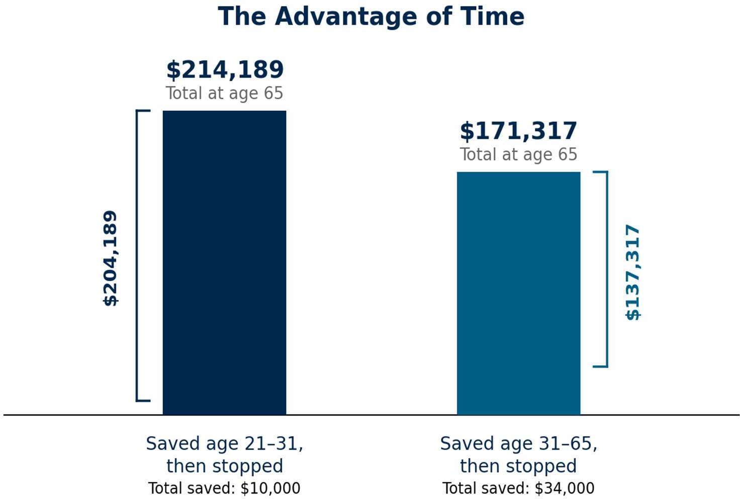
Starting Early Pays Off
T IME IN THE MARKET
Time in the market — not timing the market — is one of the most powerful tools available to a saver. The earlier savings begin, the longer compounding has to work in your favor.
If you are young and haven't started: start today.
If you have started and can increase your savings: start today.
If you haven't started, no age is too late: start today.
Assumptions — Hypothetical example for illustrative purposes only; not indicative of any particular investment. Calculation by Stephens Capital Management. This hypothetical example assumes an 8% annual return. A single $1,000 deposit made at the beginning of each year from age 21 to 31 (then stopped). A single $1,000 deposit made at the beginning of the year from age 31 through 65 (then stopped).

Slide 4
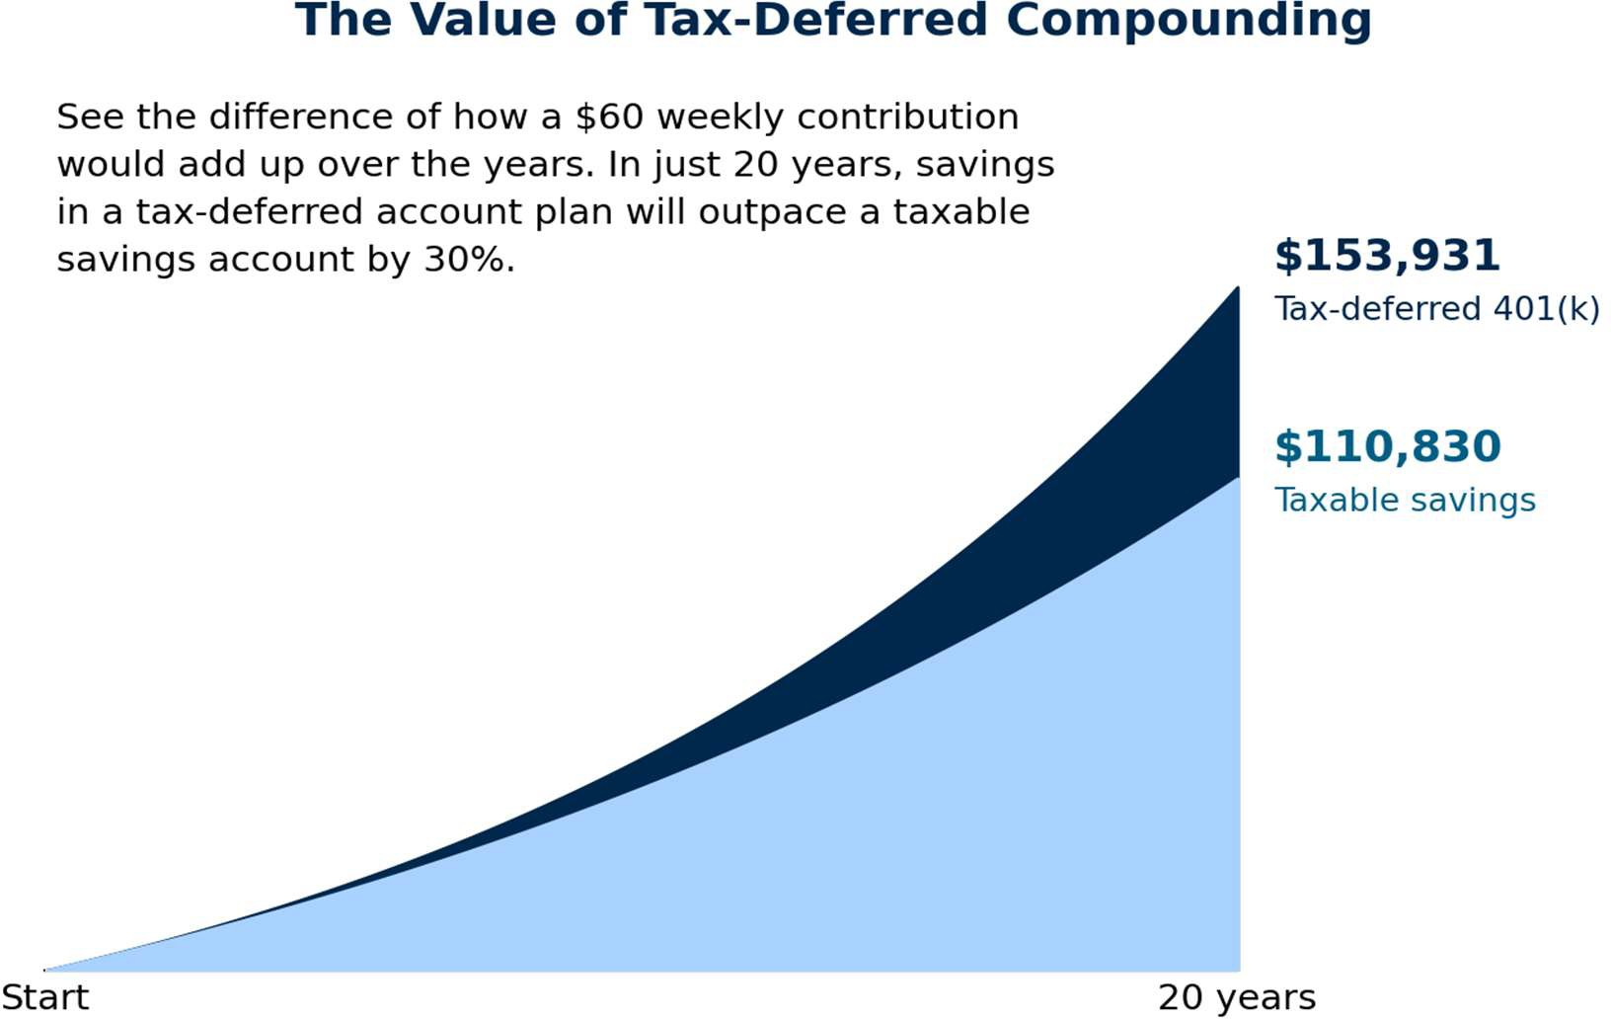
The Value of Tax-Deferred Compounding
THE POWER OF COMPOUNDING
When savings and investment earnings are allowed to grow tax-deferred, more money in the account keeps working year after year instead of being reduced by taxes along the way. Over long periods of time, that difference compounds into a meaningfully larger balance. Take advantage of tax deferred accounts like an IRA, 401(k) Plan, 457 Plan, 401(b) Plan or other types of Retirement Plan accounts.
Savings and earnings grow without being reduced by current income taxes each year, so a larger base stays invested and continues to compound.
In a taxable account, a portion of investment gains is typically owed in taxes annually, which slows the compounding effect over time.
Consistency matters as much as the amount: a modest, regular savings — like $60 a week — can add up significantly over two decades.
Taxes are generally still owed when funds are eventually withdrawn from a traditional tax-deferred account, but the deferral itself provides a meaningful long-term advantage. If a Roth account, either Roth IRA or Roth 403(b), Roth 401(k), are available, taxes are paid and after-tax contributions go into the account. Distributions are generally not subject to taxes, after satisfying Roth rules.
See the difference of how a $60 weekly contribution would add up over the years between a tax-deferred account and a taxable savings account. In just 20 years, savings in a tax-deferred account will outpace a taxable savings account by 30%.
Tax-deferred Account
Taxable Savings Account
Assumptions – This hypothetical example assumes 8% annual return before inflation, with all capital gains and dividends reinvested, and a 28% tax rate on savings. Calculation by Stephens Capital Management.

