Slide 1

Raymond James Public Finance | July 2026
Cheryl Schluterman, Director, Public Finance
T 501.671.1324 // C 501.258.7129 (calls) // C 901.910.3240 (texts)

Slide 2

Raymond James’ Continued Strength in the Municipal Market
Calendar Year 2025
No. 8 Senior Manager nationally by par amount of municipal bond issues | $26.8B+ Senior Manager on 441 municipal bond issues | No. 3 Senior Manager nationally by number of municipal bond issues
81 $100M+ senior managed transactions | 18 Public finance professionals hired for a total of 189 | No. 2 Senior Manager of Arkansas Bonds
Raymond James has continued to build momentum in 2025,
having underwritten 441 negotiated issues through calendar year 2025 vs 397 during the previous year
Source: Bloomberg
*Based on tax-exempt, long term negotiated issues, unless otherwise noted
| 2

Slide 3
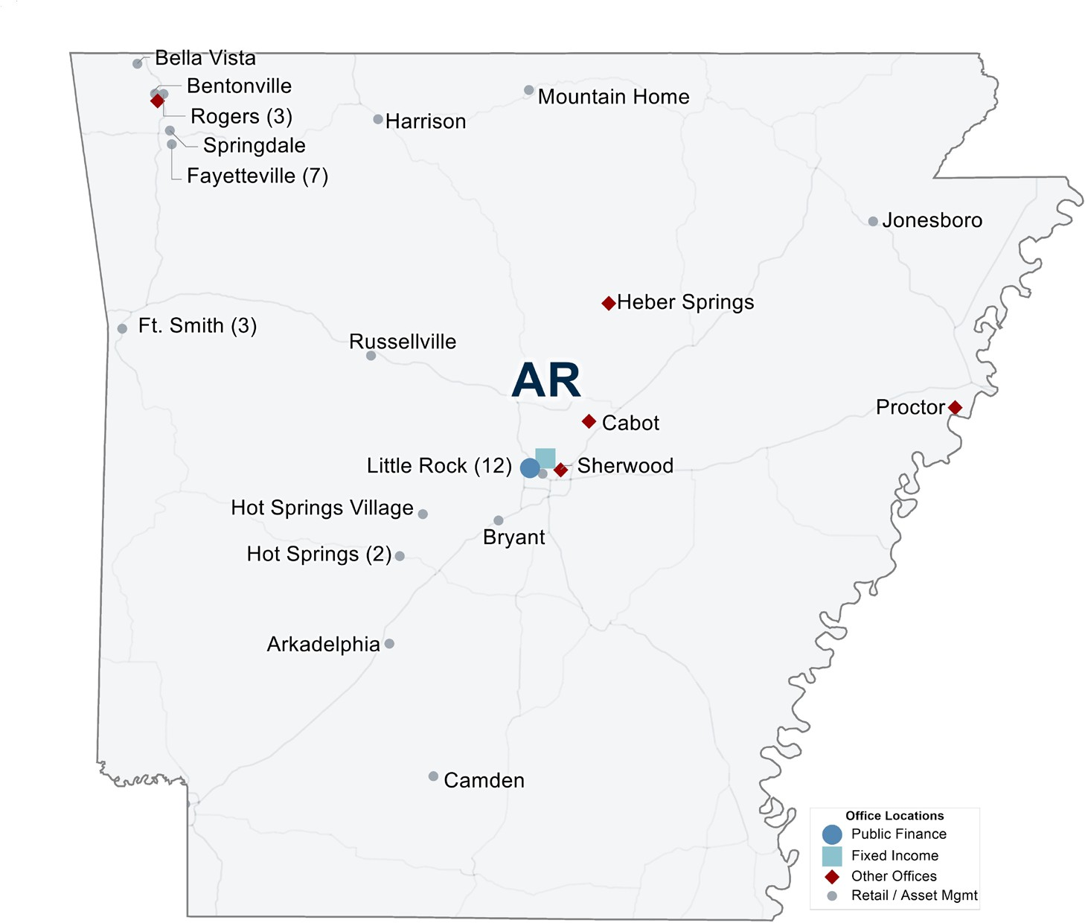
Commitment to Arkansas
Raymond James’ Arkansas presence
By the numbers
49 office locations
188 employees
120 financial advisors
43,400 retail accounts
$14.9B Assets under management
$720M Muni assets under management
$21.1M state payroll
All data as of 12/31/2025 unless otherwise noted
| 3

Slide 4

Raymond James works with the Rural Water Financing Agency
FINANCING SOLUTIONS. FUNDING PROGRESS.
Whether your utility has a USDA-RD or SRF project that needs interim
construction financing or a project that needs long-term financing quickly,
Raymond James can help.
Our finance team has assisted utilities with over 750 loans for more than
$1.6 billion through the Rural Water Financing Agency.*
INTERIM PROGRAM
Contact us:
Nick Roederer Managing Director 502.741.3686
nick.roederer@raymondjames.com
Construction financing with a USDA or
SRF takeout
Streamlined and efficient application and
INTERIM PROGRAM
$1,100,000,000
Over 450 loans
document process
Fixed rate for the term of construction
Cheryl Schluterman Director 501.671.1324
cheryl.schluterman@raymondjames.com
All interest is capitalized
FLEX TERM PROGRAM
AA-rated program offers borrowers access to tax-exempt markets at low rates
No Debt Service Reserve Fund requirement
Fixed rate terms from 1-30 years
FLEX TERM PROGRAM
$500,000,000
Over 300 loans
Variety of project types (construction,
refinancing, cost-overruns, match funding, etc.)
*Includes the Agency’s predecessor organization
@2023 Raymond James & Associates, Inc., member New York Stock Exchange/SIPC
|

Slide 5
Advisory Team
5
David Sutton Managing Director Public Finance
T 727.567.1152 880 Carillon Parkway, Tower 3
F 727.567.8315 Saint Petersburg, FL 33716
david.sutton@raymondjames.com www.raymondjames.com
Raymond James & Associates, Inc., member FINRA/SIPC, is a subsidiary of Raymond James Financial, Inc.
Chad Myers Managing Director Public Finance
T 901.579.4923 1100 Ridgeway Loop, 3rd Floor
Memphis, TN 38111 Chad.Myers@raymondjames.com www.raymondjames.com
Raymond James & Associates, Inc., member FINRA/SIPC, is a subsidiary of Raymond James Financial, Inc.
David Sutton, team leader, has 30 years of experience helping public sector entities invest bond and non-bond proceeds assets subject to indentures/ resolutions (or not).
The Strategies Team focuses our client efforts solely with public sector and not-for-profit entities.
Andrew Dillon Associate Public Finance
T 901.529.5377 1100 Ridgeway Loop, 3rd Floor
Memphis, TN 38120 Andrew.dillon@raymondjames.com www.raymondjames.com
Raymond James & Associates, Inc., member FINRA/SIPC, is a subsidiary of Raymond James Financial, Inc.
Andrew Herran Associate Public Finance
T 901.529.5437 120 S Riverside Plaza, Suite 600
Chicago, IL 60606 Andrew.herran@raymondjames.com www.raymondjames.com
Raymond James & Associates, Inc., member FINRA/SIPC, is a subsidiary of Raymond James Financial, Inc.
|

Slide 6






Raymond James Public Finance Investment Strategies Group
Experience
PFISG is led by David Sutton with over 30 years of experience in the reinvestment of bond proceeds and other funds.
PFISG operates as a Registered Investment Advisor with a sole focus on optimizing clients’ investment returns for both restricted and non-restricted bond proceeds while balancing safety and liquidity.
The group stands as an industry leader in the development of custom investment strategies tailored to the unique needs of each individual client – specializing in both large and small complicated situations.
Transparency
Upfront disclosure of fees based on the required scope of services uniquely designed for each transaction.
PFISG prepares IRS-compliant documentation for each transaction to ensure maximum level of transparency for the benefit of the client and Bond Counsel, if applicable.
Competitive Bid Process
PFISG quarterbacks the entire procurement process maximizing results in terms of yield/interest earnings and minimizing administrative time & effort required by the rest of the working group.
PFISG possesses the capability to actively track the market on a daily, even hourly basis, enabling client’s ability to optimize their entry point into the market.
Extensive Market Knowledge and Access
Ability to Ensure the City Receives the Best Pricing
Public Finance - Investment Advisor Experience ($Million)
Amount Invested
Expertise Across a Broad Range
No deal too large or small
$3,572
$4,025
_{$2,135} $2,628 |  |  |  |  |  | $2,127 | $2,272
2019 | 2020 |  | 2021 |  | 2022 | 2023 | 2024
Structuring Expertise
Totaling over $30 billion in assets since 2016
Over 450 transactions structured over the past five years
|

Slide 7
Experience
Maximizing Transparency
Raymond James Quarterbacks Entire Investment
Process
Raymond James
Reduces Administrative Burden & Time
Opportunity to Increase Yield Via Proactive Investment Management
Putting Dollars to Work
Raymond James
Registered Investment
Advisor
Value Added Reporting
As RIA, Raymond James does NOT have discretion as to the security/investment selection NOR price
As RIA, Raymond James does NOT offer securities out of its own inventory—not acting as principal but rather executing a competitive bid/offering process amongst 3rd party primary and/or regional broker/dealers
Fiduciary Duty
Raymond James Holds Extensive Knowledge of Provider Universe & Propensities
|

Slide 8
Depiction of a Competitive Bid Process
Determine Investment Strategy
Execute Bid/Make Award
Oversee Settlement
Develop Term Sheet
Bid 1
Bid 2
Settle Securities
Bid 3
Transparency can be maximized by soliciting numerous dealers specializing in U.S. Treasury securities
Bid 4
Distribute Term Sheet to 8 potential bidders
Bid 5
Bid 6
Bid 7
Bid 8
|

Slide 9
Disclaimer
The information contained herein is solely intended to facilitate discussion of potentially applicable financing applications and is not intended to be a specific buy/sell recommendation, nor is it an official confirmation of terms. Any terms discussed herein are preliminary until confirmed in a definitive written agreement. While we believe that the outlined financial structure or marketing strategy is the best approach under the current market conditions, the market conditions at the time any proposed transaction is structured or sold may be different, which may require a different approach.
The analysis or information presented herein is based upon hypothetical projections and/or past performance that have certain limitations. No representation is made that it is accurate or complete or that any results indicated will be achieved. In no way is past performance indicative of future results. Changes to any prices, levels, or assumptions contained herein may have a material impact on results. Any estimates or assumptions contained herein represent our best judgment as of the date indicated and are subject to change without notice. Examples are merely representative and are not meant to be all-inclusive.
Raymond James shall have no liability, contingent or otherwise, to the recipient hereof or to any third party, or any responsibility whatsoever, for the accuracy, correctness, timeliness, reliability or completeness of the data or formulae provided herein or for the performance of or any other aspect of the materials, structures and strategies presented herein. This Presentation is provided to you for the purpose of your consideration of the engagement of Raymond James as an underwriter and not as your financial advisor or Municipal Advisor (as defined in Section 15B of the Exchange Act of 1934, as amended), and we expressly disclaim any intention to act as your fiduciary in connection with the subject matter of this Presentation. The information provided is not intended to be and should not be construed as a recommendation or “advice” within the meaning of Section 15B of the above-referenced Act. Any portion of this Presentation which provides information on municipal financial products or the issuance of municipal securities is only given to provide you with factual information or to demonstrate our experience with respect to municipal markets and products. Municipal Securities Rulemaking Board (“MSRB”) Rule G-17 requires that we make the following disclosure to you at the earliest stages of our relationship, as underwriter, with respect to an issue of municipal securities: the underwriter’s primary role is to purchase securities with a view to distribution in an arm’s-length commercial transaction with the issuer and it has financial and other interests that differ from those of the issuer.
Raymond James does not provide accounting, tax or legal advice; however, you should be aware that any proposed transaction could have accounting, tax, legal or other implications that should be discussed with your advisors and/or legal counsel.
Raymond James and affiliates, and officers, directors and employees thereof, including individuals who may be involved in the preparation or presentation of this material, may from time to time have positions in, and buy or sell, the securities, derivatives (including options) or other financial products of entities mentioned herein. In addition, Raymond James or affiliates thereof may have served as an underwriter or placement agent with respect to a public or private offering of securities by one or more of the entities referenced herein.
This Presentation is not a binding commitment, obligation, or undertaking of Raymond James. No obligation or liability with respect to any issuance or purchase of any Bonds or other securities described herein shall exist, nor shall any representations be deemed made, nor any reliance on any communications regarding the subject matter hereof be reasonable or justified unless and until (1) all necessary Raymond James, rating agency or other third party approvals, as applicable, shall have been obtained, including, without limitation, any required Raymond James senior management and credit committee approvals, (2) all of the terms and conditions of the documents pertaining to the subject transaction are agreed to by the parties thereto as evidenced by the execution and delivery of all such documents by all such parties, and (3) all conditions hereafter established by Raymond James for closing of the transaction have been satisfied in our sole discretion. Until execution and delivery of all such definitive agreements, all parties shall have the absolute right to amend this Presentation and/or terminate all negotiations for any reason without liability therefor. Thomson Reuters Municipal Market Data (“MMD”) is a proprietary yield curve which provides the offer-side of AAA rated state general obligation bonds as determined by the MMD analyst team. Raymond James & Associates, Inc., member New York Stock Exchange/SIPC.
|

Slide 10
INTERNATIONAL HEADQUARTERS: THE RAYMOND JAMES FINANCIAL CENTER 880 CARILLON PARKWAY // ST. PETERSBURG, FL 33716 // 800.248.8863 RAYMONDJAMES.COM
© 2026 Raymond James & Associates, Inc., member New York Stock Exchange/SIPC. Raymond James® is a registered trademark of Raymond James Financial, Inc.

