Slide 1

Notes:
***Utilize your DISC training to determine the optimal communication style for the decision make you’re meeting with***
Thank you for taking the time to talk with me today about your business and current fleet program. The purpose of this meeting is to review how you’re currently managing your fleet and see if there are opportunities for EFM to assist you with making it more cost-effective or operationally efficient.
Let me tell you a little bit about myself…(quick summary of yourself and your experience with EFM)
According to LinkedIn, I see you’ve been with Company XYZ for (X) number of years, is that correct?
From our prior conversation, my understanding is that you would like to focus on the benefits of (select what applies below), is that correct?
Acquisition
Funding
Maintenance
Remarketing
(Once areas of focus are confirmed) Fantastic. Let me tell you a little bit about EFM, then I’ll provide an update on the current state of the industry, and finally, we’ll review how we can help you achieve your fleet goals!

Slide 2
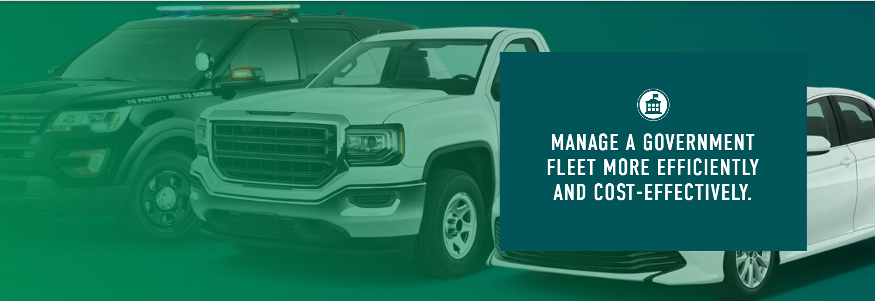

Slide 3
TODAY’S AGENDA
WHO WE ARE!
WHO WE WORK WITH!
AWARDED CONTRACTS
PARTNERSHIP PROGRAMS & RESOURCES
WHY ENTERPRISE
NEXT STEPS FOR YOUR FLEET
EFM Overview

Slide 4

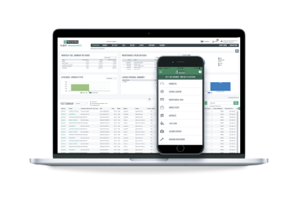
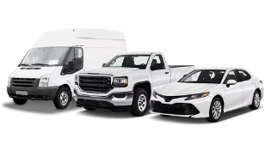
LONG-TERM GOVERNMENT PARTNERSHIP
CLIENT STRATEGY MANAGERS
60
LOCAL OFFICES
2,400+
GOVERNMENT CLIENTS
That provide personalized and customized recommendations
Providing
hands-on support
We have experience working with entities like yours
LOCAL OFFICES
REAL-TIME FLEET TOOLS
Client Portal & Mobile App empowering fleet managers
175k+
60+
Managed Vehicles
Local Government Clients
Notes:
Did you know that Enterprise Fleet Management is a subsidiary of Enterprise Mobility? And that Enterprise buys and sells more than any other entity in North America?
This gives EFM the resources of a large globally recognized brand, and our high-touch business model enables us to provide quality personalized service through our Client Strategy Managers at our 60 local offices across North America
We have experience in the government space with over 2,400 clients and a managed fleet of over 175K units.
***Don’t spend too much time on this slide***

Slide 5












REFERENCES
Notes:
Goal: Highlight other partnerships – further prove our solution does work

Slide 6
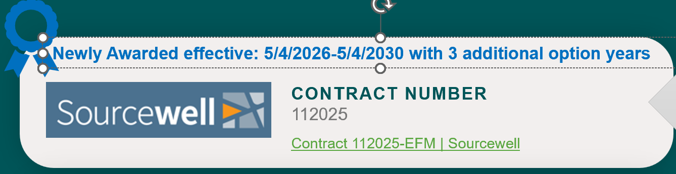



COOPERATIVE PURCHASING PARTNERSHIPS
CONTRACT NUMBER
030122
CONTRACT NUMBER
240502
CONTRACT NUMBER
CNR01399
Notes:
Please make sure to update the Sourcewell/TIPS/E&I membership ID for the prospect that you’re meeting with

Slide 7
EFFECTIVE VEHICLE LIFECYCLE
Determining the right time to replace vehicles
DEPRECIATION
FUEL
MAINTENANCE
OPTIMAL TIME
TO REPLACE
COST
TIME
Notes:
Here, you can see a graphic illustration of how we evaluate “when is the right time to replace vehicles?”
First, we look at depreciation. Simply put: What you buy the vehicle for, minus what you sell it for. This declines over time as the vehicle value decreases. There is a point where it still has market value that could reduce the cost of the replacement vehicle.
Fuel efficiency degrades over time as the vehicle ages. We also know that newer vehicles are more fuel efficient.
Maintenance increases over time as the vehicle ages. Early on, the vehicle is covered by warranty and only preventative maintenance is required. Larger repairs increase with age and mileage, in addition to larger preventative items such as brakes and tires.
Where these 3 cost buckets intersect is the lowest cost of ownership, or the sweet spot on when you should consider replacing the vehicle.
Questions:
What are your thoughts on this philosophy to fleet management? Have you ever looked at it this way before?
-When is the optimal time to replace vehicles?
-The three largest costs associated with any fleet are depreciation, fuel and maintenance.
-What is often missed is resale value.
-Our goal is to find where these lines intersect to have a clear path for replacement
-Vehicle depreciates a lot in the beginning
-Brooks, do you think we can agree that maintenance and fuel costs begin to rise as the vehicle ages or increases in mileage?
-We have a history of data from the 2 million vehicles we buy and sell and have found the optimal time to replace

Slide 8
DEDICATED & PROACTIVE TEAM
One call away.
Client Strategy Manager
Expert advice w/ genuine guidance
Proactive fleet analysis
Annual client review
Account Fleet Coordinator
Day-to-day contact for all administrative tasks
Fleet Plan
Operating Plan
Safety & Risk
Admin. & Compliance
ENTERPRISE FLEET MANAGEMENT CONSULTATION
Notes:
EFM competitive advantage is our ability to provide local, expert, accountable service
Customer payoff:
Improves ability to make adjustments to strategy as situation changes
Improves probability of successful outcomes in any given AFCOR issue
Improves probability of solving the four circles riddle involving communication and coordination of internal/external parties.
FMC competition all charge between $5-$8/month for “Enhanced Fleet Management” or “Outsourced Driver Administration” which we do as a matter of course.

Slide 9

THE POWER AND REACH
OF ENTERPRISE
    Gain an entire team of fleet experts.
    Dedicated account team (industry exclusive) to execute and coordinate your fleet plan.
    Multi-channel vehicle resale network.
    Consolidated reporting with
    state-of-the-art technology.
    Ongoing industry expertise and annual financial review.
2 BIGGEST COMPETITIVE ADVANTAGES
FINANCIAL VALUE FOR OUR CLIENTS
The Enterprise Infrastructure
Backed by the power of one of the largest and most trusted mobility companies in the world, our team provides genuine guidance, ensuring your fleet needs are well managed to empower you to have the confidence to concentrate on your core business.
Local Team of Fleet Experts –
Strategy and Execution
We get to know you and your business so we can provide the best fleet solutions for long-term success. Our dedicated team regularly reviews your fleet to discover continued opportunities for growth and value.
Notes:
Recommended Use: FF/PZ

Slide 10
Notes:
** ANIMATION ** - Click the circles with the icons to show more detailed information about that specific area. Click the center EFM Logo/vehicles to return to main page.
PLEASE NOTE – In order for the animation to work, you need to copy over all the wheel slides that are “hidden”.
To ensure I can come back with a customized analysis/recommendation that best fits the needs of your business, I want to ask you several questions about how you're currently operating the fleet. Is that alright with you?
Great! (Stop Screen Share)
Let’s start with acquisition. Can you tell me about your last vehicle purchase?
How did you acquire it?
Have you always done it that way?
What determining factors did you consider when making that decision?
Are you open to considering other makes and models?
Have you experienced any challenges with that approach? (Look for inventory, specs, cost, etc.)
How did you fund the vehicle? (Look for Finance? Lease? Pay cash?)
Have you always done it that way?
Do you finance or lease any other equipment or office supplies such as computers or copiers? (If yes, why?)
When you say, “pay cash,” do you mean writing a check out of your operating account or are you utilizing any lines of credit or bank revolver to fund the purchase? What factors did you consider when making that decision?
Have you ever leased or financed before? If so, why? If no, why not?
Are you open to reviewing alternative funding solutions for your vehicles if it makes sense financially for the business? What factors will you consider when making that determination?
Let’s take a moment to discuss your largest operating expenses, Maintenance and Fuel…
How are you handling your fleet maintenance today? (Look for outsourcing or in house)
How are you tracking your maintenance and fuel expenses today? Who handles that? What kind of visibility do you have for tracking these expenses?
If in house- How many mechanics do you have? Are they ASE certified? Do they work on equipment as well? How would you assess their workload today (slow, just right, overwhelmed?) Would there be any benefit to separating out the light duty fleet from the heavy fleet?
If outsourced- How did you decide that you would outsource your maintenance? How do you decide which shops to use? Who approves repairs? How do they evaluate if it is the right repair at a fair cost?
How do you handle breakdowns or roadside requests? How often do these events occur? Who handles that?
How are you handling auto insurance today? Would you have any interest in doing a risk management evaluation if we progress in the process?
Do you utilize any telematics programs today? If so, who? What drove your decision to implement telematics? How is it used today? Are you open to discussing our solution in greater detail in our next meeting?
Lastly, let’s discuss vehicle disposal.
How long would you say a vehicle remains in service before it’s replaced? Mileage? Age?
Who makes that call?
When it’s time to dispose of a vehicle, how do you handle that process? (Look for sell on own, dealer trade, auction, etc.)
What kind of value are you seeing for your vehicles at XX age/ XX,XXX miles?
Great, this information will be helpful as we continue to evaluate how we might be able to help. Do you have any questions for me at this point? (Resume Screen Share)

Slide 11
ACQUISITION
Proactive planning
Average Factory Order savings of $5,800 (12%) vs. Stock in 2024
FACTORY ORDERING
INFRASTRUCTURE ON STOCK
INCENTIVE STRATEGY
ORDER TIMING
Last year alone, Enterprise Fleet
Management collected
$96 MILLION
in manufacturer incentives for clients.
AFTERMARKET
PROCESS & LOGISTICS
Source: Internal EFM Data
Notes:
Goal: Using a consultative approach, we educate on how we are proactive vs. reactive with the fleet. This allows the benefits of factory ordering. Emphasize that we still have a strong infrastructure for stock units, when needed (unexpected vehicle breakdowns/growth).
Focus on incentive strategy:
- Fleet Equalization – when retail incentives are greater than fleet incentives at time of delivery, you will receive the greater of the two. Our NVA team provides oversight to ensure we’re capturing these incentives. In FY25, we’ve already received $6.5M in fleet equalization incentives for our client.
- Relationships with manufacture reps to secure volume incentives
Order Timing:
Order timing to lower invoice cost (vehicle costs rise throughout the model year) and sell at the right time to maximize value
Replacement planning as model year typically opens in late Spring/early Summer
AME & Logistics:
- Manage the logistics of getting vehicles in and out of service and through the aftermarket process

Slide 12
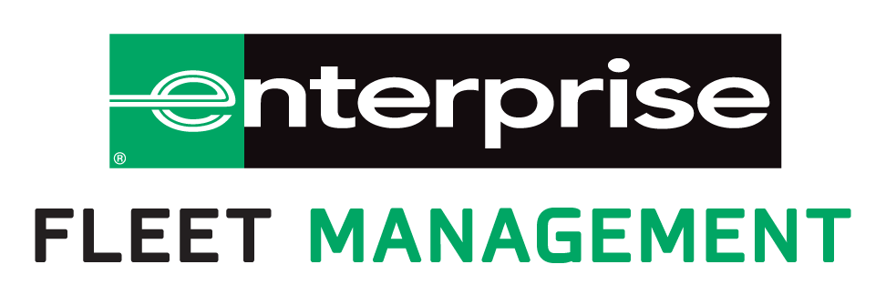
FLEXIBLE FINANCING OPTIONS
Open-End Lease Benefits
Separate line of credit for vehicles
Optimize cash flow with flexible funding options
Unlimited mileage, no mileage penalties
No abnormal wear & tear clauses
Greater flexibility if requirements change
Flexibility of term
City Retains Equity at End of Term
Notes:
Goal: Educate on open-ended leasing. This is not the same as the consumer lease you get from a dealership. We have flexible financing options that can be customized to meet our customers needs.
Relevant stuff includes: Term length, depreciation rate per month, the “index” (instrument) we are using, the “adder”, the management fee. NB: Donlen stipulates 20% cap reduction on 60 mo/10% cap reduction on 48 months/0% on 36 months in their offer page.
**Do we state the Service charge here or place at Remarketing section?

Slide 13

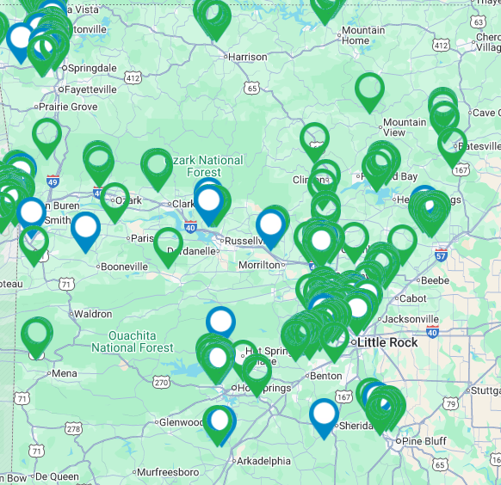
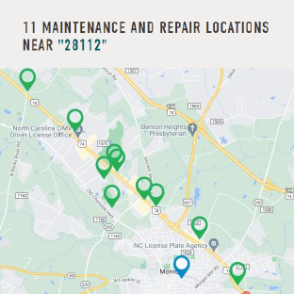
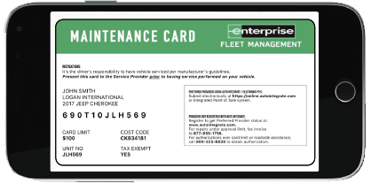
UNPARALLELED
MAINTENANCE OVERSIGHT
FULL
MAINTENANCE
Fixed & budgetable monthly rate
Simple process for all parties
24/7 Roadside Assistance
Relieves you from worrying about maintenance expenses
MAINTENANCE
MANAGEMENT
“Bridge” program for
current vehicles
Maintenance costs passed through to monthly invoice
Seamless experience
for field drivers

Slide 14
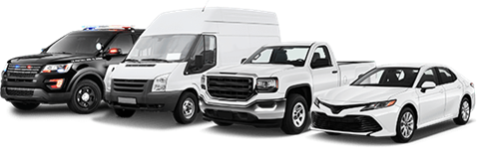
MAINTENANCE EXPERTS ON YOUR SIDE
National Service Department
234
ASE CERTIFIED TECHNICIANS
2.3M
REPAIR ORDERS
HANDLED IN
2025
$97M
TOTAL SAVINGS IN 2025
30
YEARS OF BLUE
SEAL CERTIFICATIONS
900K
UNITS MANAGED

Slide 15
DEDICATED AFTERMARKET EQUIPMENT TEAM
Consulting
EXPERTISE
Sourcing ame
PROACTIVELY
REDUCED DELIVERY TIME BY
OVER 30%
VS. HANDLING ON YOUR OWN
CLIENT’S NEED
Safety
Logistics
COMPLIANCE
Speed
Cost
Purchase order management
Status tracking
Notes:
The AME Department has a wealth of knowledge, industry resources, and vendor partnerships to ensure that you receive the expertise needed. At the heart of everything we do will be compliance, safety, and what is most important to your specific needs.
Services offered are:
Consulting - We are happy to connect with you about solutions for your AME needs for one vehicle or your entire fleet. If it makes sense for a vendor to join in the discussion, we are able to invite them as well. This is a great way to make sure that your plan for AME is tailored to your needs.
Sourcing – Let us do the work of obtaining quotes for you. We will source quotes from our vendor network which includes many preferred regional and national partners, and will take into account what is important to you – cost or time. We’re happy to provide competitive quotes to ensure your fleet’s needs are being met.
Logistics – The AME Team will ensure the logistics to get the vehicle from the OEM through the upfit process and ultimately in your hands is timely, efficient, and cost effective. Through an effective strategy around usage of ship thru, drop ship, or local delivery, there are often savings in time and money that can be achieved by reducing touches. With transportation costs being high, this is an important area to consider.
Purchase Order Management – The AME Team will issue the PO to the vendor and confirm it’s received timely so that they can plan their procurement and scheduling of the aftermarket equipment. All payments, including any down payments for the AME will be handled through EFM and this process by us handling the issuing of the PO.
Status Tracking – We receive regular status updates from major partners, and have teams that follow up to ensure vehicles are moving through the upfit process at an appropriate pace. This ensures you have the windows into when you can plan on the vehicles arrival.

Slide 16
REMARKETING:
BY THE NUMBERS
Resale channels
Direct Sales
Auction
Percentage of Sales
Total % over Black Book (CVI)
150
REMARKETING LOTS
IN NORTH AMERICA
150K+
VEHICLES SOLD BY ENTERPRISE IN 2025
AT AN AVERAGE OF
110%
ABOVE BLACK BOOK (CVI)
12,000+
UNIQUE BUYERS
471
DEDICATED REMARKETING EMPLOYEES
Notes:
Recommended Use: FF/PZ
471 remarketing sales employees in North America
Infrastructure can support over 1 million sales per year (averaged 1.1+ million prior 3 years before COVID, 4,600+ direct sales per day) – EM sold 126K+ units for EFM in 2024
Currently sell to 7,500+ dealers per month
Average tenure of remarketing sales team = 15.8 years
Average tenure of sales managers = 21.3 years
Over 150 remarketing lots
Over 165 car sale dealerships

Slide 17
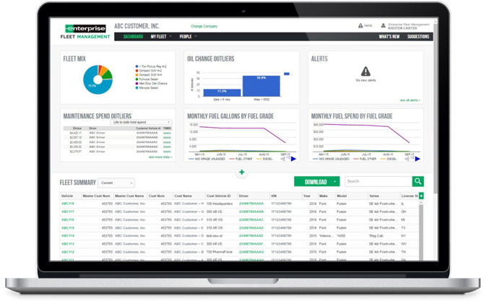
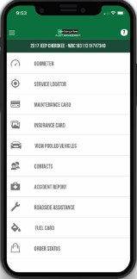
EMPOWERING CLIENTS THROUGH ACTIONABLE DATA
Fleet Management Platform and Mobile App
COMPREHENSIVE FLEET LIST
ORDER STATUS UPDATES
MAINTENANCE INSIGHTS
OPERATOR INSIGHTS
FUEL SPEND
Notes:
What type of technological tools are you using to manage your fleet today?
How’re those tools working for you?
What if I told you that EFM’s desktop and app reporting tool could enable you to quickly obtain?:
Comprehensive Fleet List
Operator insights
Maintenance insights
Order status updates
Fuel Spend
App Benefits:
Expansive Vehicle Inventory
Your local, dedicated Client Strategy Manager will use the Fleet Planning Toolkit with detailed specifications, like Gross Vehicle Weight (GVW), fuel efficiency, and future maintenance to help right-size vehicles to your business needs. With our Vehicle Selector tool, they’ll help you access our large vehicle inventory to view all makes and models in detail and identify the best fit for your business. Vehicle Selector makes it easy to understand all the options and alternatives so that you’re well-equipped to make smart, cost-effective fleet vehicle decisions for your fleet.
Customizable Dashboards
Your Enterprise Fleet Management portal is 100% customized to your fleet. Accessible 24 hours a day, 7 days a week, the Client Website pulls from a robust database of information, enabling you to check maintenance schedules and statuses, billing information, fuel data, driver information, and more. Customize it any way you like to ensure you see the information you want as soon as you log in.
Real-Time Data and Alerts
Our real-time logistical data pinpoint areas that can be improved upon, helping you optimize fleet productivity and efficiency. The system can even deliver alerts to mobile devices like smartphones and tablets, so you and your drivers never miss a beat, even when you’re on the go.
Self Service
With Enterprise’s Client Website, you can easily self-manage and update your fleet information as needed. Update driver information and add vehicle descriptors, mileage information, and more. You can also assign unlimited unique identifiers to each vehicle to simplify routine tasks and consolidate all vehicle documents and claims online.
Mobile App for Drivers
Keep drivers connected. Our eFleets Mobile App integrates with Enterprise’s existing platforms to ensure drivers have what they need whether they’re in the office or on the road. Once the driver downloads and logs into the app, key information and important notifications will be easily accessible 24/7. Your drivers are never more than a tap or two away from their maintenance card, insurance cards, roadside assistance, fuel and maintenance locators, and accident reporting tools.
Total Cost Analysis
Using cutting-edge technology and analytics, we pinpoint the best opportunities to optimize your fleet – with accurate, real-time [1] data. Enterprise’s technology will integrate all expenses for a total cost analysis. Your Client Strategy Manager will use this data to consider all of your monthly costs, replacement schedules, maintenance, taxes, fuel, and other financial factors, so you can have a clear picture of all potential expenses moving forward.
Telematics Benefits:
Real-Time Fleet Data
With just a small, plug-and-play, cellular telematics device, you can drastically improve your fleet’s efficiency. Gain access to a wealth of real-time, vehicle-specific data through your online portal, including GPS location, speed, fuel usage and engine performance, and capture insights that will help you and your Client Strategy Manager optimize fleet performance and savings.
Improve Compliance and Reputation
By tracking and making sure the fleet is running efficiently and safely
with courteous drivers, Telematics can improve your company’s bottom line and protect your company’s good reputation. Monitor unplanned stops, as well as driving time vs. customer service time. Reduce paperwork and track hours of service, driver vehicle inspection reports, international fuel tax agreement compliance and driver e-logs.
Better, More Informed Decisions
The online telematics portal, available through Geotab, gives you and your Client Strategy Manager a bird’s eye view of your entire fleet. Access vehicle insights 24/7 to make more informed decisions about fuel management, route optimization and proactive maintenance. And, in case of an emergency, operators can locate company vehicles. Now that’s peace of mind.
TRIAL CLOSE:
Based on our conversation today, would you be open to continuing our conversation and allow us the opportunity to run this analysis for your business?
Great! I will come back to present my recommendations on how Enterprise can add value to your operation. The analysis will be customized to your fleet with the goal of providing you specific insights on the lowest cost to operate your fleet, along with what it looks like to partner with Enterprise.
Any other questions or areas you would like to discuss that we didn’t get a chance to review?
What does your schedule look like next week?
Great, is there anyone else we should include in that meeting? Perfect, I will send out a calendar reminder shortly.
Thank you for your time today, looking forward to seeing you next week!

Slide 18

WHY PARTNER WITH ENTERPRISE
FINANCIAL
STRETCH
YOUR BUDGET
More new vehicles
with less funds
EVEN OUT
CAPITAL AND OPERATING BUDGETS
FORECAST EXPECTED BUDGET IMPACTS
years into the future
OPERATIONAL
REDUCE DOWNTIME
INCREASE
FLEET SUPPORT
for local team
VEHICLE INFORMATION
housed in EFM’s
data warehouse
ADMINISTRATIVE
PROVIDE EXPERT OVERSIGHT
and industry updates
TOTAL COST
OF OWNERSHIP ANALYSIS
to assist administrative team with decision making
WE COMPARE
EACH VEHICLE
on a cost per mile basis

Slide 19
Schedule Fleet Consultation Meeting
Customized Proposal
Council and budget approval
Implement partnership
Next
Steps

Slide 20
Fleet Profile

Slide 21








Total fleet size: Total fleet value:
Fleet Profile
102
$1,393,975
Manufacturer breakdown
Model year analysis
10 years
and older
Avg holding
Period (in years)
Avg age
10 years
42.5
Avg annual
acquisitions
Manufacturers
in fleet:
2.4
7
Odometer distribution
Average Odometer: 53,662
52%
35%
12%
1%
53 vehicles
36 vehicles
12 vehicles
1 vehicles
Notes:
FPT - Presentation Tool Quick Reference can be located at: Salesforce > Files > Libraries > Sales Support Tools
- Total Fleet Size: Total size of the fleet.
- Total Fleet Value: The sum of the Market Values for the total fleet.
- Manufacturer Breakdown: Vehicles with 1% or less representation will not show a % on the donut chart.
- Average holding period (in years): Total fleet size divided by the average annual acquisitions.
- Average annual acquisitions: Average of the vehicles purchased in the past 5 years.
- Average holding and acquisitions may represent N/A in the event that no vehicles were acquired in the last 5 years.
- Average Age: The sum of the ages of vehicles in the fleet divided by the fleet size. The age of each vehicle is calculated based on Model Year:
- Subtract 1/1 of the Model Year from current date - if less than 1, round up to 1 year

Slide 22
Total fleet size:
Estimated Annual Expense
102
Total Depreciation
$323,000
Holding period (years) | 12
Total cost fleet new | $4,488,000
Total estimated value at holding period | $612,000
$566,482
Cents
per mile
Total Maintenance
$118,728
Estimated monthly | $97
$1.05
Total Fuel
$124,754
Avg MPG | 13
Fuel cost per gallon | $3.00
Miles driven | 540,600
Private and confidential
information. Data is based on client provided,
estimated valuations.
Assumes average new vehicle price is $44,000 and average resale at 12 years is $6,000.
Notes:
- The Annual Cost Calculator is used to populate this slide. If you did not opt to use the Calculator, this slide will not generate.
- This slide is driven by the data you enter in the Annual Cost Calculator.
- Best practice: leverage this as a conversation in the Fact Find with your client or prospect to gain buy in to the values.
- When using the calculator, the values will populate on the screen as you enter them in the Fleet Planning Toolkit.

