Slide 1

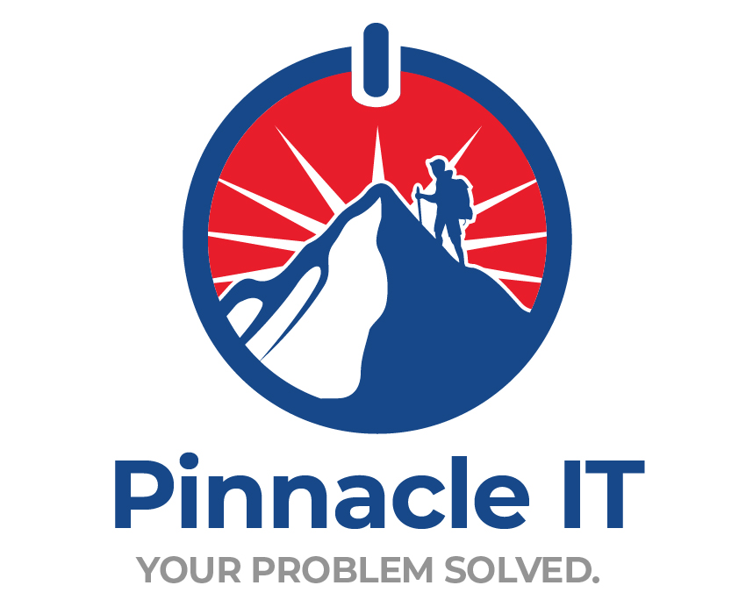
ARKANSAS GFOA ANNUAL CONFERENCE
Cybersecurity, Fraud & Financial Risk
What municipal finance teams need to know about protecting public funds.
Teri Westbrook
Director of Technology & Cybersecurity, Pinnacle IT
July 2026
Notes:
Introduce yourself and Pinnacle IT. Frame the session: this is not an IT talk, it is a finance talk. Every control we discuss protects a payment, a budget cycle, or an audit finding.

Slide 2
AGENDA
What we'll cover
01
02
How the money leaves
When operations stop
Business email compromise, wire and ACH fraud, vendor payment diversion.
Ransomware, downtime cost, and what recovery actually looks like.
12 minutes
10 minutes
03
04
Governance, risk & compliance
What to do Monday
Arkansas statutory requirements, audit questions, third-party risk.
Controls, budget framing, and a ninety-day sequence.
12 minutes
8 minutes
Notes:
Set expectations. Four parts, forty-five minutes, questions welcome throughout but a formal Q and A at the end.

Slide 3
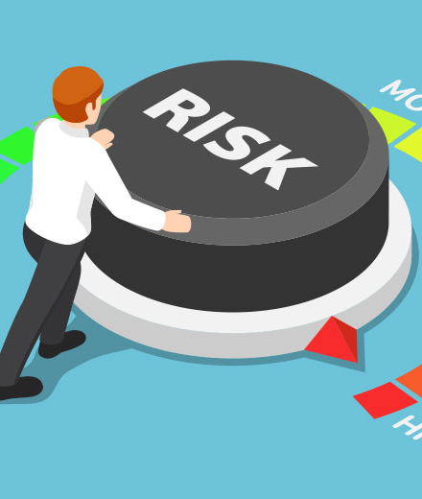
SHOW OF HANDS
Quick audience poll
01
Who reuses the same password in more than one place?
02
Who has clicked something and immediately regretted it?
03
Who has approved a payment change based only on an email?
04
Whose city has a written, tested incident response plan?
Notes:
Ask for a show of hands on each. Do not rush. The last question usually gets the fewest hands and sets up Part Three.

Slide 4
THE SCALE OF IT
Cybercrime is a treasury problem
$20.9B
$3.05B
$797.9M
Reported to the FBI in 2025, up 26% in a single year.
Lost to business email compromise alone.
Lost to criminals impersonating government offices.
Roughly 85 cents of every dollar lost came from cyber-enabled fraud — not malware. Someone received something convincing and acted on it.
Source: FBI Internet Crime Complaint Center, 2025 Internet Crime Report.
Notes:
The headline point: this is a fraud problem wearing a technology costume. Eighty-five cents of every dollar lost came from someone acting on something convincing.

Slide 5
ASSUMPTIONS WORTH RETIRING
Four myths that cost cities money
WHAT WE HEAR
WHAT IS TRUE
“We're too small to be a target.”
Small governments are targeted because staffing and controls are thin.
“The bank will make us whole.”
Public operating accounts don't carry consumer protections. Recovery depends on how fast you call.
“That's IT's job.”
Most of the controls that stop payment fraud sit in finance, not in IT.
“We're covered by insurance.”
Coverage is capped, secondary, and conditional on controls you have to prove you had.
Notes:
Work down the rows. The insurance row is the one this audience reacts to — it previews the Arkansas coverage cap later.

Slide 6
ENTRY POINTS
Where attacks on local government start
Almost none begin with someone defeating your firewall. They begin with a login.
Stolen credentials
A phishing email
A trusted third party
Unpatched remote access
Reused passwords surface in breach dumps and get tried against your email.
One convincing message to one clerk on one busy afternoon.
The engineer, the vendor, the software provider — compromised first, then used.
A forgotten VPN appliance or an open remote desktop port.
Notes:
Nobody breaks the firewall. They log in. Make the point that four doors cover almost everything, and all four are manageable.

Slide 7
PART ONE
How the money leaves
Business email compromise, wire fraud, and vendor payment diversion.
Notes:
Transition. We are now talking about money leaving the account.

Slide 8
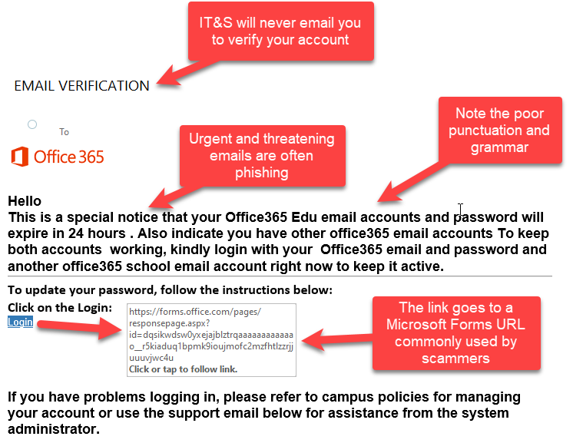
THE THREE-WORD TEST
What phishing actually looks like
Known
Do I actually know this sender, at this address?
Needed
Is this request something my role would normally receive?
Expected
Was I already waiting for it, through a channel I trust?
If any one of the three fails, verify by phone before you act.
Notes:
Walk the annotated example. Then give them the three-word test: Known, Needed, Expected. If any one fails, stop.

Slide 9
THE PATTERN
Anatomy of a vendor payment diversion
Attackers rarely rush. They wait for a real invoice.
STEP 1
STEP 2
STEP 3
STEP 4
STEP 5
Access
Observation
Insertion
Payment
Discovery
A vendor's or employee's mailbox is compromised through a stolen password.
They read quietly for weeks — learning names, projects, amounts, and tone.
Updated remittance details arrive attached to a legitimate, expected invoice.
Finance pays the invoice it was already expecting to pay.
Thirty days later the real vendor asks where the money went.
Notes:
This is the pattern behind most municipal payment loss. Emphasize step two — the quiet period — because that is what makes the final email so convincing.

Slide 10
ILLUSTRATIVE COMPOSITE
Scenario: the changed bank account
$412,000
A city of 18,000 is midway through a street resurfacing contract. The engineering firm's project manager emails the usual monthly draw request.
Single payment diverted
31 days
Attached to the real invoice is a signed letter on the firm's letterhead: the firm has changed banks, please update remittance details.
Before the real vendor followed up
1 call
Accounts payable updates the vendor master and releases the payment. Nobody calls, because nothing about the email looked unusual — it came from the project manager's real address.
To a known number would have stopped it
Notes:
Illustrative composite, not a specific client. Ask the room where they would have caught it. Most will say the callback — which is the point.

Slide 11
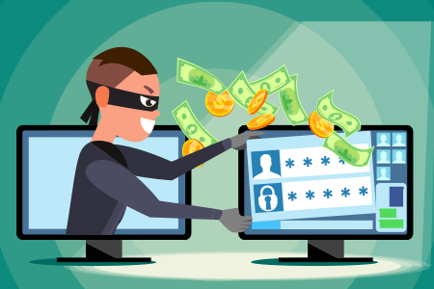
THE QUIETER VERSION
Payroll and ACH diversion
An employee emails HR asking to update direct deposit before the next cycle.
The request is real in form and fake in origin — the mailbox was taken over.
One paycheck disappears, and the employee finds out on payday.
Self-service portals make the change silent unless alerts are turned on.
Treat a banking-detail change like a payment: verify out of band, every time.
Notes:
Smaller dollar amounts, higher frequency, and it hits employees directly — which makes it a personnel and reputation issue as well as a financial one.

Slide 12
CONTROLS
Verification controls that actually work
CONTROL
WHAT IT STOPS
COST
Callback verification
Any change to banking detail, using a number already on file — never one in the email.
None
Dual authorization
One person initiates, a second releases — above a threshold your board sets.
None
Vendor master change log
Silent edits. Every change is logged, dated, and reviewed monthly.
None
Positive pay & ACH filters
Unauthorized debits and altered checks, at the bank rather than at reconciliation.
Bank fee
MFA on email and banking
The mailbox takeover that makes all of the above possible in the first place.
Low
Notes:
This is the practical heart of Part One. Note that four of the five cost nothing but discipline.

Slide 13
PART TWO
When operations stop
Ransomware, downtime, and the real cost of recovery.
Notes:
Transition from money leaving to operations stopping.

Slide 14
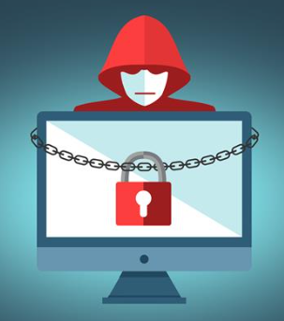
CONTINUITY
Ransomware in a municipal environment
Files are encrypted, and payment is demanded to release them. What matters to finance is what goes dark:
Utility billing
Payroll
Court records
Permitting
Accounts payable
Public safety records
With tested, offline backups this becomes an inconvenience. Without them, it becomes a budget event.
Notes:
Ransomware is a continuity problem before it is a payment problem. Ask which of these systems their city could run manually for a week.

Slide 15
SCENARIO
ILLUSTRATIVE COMPOSITE
Ransomware during budget season
A finance department of nine loses file access on a Monday in September. No ransom is paid. Recovery still takes eleven business days.
LINE ITEM
COST
Incident response & forensics
$85,000
Rebuild and restore
$60,000
Overtime and temporary staffing
$40,000
Legal, notification, and outside counsel
$35,000
Delayed utility billing revenue
$70,000
Total, before any ransom
$290,000
Notes:
Illustrative composite. The ransom is not the expensive part — the recovery and the overtime are. Pause on the total.

Slide 16
ARKANSAS ACT 846 OF 2023
The $100,000 question
ILLUSTRATIVE INCIDENT COST
Every Arkansas municipality participates in the Self-Funded Cyber Response Program. It is a real backstop — and it is a capped one.
$290,000
PROGRAM COVERAGE CEILING
Coverage is limited to actual losses, not to exceed $100,000.
$100K
It is secondary to any insurance you already carry.
Entities have twelve months to meet the Board's minimum cybersecurity standards.
The gap between those two bars is a general fund appropriation nobody planned for.
Falling short of those standards can reduce the coverage amount.
Source: Ark. Code Ann. § 21-2-801 et seq., Arkansas Self-Funded Cyber Response Program Act (Act 846 of 2023, as amended); program administered by the Arkansas Cyber Response Board through the Arkansas Insurance Department, Risk Management Division.
Notes:
Arkansas Act 846 of 2023. All municipalities participate. Coverage is capped, secondary to existing insurance, and conditioned on meeting the Board's minimum standards within twelve months. This is the slide that makes the budget case.

Slide 17
TWO NUMBERS TO KNOW
Backup and recovery in plain English
RTO
RPO
How long can we be down?
How much work can we redo?
Recovery time objective. Set it per system — utility billing is not payroll.
Recovery point objective. It is the amount of data you accept losing.
Keep at least one copy offline and immutable — ransomware encrypts what it can reach.
Keep one copy geographically separate from city hall.
Test a restore on a schedule. An untested backup is an assumption.
Notes:
RTO and RPO are the two numbers to bring to the board. Untested backups are the single most common failure we find.

Slide 18
PART THREE
Governance, risk & compliance
What Arkansas requires, what auditors ask, and who owns the answer.
Notes:
Transition into governance, risk and compliance — the part that shows up in audit.

Slide 19
COMPLIANCE
What Arkansas law now requires
AUTHORITY
REQUIREMENT
WHAT FINANCE SHOULD ASK
Act 504 (2023)
Public entities must adopt technology-use and cybersecurity policies aligned to State Cyber Security Office standards, and submit them for review on a recurring cycle.
Do we have an adopted policy, and when was it last submitted?
Act 846 (2023)
Self-Funded Cyber Response Program. All municipalities participate; coverage is capped and conditioned on minimum cybersecurity standards.
Can we document that we meet the minimum standards today?
Act 510 (2025)
Incident response plans and cyberattack details are treated as confidential rather than open records.
Who is authorized to speak during an incident?
Act 489 (2025)
Arkansas Cybersecurity Act — establishes a State Cybersecurity Office and statewide standards.
Whose standards are we measuring ourselves against?
Summary only — confirm current text and deadlines with your city attorney.
Notes:
Four statutes worth knowing by number. Act 504 is the one most cities are quietly out of compliance with. Confirm current filing deadlines with your city attorney.

Slide 20
DEFINITIONS
Governance, risk and compliance in plain English
Governance
Risk
Compliance
Who decides, who approves, and what is written down. Policies, thresholds, and delegated authority.
What could go wrong, how likely, how expensive — and which of those you accept on purpose.
Proving it. Evidence, dates, logs, and training records an auditor can actually read.
Owned by the council and the finance director.
Owned jointly with IT and your insurer.
Owned by whoever answers the audit letter.
If a control is not documented, it does not exist during an audit or a claim.
Notes:
Demystify the acronym. The ownership row is the important one: finance owns more of this than most cities assume.

Slide 21
SELF-ASSESSMENT
The controls auditors and underwriters ask about
Count the ones you could evidence this afternoon.
MFA on email, VPN, and banking
Endpoint detection on every device
Offline, immutable backups
A documented restore test
Written incident response plan
Security awareness training records
Least-privilege and offboarding
Patch and vulnerability reporting
Every one of these is a question on a cyber insurance application.
Notes:
Read these as a self-assessment. Ask people to count how many they can evidence today, not just how many they believe are in place.

Slide 22
VENDOR RISK
Third-party risk across every transaction
A single capital project can involve a dozen outside mailboxes. Any one of them can be the compromised sender.
THREE QUESTIONS AT RENEWAL
01
Do you require multi-factor authentication on the accounts that email us?
Bond counsel
Engineering firms
Depository banks
ERP and billing vendors
02
How will you notify us of a breach, and how quickly?
Title companies
Payment processors
Contractors
Grant administrators
03
Who at your firm can authorize a change to payment instructions?
Notes:
Municipal transactions touch a long list of outside parties. Your posture is partly theirs. Three questions belong in every contract renewal.

Slide 23
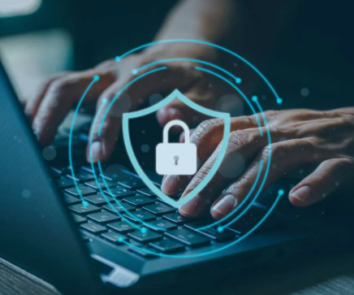
AWAY FROM THE DESK
Mobile workforce and remote access
Approving payments from a phone in a hotel lobby is now normal. The controls have to travel too.
Personal devices reaching city email without management or encryption.
Public Wi-Fi at hotels, airports, and conference centers.
Remote access left open for a vendor and never turned back off.
Devices that leave with an employee and are never wiped.
Notes:
Short slide. Conferences, travel, and hotel Wi-Fi are the everyday version of this risk — including this week.

Slide 24
PART FOUR
What to do Monday
Habits, controls, budget framing, and a ninety-day sequence.
Notes:
Shift to action. Everything from here is something they can start this week.

Slide 25
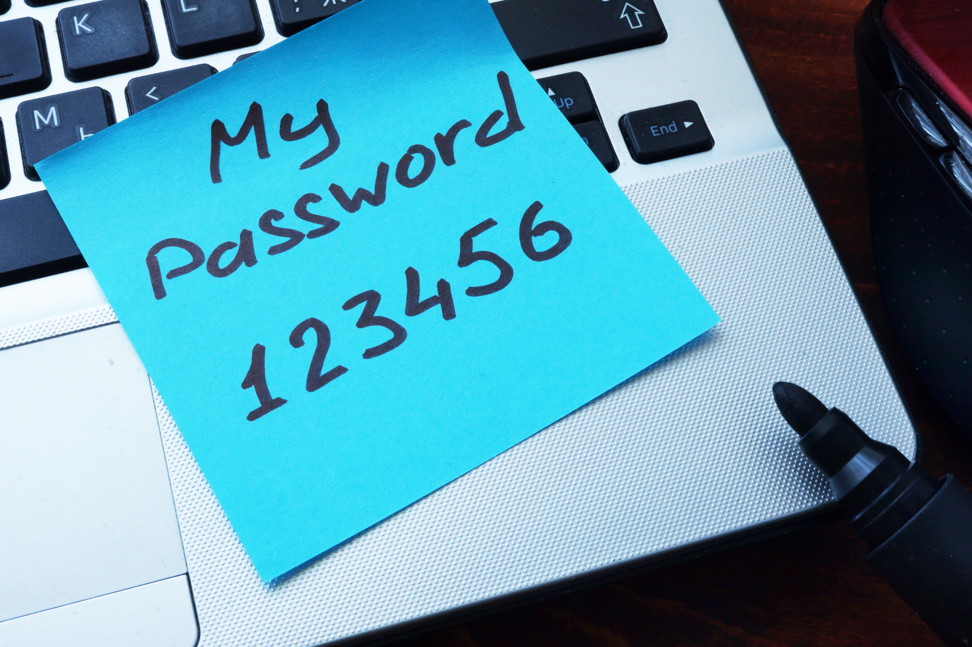
THE HUMAN LAYER
Passwords are still the front door
Attackers do not guess. They buy lists from other breaches and try them everywhere.
STILL IN CIRCULATION
Password123
CityName2026
Welcome1
Reuse is the real problem. One breach elsewhere becomes a login here.
Notes:
Light moment. The sticky note gets a laugh, then make the serious point about reuse and breach dumps.

Slide 26
THE UPGRADE
Passphrases and password managers
WEAK
What a password manager fixes
bulldozer
A unique password everywhere, without anyone memorizing them.
BETTER
Shared credentials handled without a spreadsheet or a sticky note.
Bulldozer2026!
Instant revocation when someone leaves the city's employment.
STRONG
MyD0gLovesCityHall!
An auditable record of who had access to what, and when.
Length beats complexity. Four unrelated words beat one clever substitution.
Notes:
Give them the upgrade path: passphrase plus manager. Length beats complexity, and a manager makes uniqueness realistic.

Slide 27
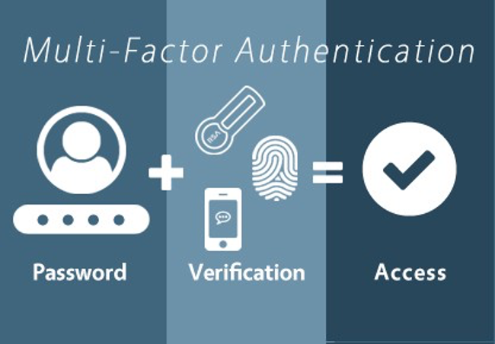
HIGHEST RETURN PER DOLLAR
Multi-factor authentication
A stolen password stops being useful. Require it in five places:
Email
Online banking and treasury portals
Remote access and VPN
The financial system and payroll
Every administrator account
Prefer an authenticator app over text-message codes.
Notes:
The single highest-return control. Name the five places it must be on, and note that text-message codes are the weakest form.

Slide 28
MAKING THE CASE
Budgeting for cybersecurity
Councils approve predictable line items far more easily than emergency appropriations.
PLANNED
UNPLANNED
A flat monthly managed security and support rate. One number, budgeted in advance, adjusted at renewal.
Emergency forensics and legal counsel at incident-rate pricing, mid-fiscal-year.
Plus overtime, delayed revenue, and a public conversation you do not control.
Produces the evidence auditors and underwriters ask for as a by-product.
Security spending is not an IT expense. It is the cost of keeping a payment control enforceable.
Notes:
Reframe security from a cost center to a predictable line item. The comparison is the argument to take to the council.

Slide 29
HOW WE WORK
The Pinnacle IT process
01
02
03
Assess & audit
Stabilize & harden
Monitor & optimize
Discovery across your infrastructure to surface security gaps and chronic pain points, with prioritized findings.
Deploy the security stack, document the network, and resolve the issues holding your staff back.
Daily support, cost optimization, and 24/7 threat hunting — with reporting in plain English.
Notes:
Brief overview of how an engagement starts. Keep it short — the offer is the assessment, not the contract.

Slide 30
ALL-INCLUSIVE
ONE FLAT MONTHLY RATE
What a managed program includes
Cybersecurity
Backup & continuity
Proactive management
Managed EDR, ITDR, and SIEM; incident response; role-based awareness training and simulated phishing; internal policy creation.
Encrypted backups, immutable offsite copies, documented failover tests against your RTO and RPO targets.
24×7 monitoring, third-party patching, monthly maintenance reporting in plain English.
Cloud & Microsoft 365
Network infrastructure
Daily ops & support
Conditional access, MFA, least-privilege enforcement, SaaS backup, and license optimization.
Firewalls, VLAN segmentation, VPN, bandwidth monitoring, and hardware lifecycle planning.
U.S.-based help desk, after-hours emergency response, on-site services, same-day onboarding and offboarding.
Notes:
One flat monthly rate. Do not read every bullet — point out the two or three that matter most to this room: cybersecurity, backup, and policy creation.

Slide 31
A SEQUENCE, NOT A PROJECT
The first ninety days
Days 1–30
Days 31–60
Days 61–90
Write the callback rule for banking changes and put it in policy.
Review your Act 504 policy and its submission date.
Run a tabletop exercise: ransomware on the Monday of budget week.
Set dual-authorization thresholds with the council.
Confirm MFA is on for email and banking, for everyone.
Document the controls the Cyber Response Board expects.
Send the three vendor questions with your next renewals.
Find out when your last backup restore was actually tested.
Put the funded gap in next year's budget request.
Notes:
Give them a sequence they can start without a procurement cycle. Everything in the first thirty days is free.

Slide 32
IF YOU REMEMBER NOTHING ELSE
Final takeaways
01
Verify payment changes by voice, every time.
Using a number you already had. It costs nothing and stops the most expensive attack.
02
Test a restore before you need one.
Backups turn ransomware into a bad week instead of a budget crisis.
03
Document the controls you already have.
Compliance, coverage, and audit findings all depend on evidence, not intent.
Notes:
Three things. If they remember nothing else, these are the three.

Slide 33
Questions
877-938-9450
Teri Westbrook
sales@pinnacleit.com
Director of Technology & Cybersecurity, Pinnacle IT
www.PinnacleIT.com
Notes:
Open the floor. Offer the no-cost assessment and hand out cards.

